Slide 1
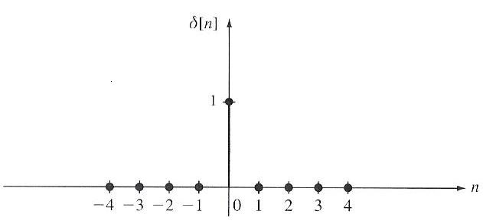
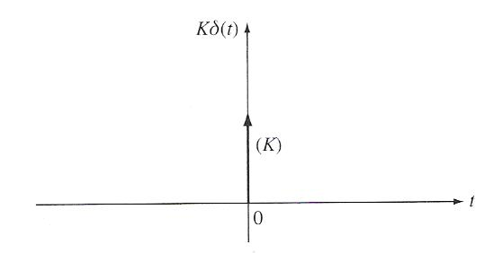
Exploiting Superposition and Time-Invariance
DT LTI
System
Are there sets of “basic” signals, x_{k}[n], such that:
We can represent any signal as a linear combination (e.g, weighted sum) of these building blocks? (Hint: Recall Fourier Series.)
The response of an LTI system to these basic signals is easy to compute and provides significant insight.
For LTI Systems (CT or DT) there are two natural choices for these building blocks:
Later we will learn that there are many families of such functions: sinusoids, exponentials, and even data-dependent functions. The latter are extremely useful in compression and pattern recognition applications.
DT Systems:
(unit pulse)
CT Systems:
(impulse)
EE 411

Slide 2
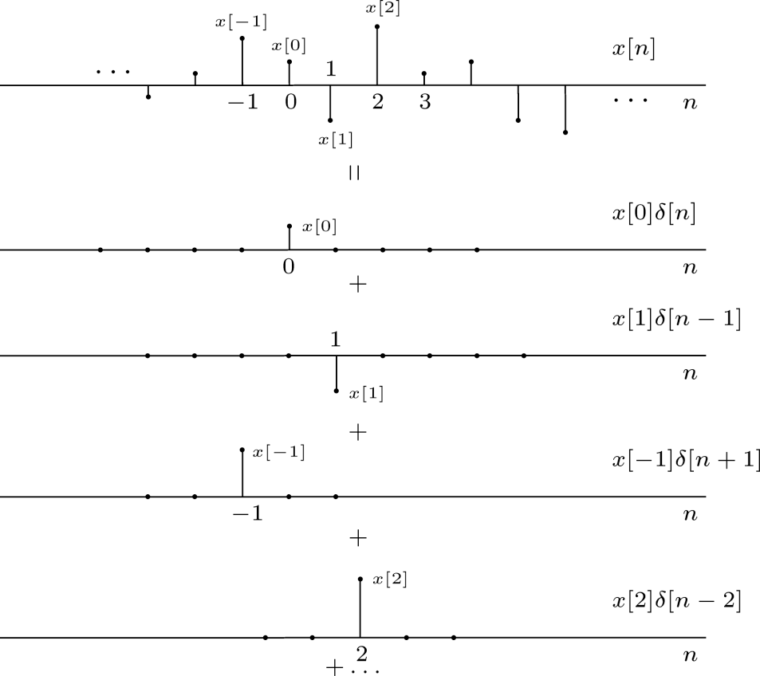
Representation of DT Signals Using Unit Pulses
EE 411

Slide 3
Response of a DT LTI Systems – Convolution
DT LTI
Define the unit pulse response, h[n], as the response of a DT LTI system to a unit pulse function, δ[n].
Using the principle of time-invariance:
Using the principle of linearity:
Comments:
Recall that linearity implies the weighted sum of input signals will produce a similar weighted sum of output signals.
Each unit pulse function, δ[n-k], produces a corresponding time-delayed version of the system impulse response function (h[n-k]).
The summation is referred to as the convolution sum.
The symbol “*” is used to denote the convolution operation.
convolution operator
convolution sum

Slide 4
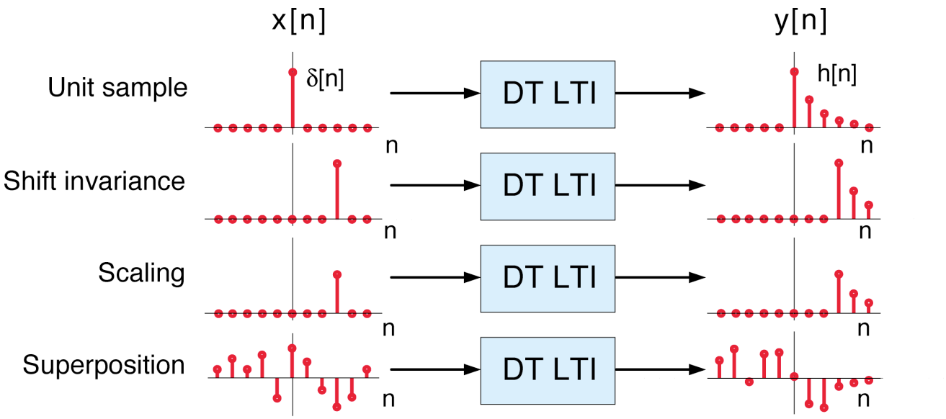
LTI Systems and Impulse Response
The output of any DT LTI is a convolution of the input signal with the unit pulse response:
Any DT LTI system is completely characterized by its unit pulse response.
Convolution has a simple graphical interpretation:
DT LTI
EE 411

Slide 5
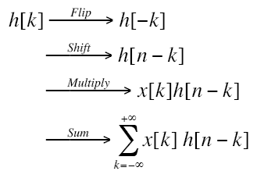
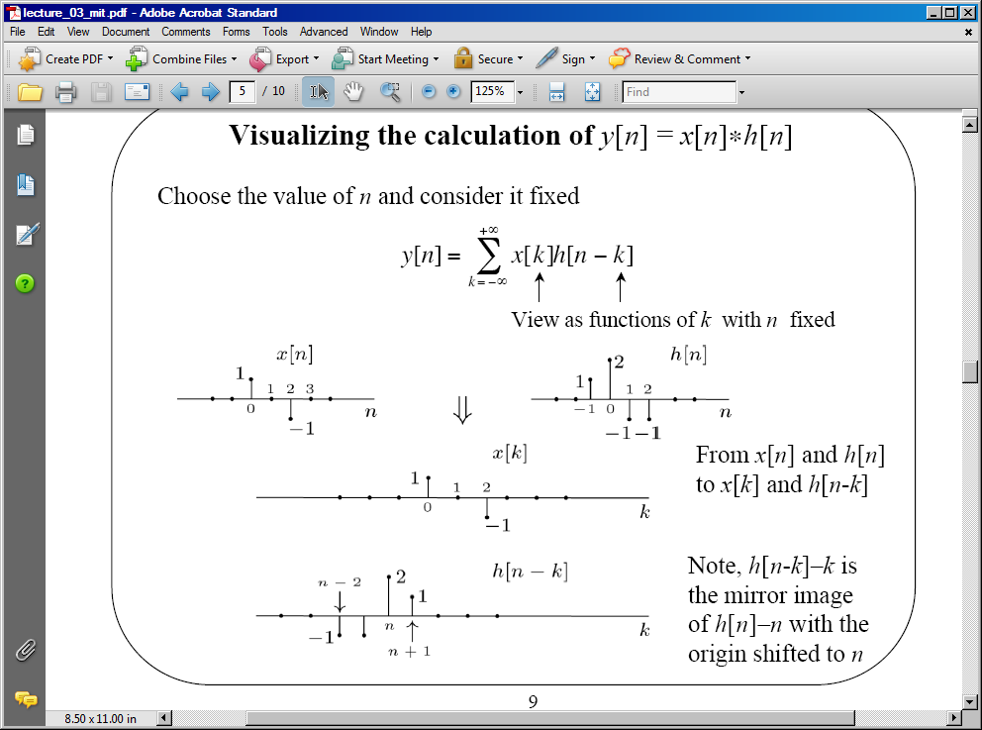
Visualizing Convolution
There are four basic steps to the calculation:
The operation has a simple graphical interpretation:
EE 411

Slide 6
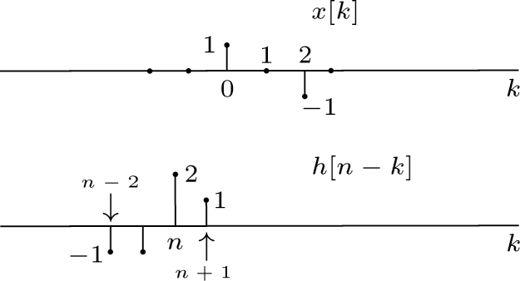
Calculating Successive Values
We can calculate each output point by shifting the unit pulse response one sample at a time:
y[n] = 0 for n < ???
y[-1] =
y[0] =
y[1] =
…
y[n] = 0 for n > ???
Can we generalize this result?
EE 411

Slide 7
Graphical Convolution
2
1
-1
-1
1
-1
k = -6 -5 -4 -3 -2 -1 0 1 2 3 4 5 6 7 8 9
EE 411

Slide 8
Graphical Convolution (Cont.)
2
1
-1
-1
1
-1
k = -6 -5 -4 -3 -2 -1 0 1 2 3 4 5 6 7 8 9
EE 411

Slide 9
Graphical Convolution (Cont.)
Observations:
y[n] = 0 for n > 4
If we define the duration of h[n] as the difference in time from the first nonzero sample to the last nonzero sample, the duration of h[n], L_{h}, is
4 samples.
Similarly, L_{x} = 3.
The duration of y[n] is: L_{y} = L_{x} + L_{h} – 1. This is a good sanity check.
The fact that the output has a duration longer than the input indicates that convolution often acts like a low pass filter and smoothes the signal.
EE 411

Slide 10
Examples of DT Convolution
Example: unit-pulse
Example: delayed unit-pulse
Example: unit step
Example: integration
EE 411

Slide 11
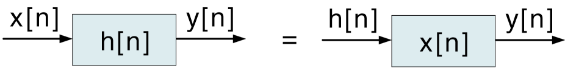
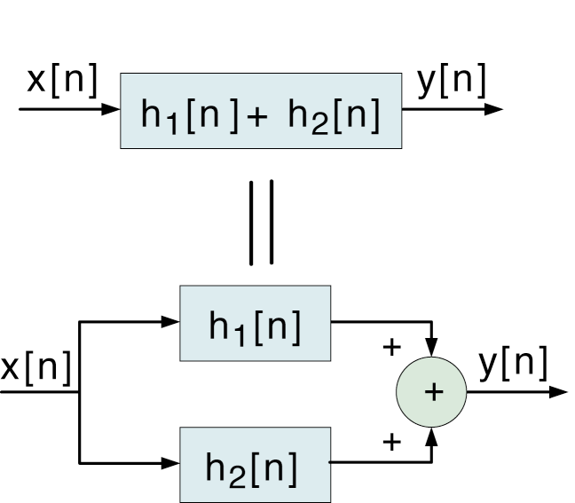
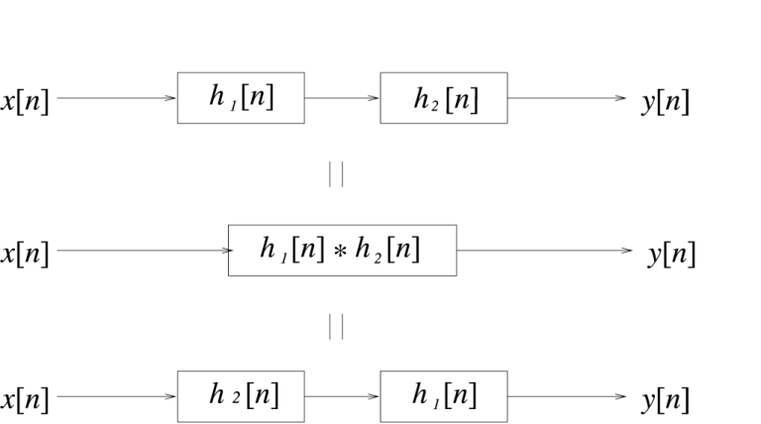
Properties of Convolution
Commutative:
Implications
Distributive:
Associative:
EE 411

Slide 12
Useful Properties of (DT) LTI Systems
Causality:
Stability:
Bounded Input ↔ Bounded Output
Sufficient Condition:
Necessary Condition:
EE 411

Slide 13
Summary
We introduced a method for computing the output of a discrete-time (DT) linear time-invariant (LTI) system known as convolution.
We demonstrated how this operation can be performed analytically and graphically.
We discussed three important properties: commutative, associative and distributive.
Question: can we determine key properties of a system, such as causality and stability, by examining the system impulse response?
There are several interactive tools available that demonstrate graphical convolution: ISIP: Convolution Java Applet.
EE 411

