Slide 1
EE 350 / ECE 490 Analog Communication Systems
Ch. 11 – Network Communications Telephone Systems

Slide 2
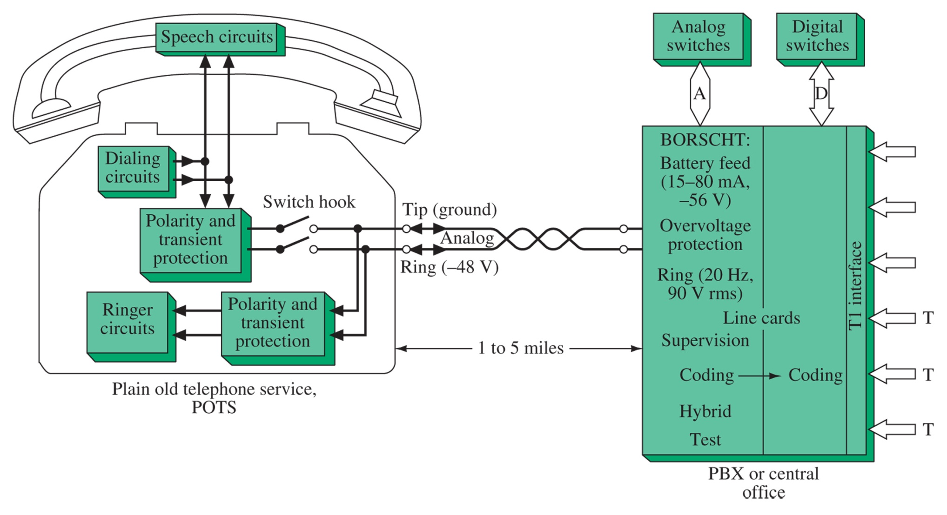
Figure 11-1 Telephone representation.

Slide 3
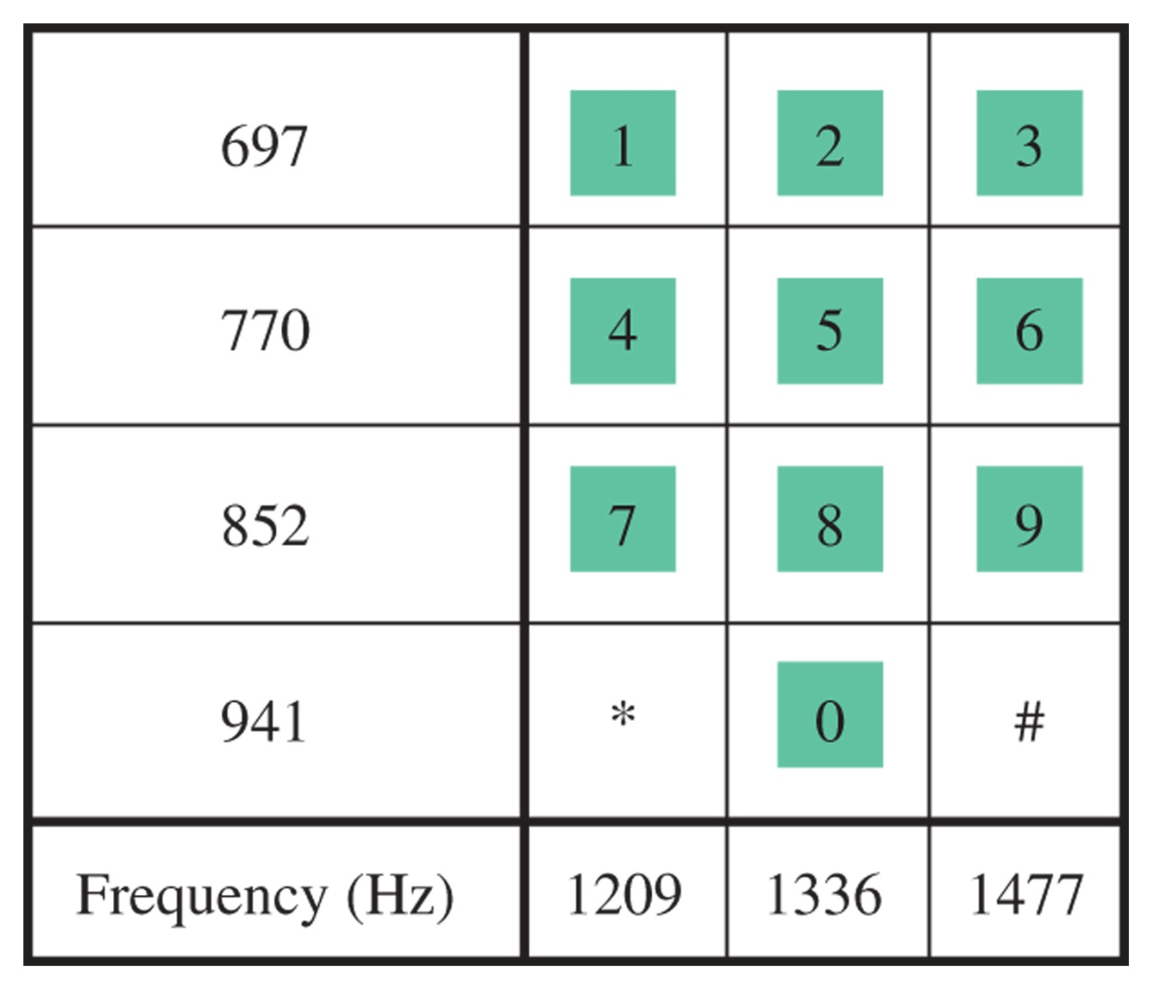
Figure 11-2 Touch-tone dialing.

Slide 4
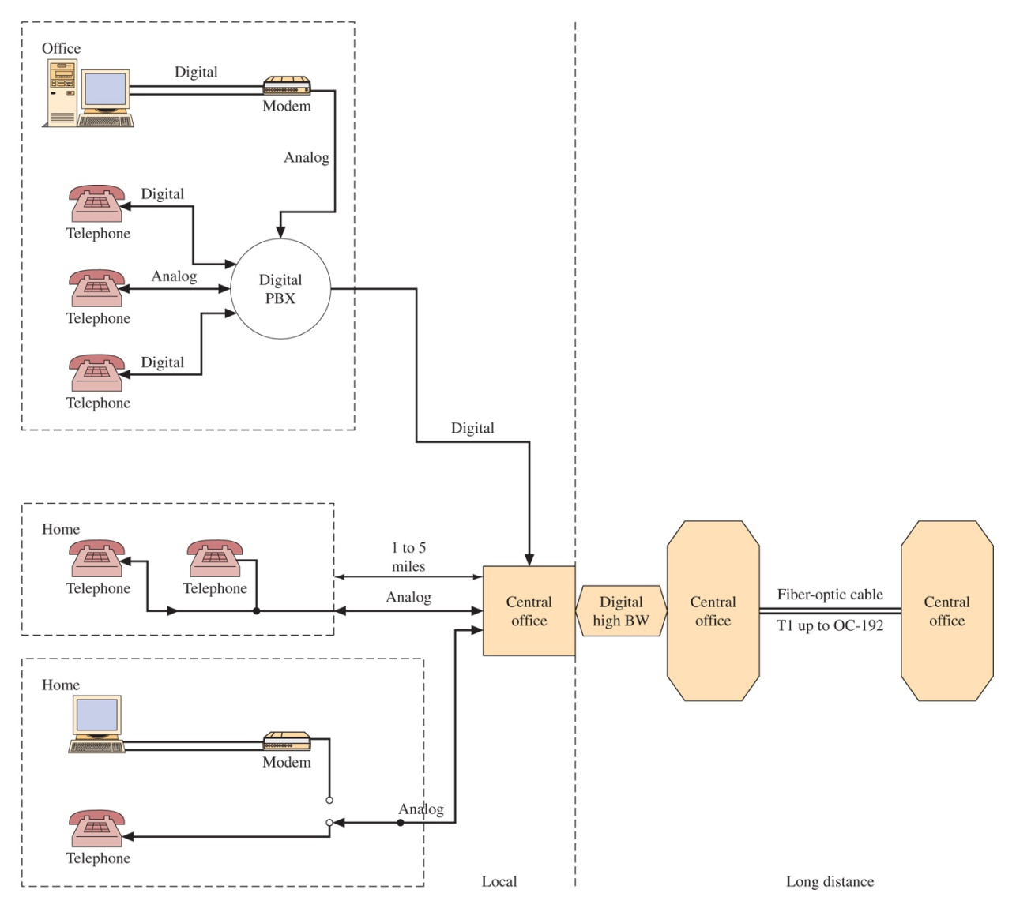
Figure 11-3 Telephone system block diagram.

Slide 5
Figure 11-4 Two- to four-wire conversion.

Slide 6
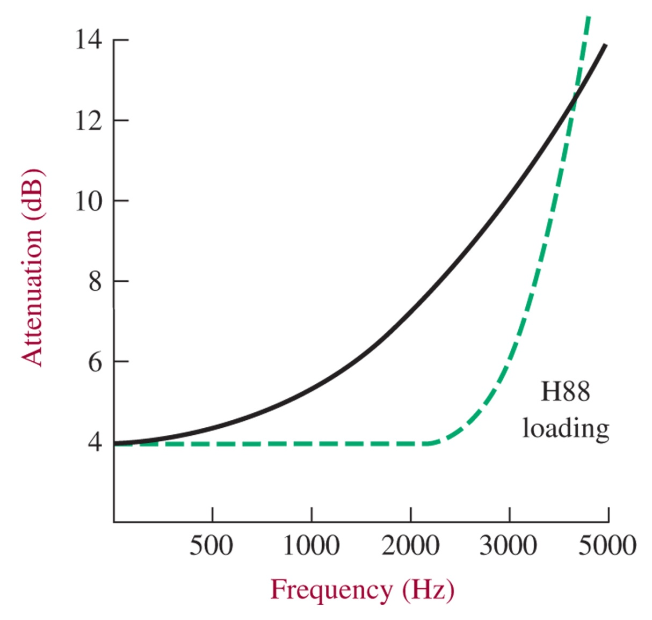
Figure 11-5 Attenuation for 12,000 ft of 26-gauge wire.

Slide 7
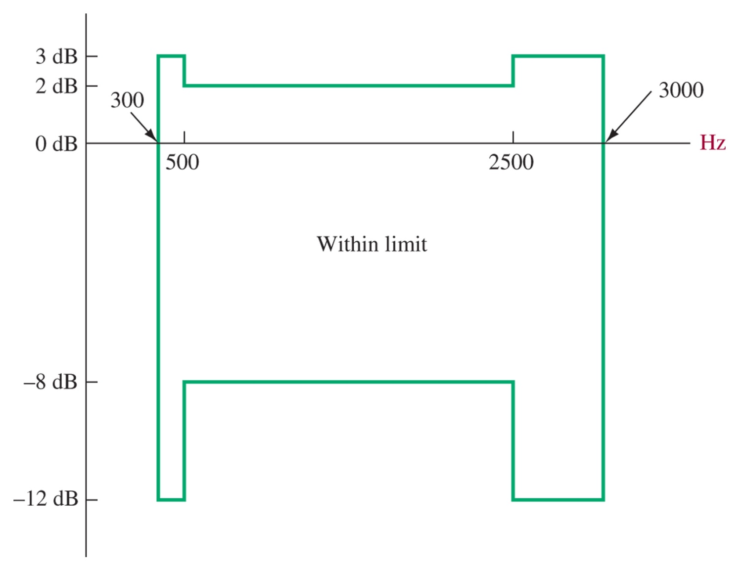
Figure 11-6 Attenuation distortion limit for 3002 channel.

Slide 8
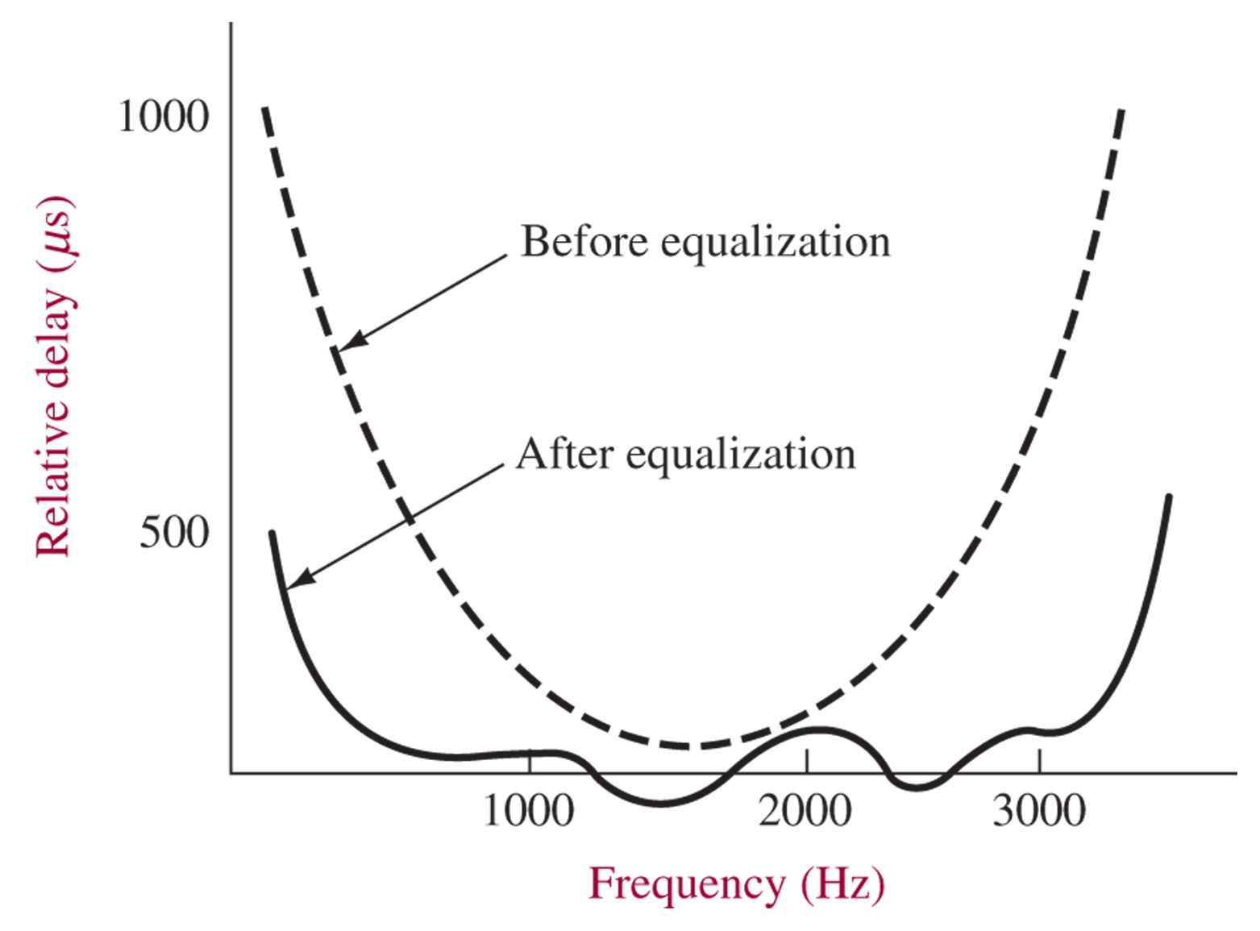
Figure 11-7 Delay equalization.

Slide 9
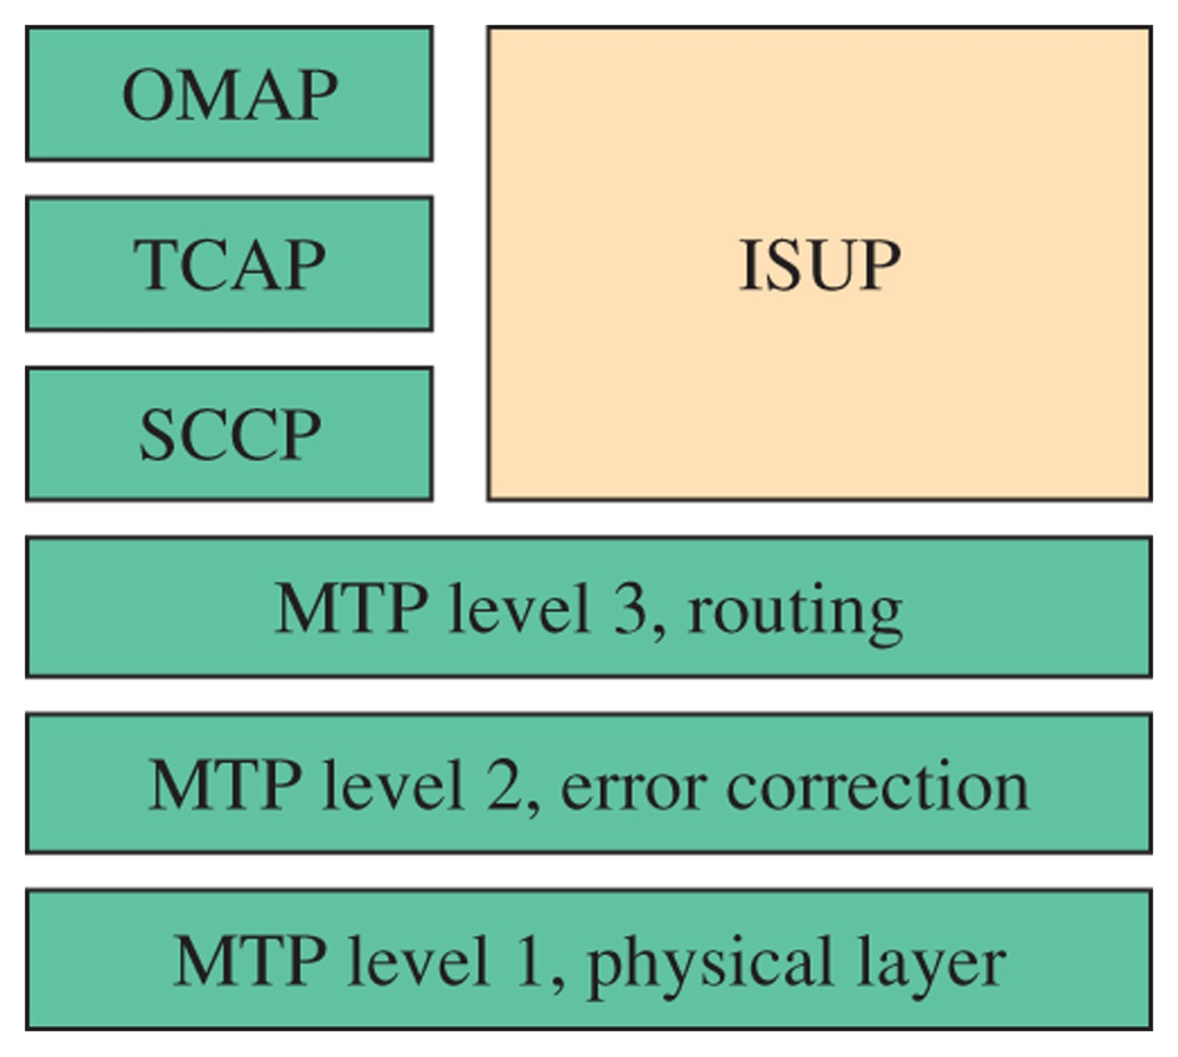
Figure 11-8 SS7 levels.

Slide 10
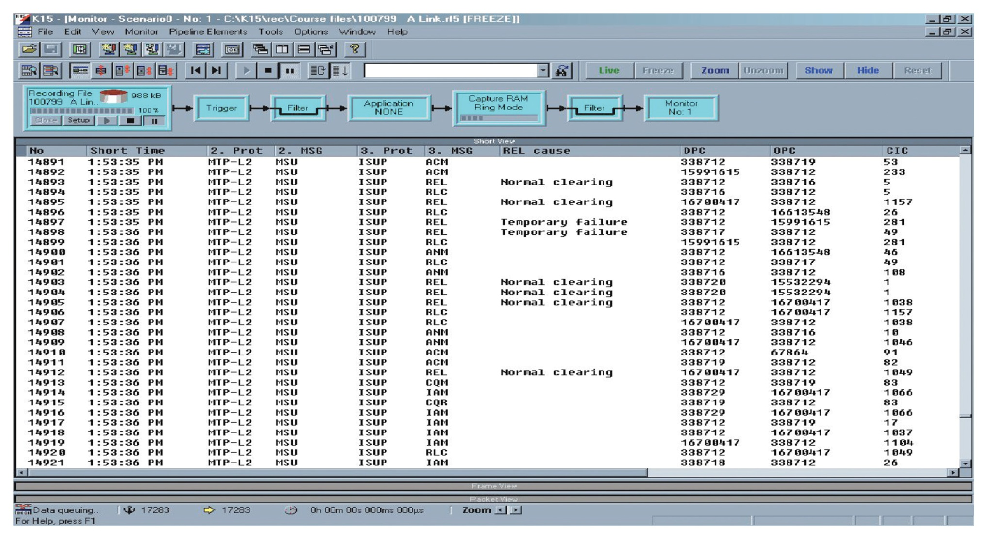
Figure 11-9 An example of captured telephone signaling messages as displayed using a Tektronix K15 protocol analyzer.

Slide 11
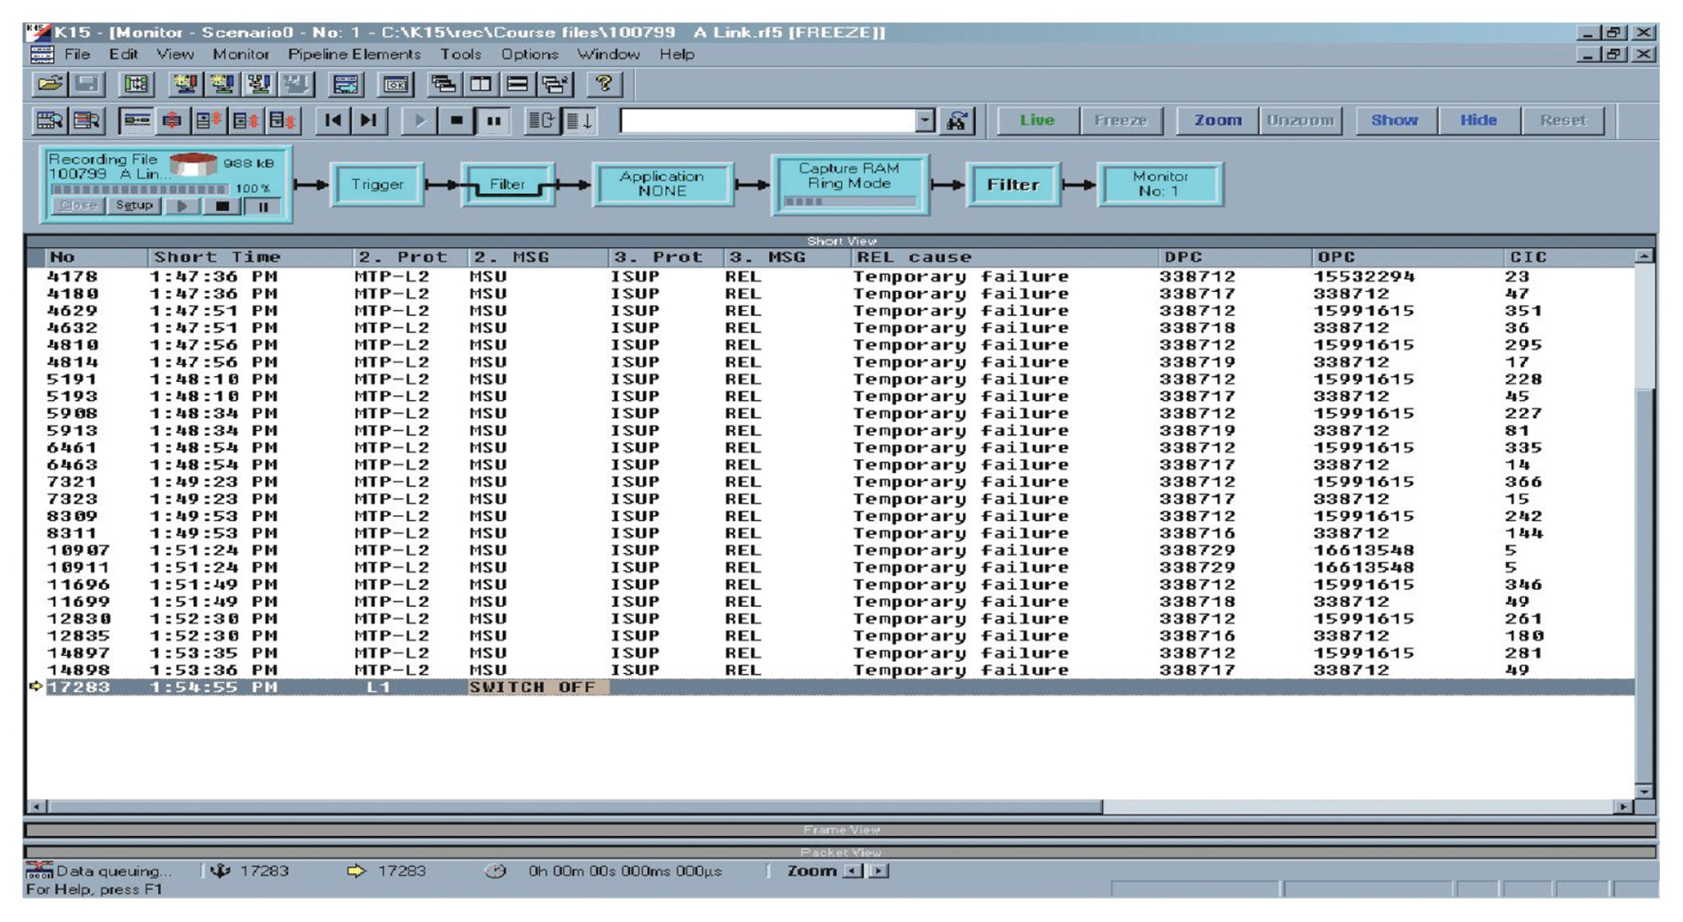
Figure 11-10 Configuration on the protocol analyzer set to display only the “temporary failure messages.

Slide 12
EE 350 / ECE 490 Analog Communication Systems
Ch. 12 – Transmission Lines

Slide 13
Objectives
Describe the operational characteristics of twisted-pair cable and its testing considerations
Describe the physical characteristics of standard transmission lines and calculate Z₀
Calculate the velocity of propagation and the delay factor
Analyze wave propagation and reflection for various line configurations
Describe how standing waves are produced and calculate the standing wave ratio
Use the Smith chart to find input impedance and match loads to a line with matching sections and single-stub tuners
Explain the use of line sections to simulate discrete circuitry
Troubleshoot the location of a line break using TDR concepts

Slide 14
12-1 Introduction
A transmission line is the conductive connections between system elements that carry signal power.
At RF you can’t simply consider “wires” to be short circuits
Energy may also be reflected back

Slide 15
12-2 Types of Transmission Lines
Two-Wire Open Line
Twisted Pair
Unshielded Twisted Pair (UTP)
Shielded Pair
Coaxial Lines
Balanced/Unbalanced Lines

Slide 16
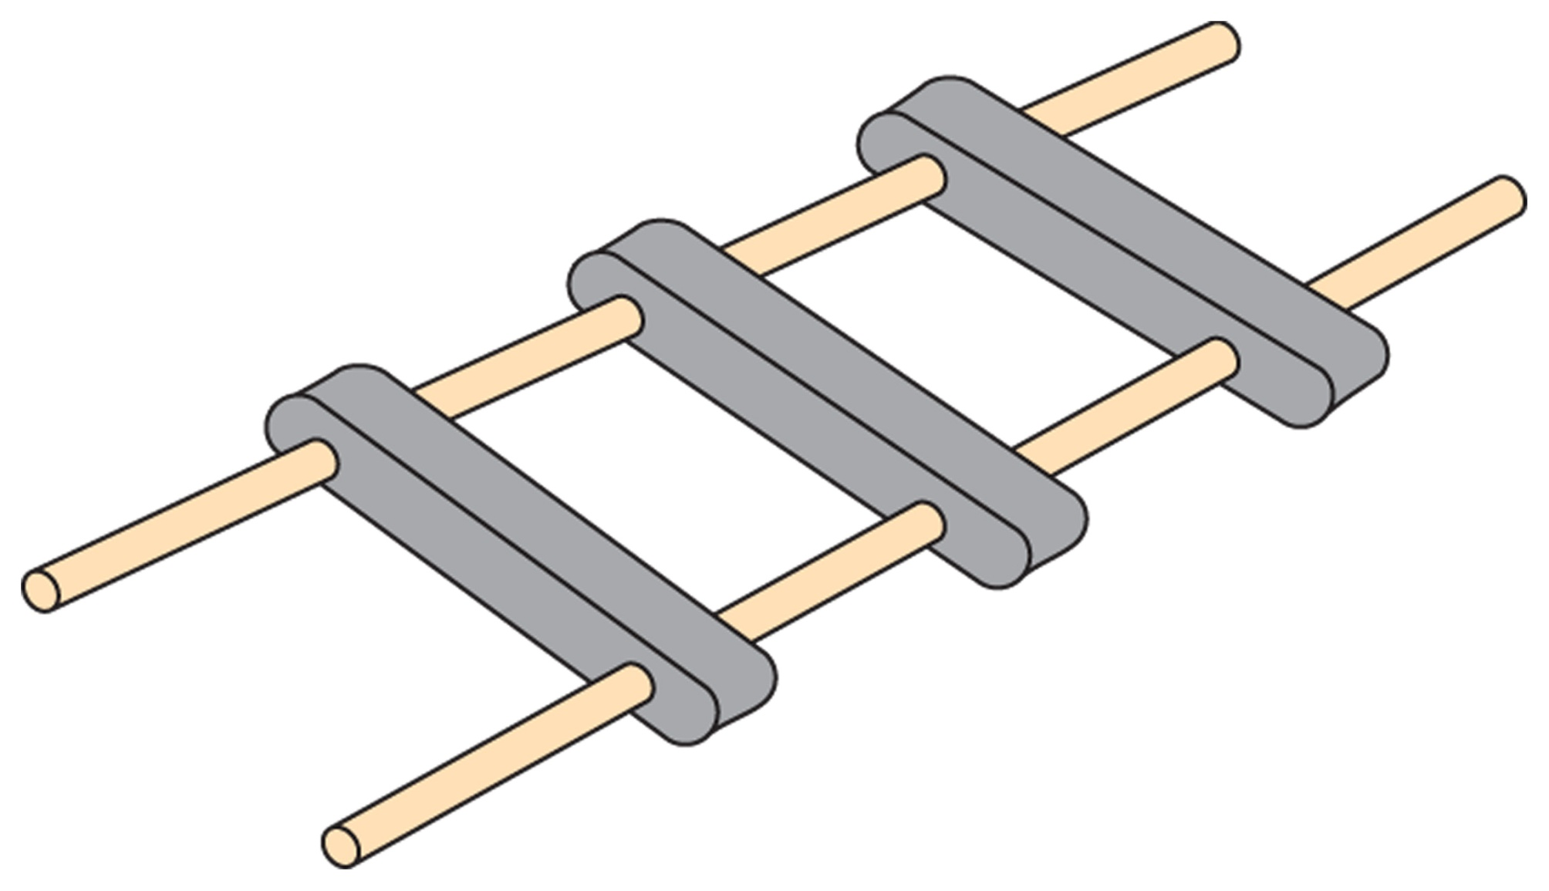
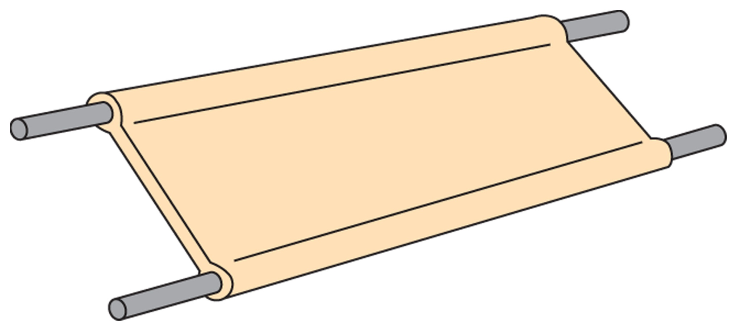
Two-Wire Open Line
Figure 12-1 Parallel two-wire line.
Figure 12-2 Two-wire ribbon-type lines.
Used antenna and transmitter or receiver

Slide 17
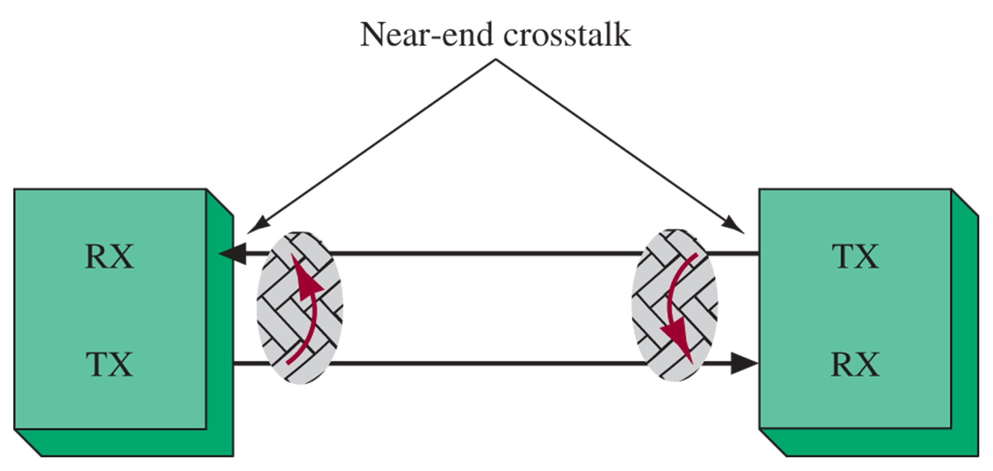
Unshielded Twisted Pair (UTP)
UTP very common in LANs, now CAT6 and 5e capable of 1000 Mbps for 100 m.
4 color-coded twisted pairs w/ RJ-45 connector
Achieving high data rates depends on low attenuation and near-end crosstalk (NEXT)
Delay skew (from uneven lengths) is also important in high speed communications
Return loss is related to signal power reflection due to impedance changes throughout the cable.
Figure 12-3 Twisted pair.
Figure 12-4 A graphical illustration of near-end crosstalk.

Slide 18
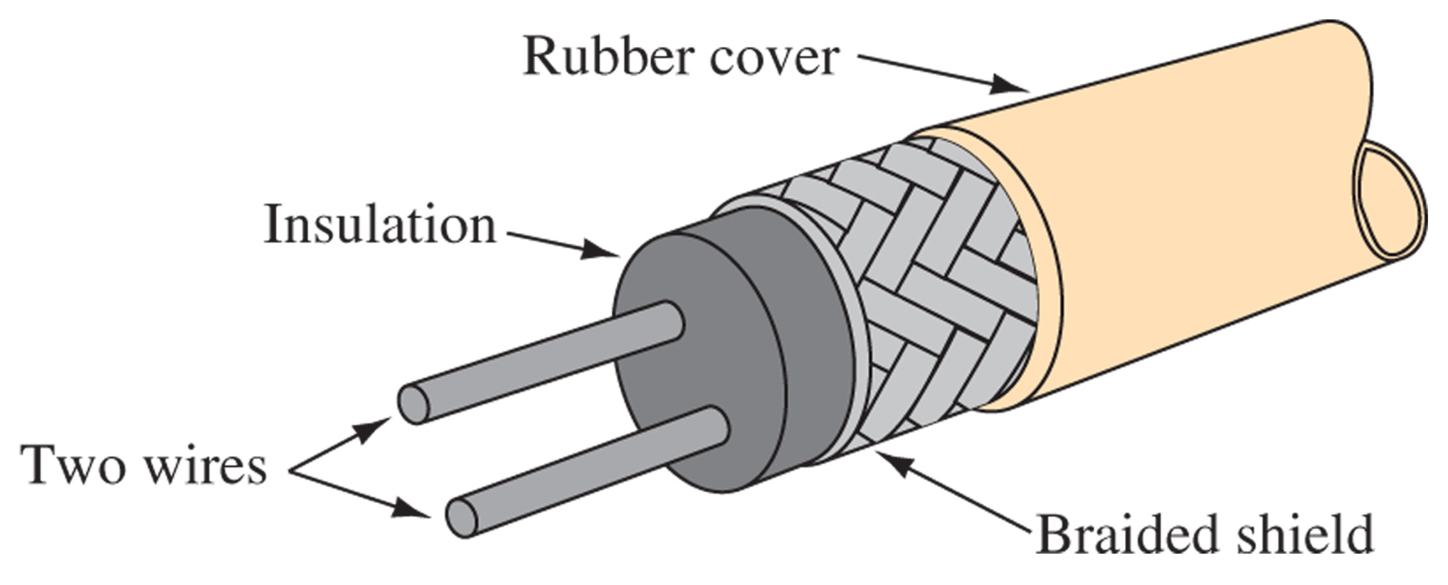
Shielded Pair
Figure 12-5 Shielded pair.
Conductors are balanced to ground due to shielding cable
Outside interference is minimized
Cross-talk is minimized

Slide 19
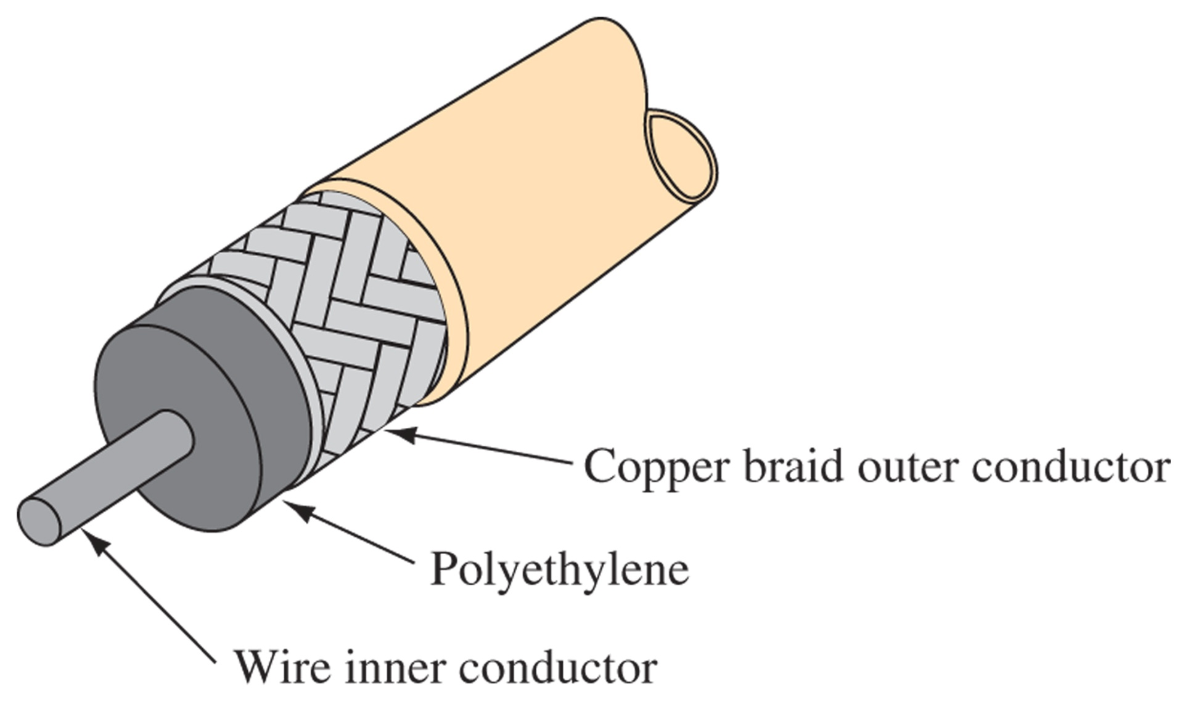
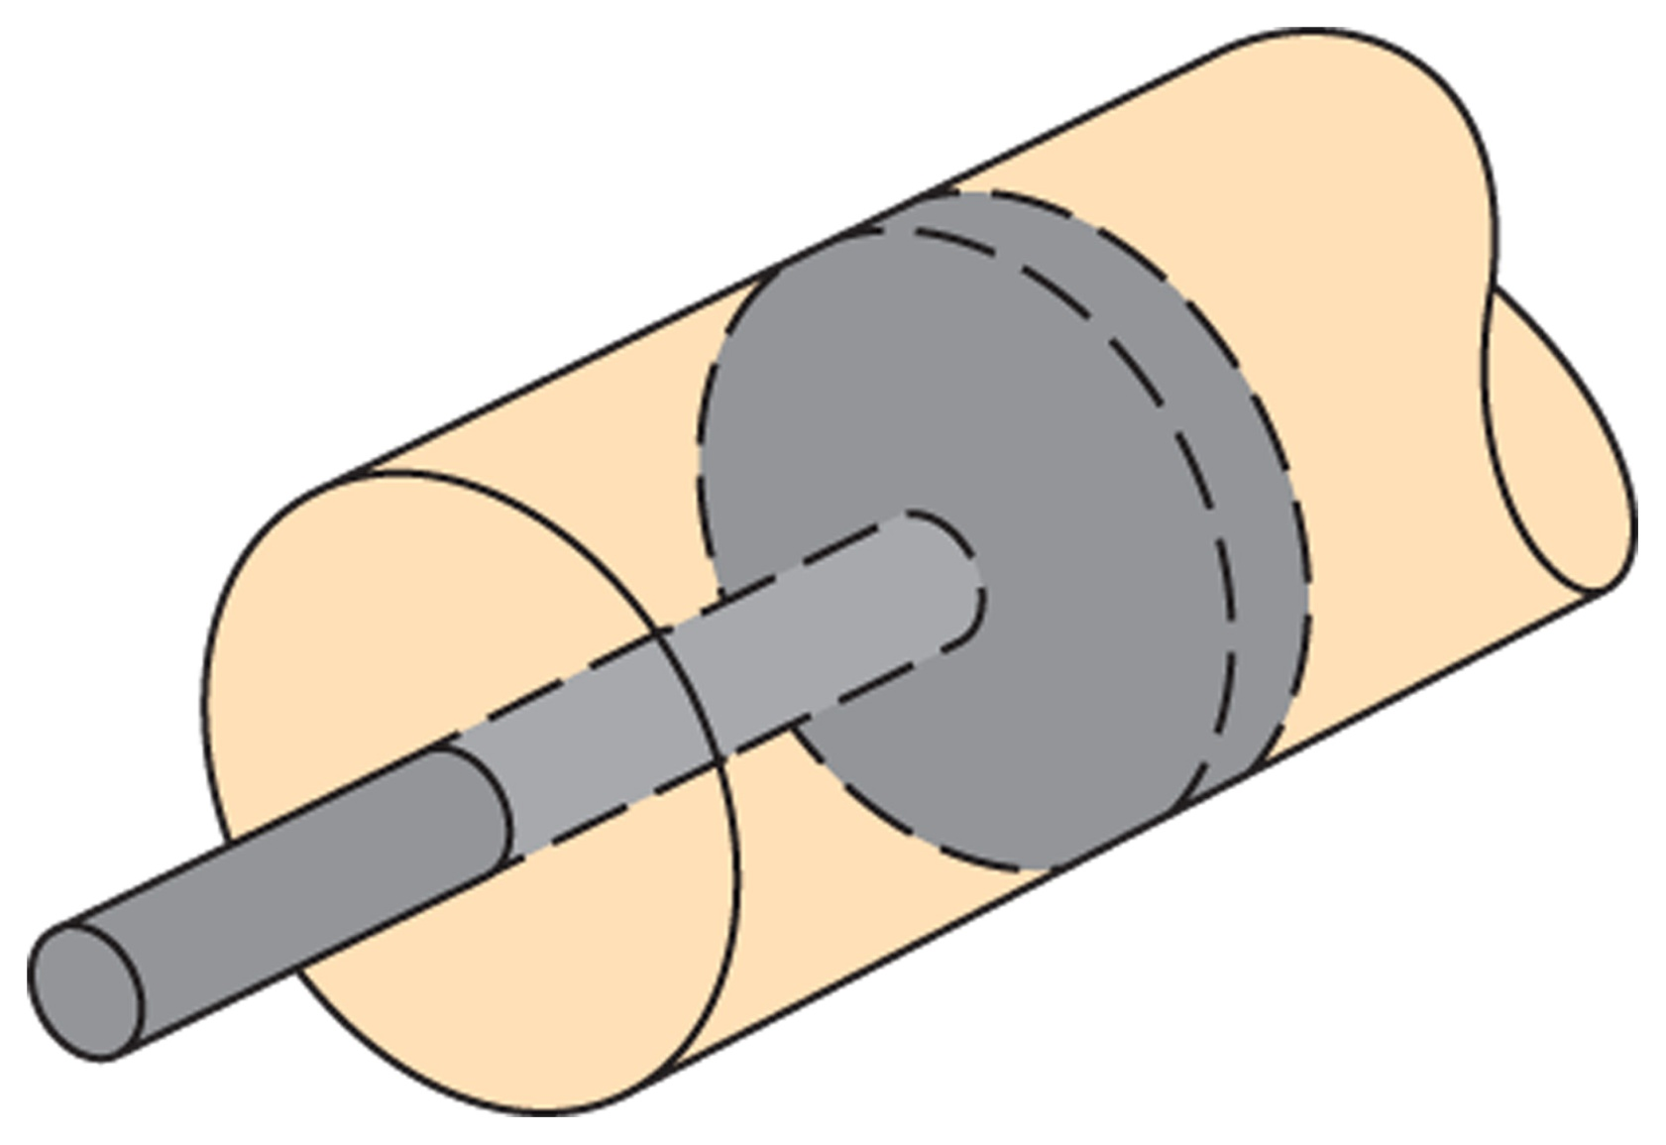
Coaxial
Figure 12-6 Rigid; Air coaxial: cable with washer insulator.
Figure 12-7 Flexible coaxial. Most common version of coax; more lossy, but easier to make and use
Most common form of transmission line

Slide 20
Coax Connectors

Slide 21
Balanced/Unbalanced Lines
180° out of phase for CMR
Figure 12-8 Balanced/unbalanced conversion. Uses a center-tapped Transformer as a Balun.

Slide 22
12-3 Electrical Characteristics of Transmission Lines
Generator (Input) is nearest source
Load (Receiving) end is nearest load
No line is perfect, there are always electrons moving through the dielectric.
In a uniform line, one section can represent the entire line

Slide 23
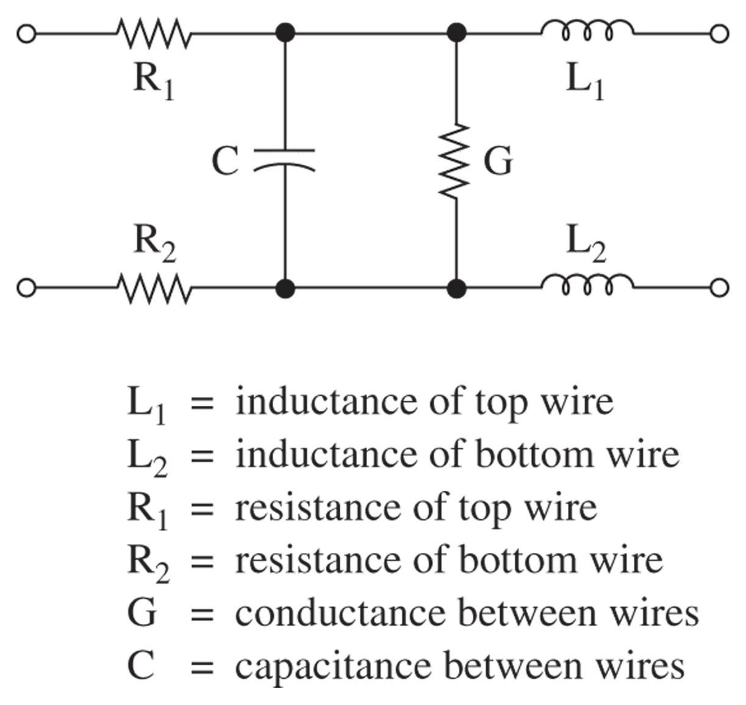
Two-Wire Transmission Line
Figure 12-9 Equivalent circuit for a two-wire transmission line

Slide 24
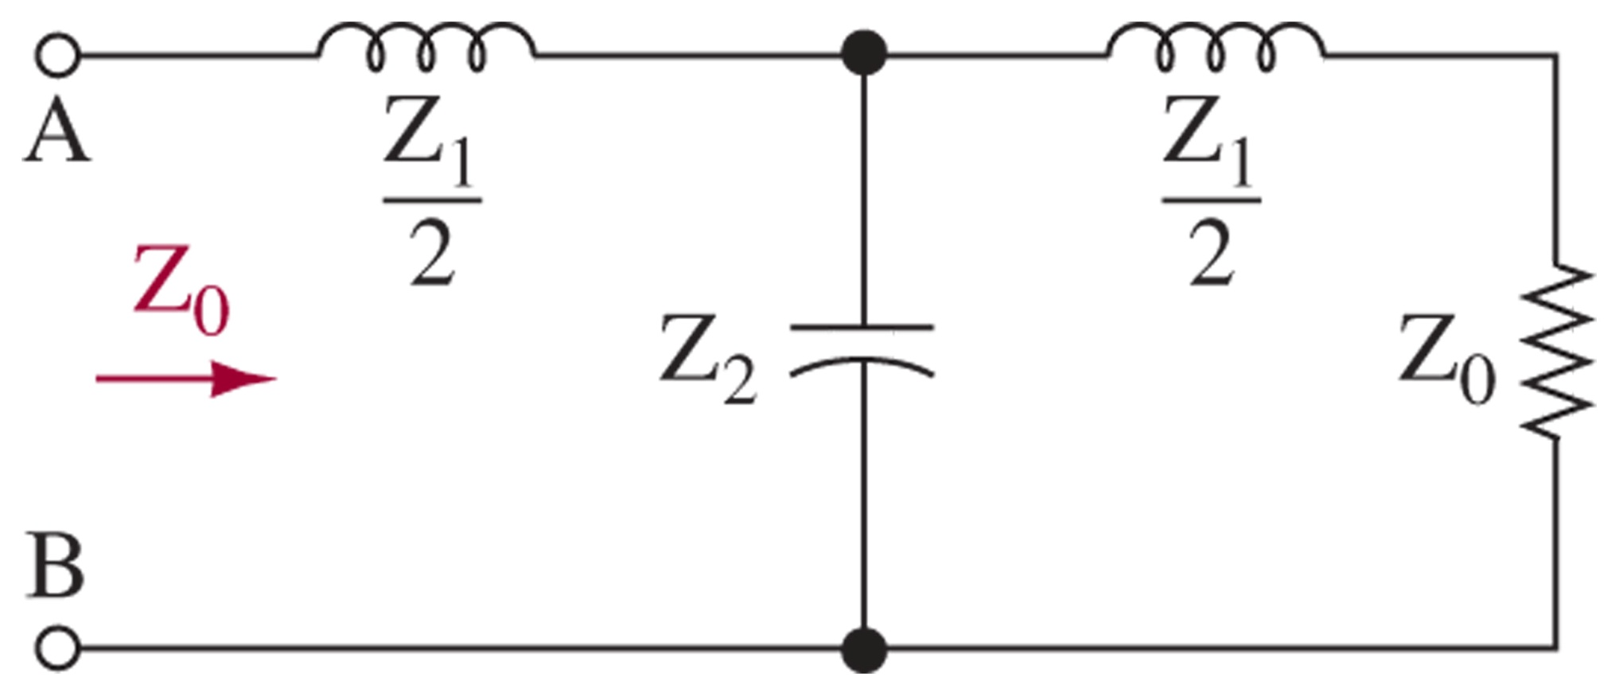
Characteristic Impedance
Fig 12-10 Simplified circuit terminated with characteristic impedance

Slide 25
Determining Characteristic Impedance
For Two-wire lines:
For Coax lines:
Insulator | ε
Air | 1
Polyethylene | 2.3
Teflon | 2.1
Polyethylene Foam | 1.6

Slide 26
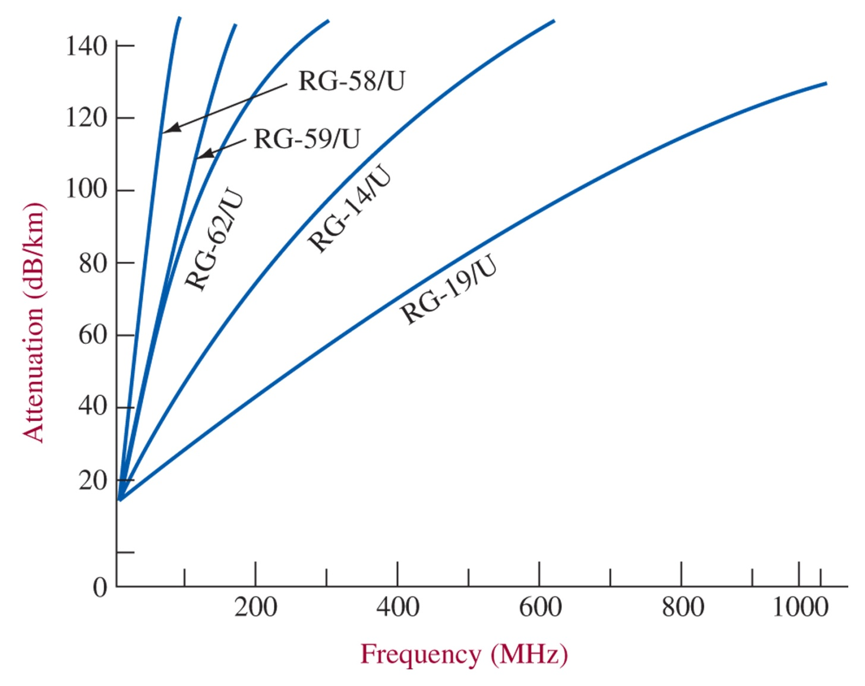
Transmission Line Losses
Copper Losses – I²R goes up at high frequency due to skin effect
Dielectric Losses – increases with voltage and frequency. Best with air, or low dielectric constant.
Induction or Radiation Losses – minimized with grounded coax and proper termination
Figure 12-11 Line attenuation characteristics.

Slide 27
12-4 Propagation of DC Voltage Down a Line
Physical Explanation of Propagation
Velocity of Propagation
Delay Line
Wavelength

Slide 28
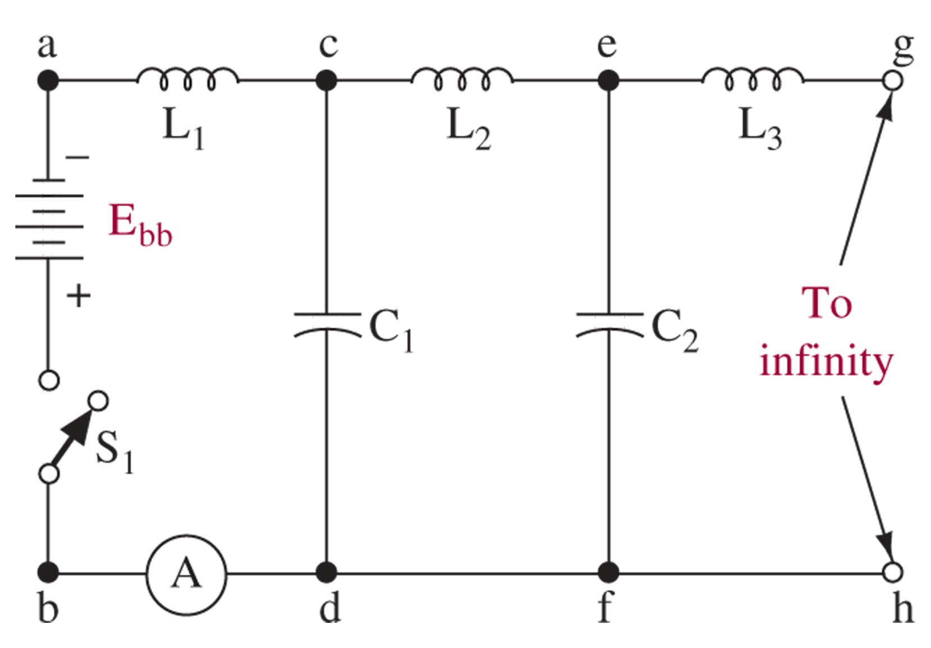
DC Propagation
Figure 12-12 DC voltage applied to a transmission line.
Look at it as sequential charging of capacitors through the inductors

Slide 29
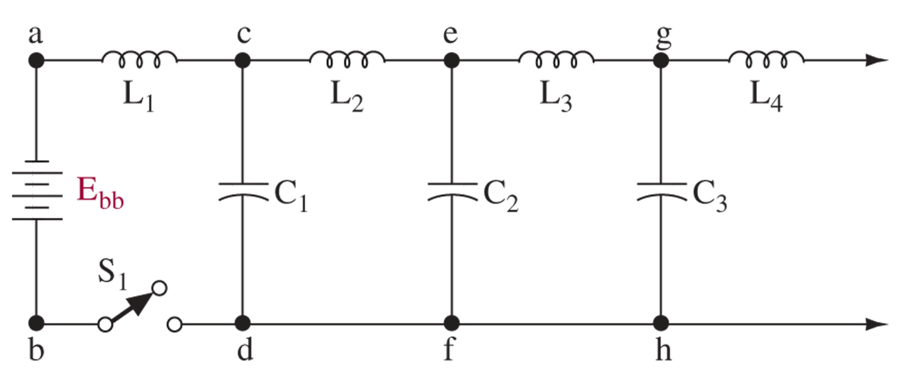
Velocity of Propagation
Wavelength in a line:

Slide 30
12-5 Nonresonant Line
Traveling DC Waves
Traveling AC Waves
Definition of a line terminated in its characteristic impedance

Slide 31
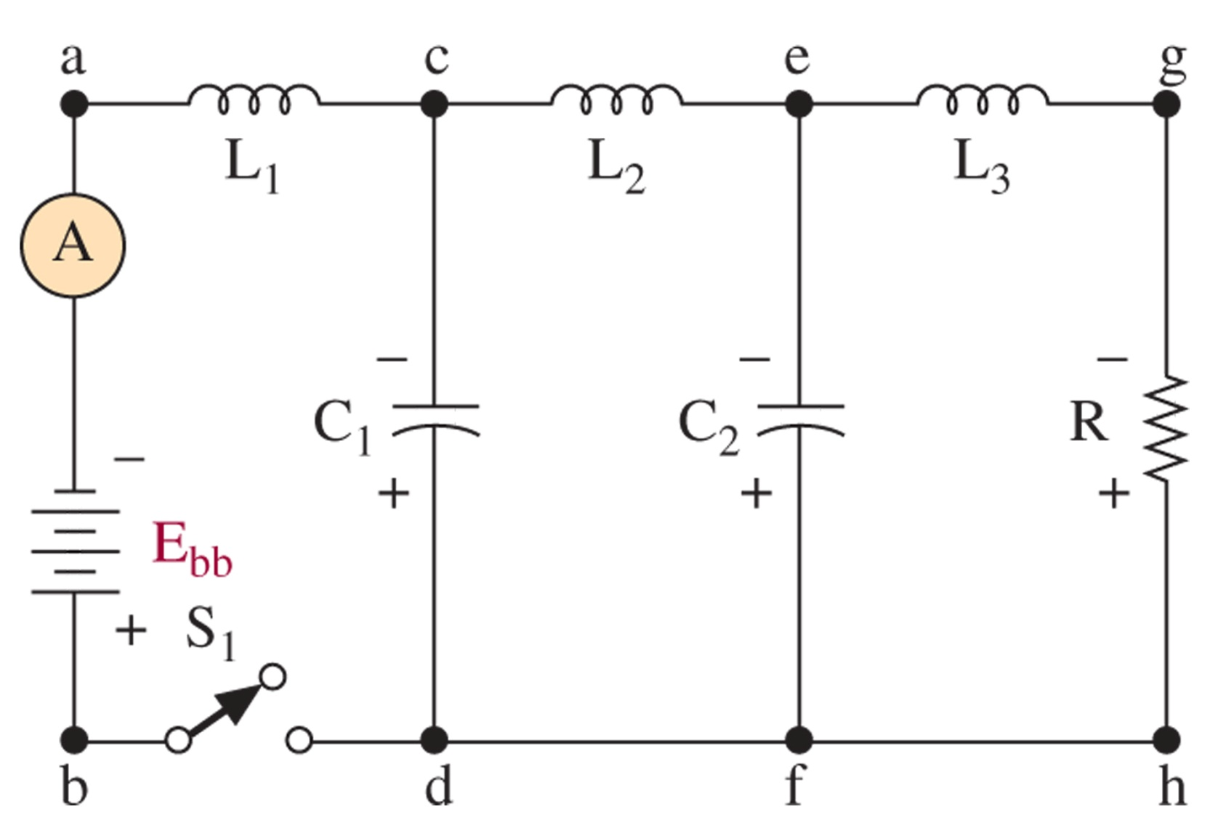
Traveling DC Waves
Figure 12-14 Charged nonresonant line.

Slide 32
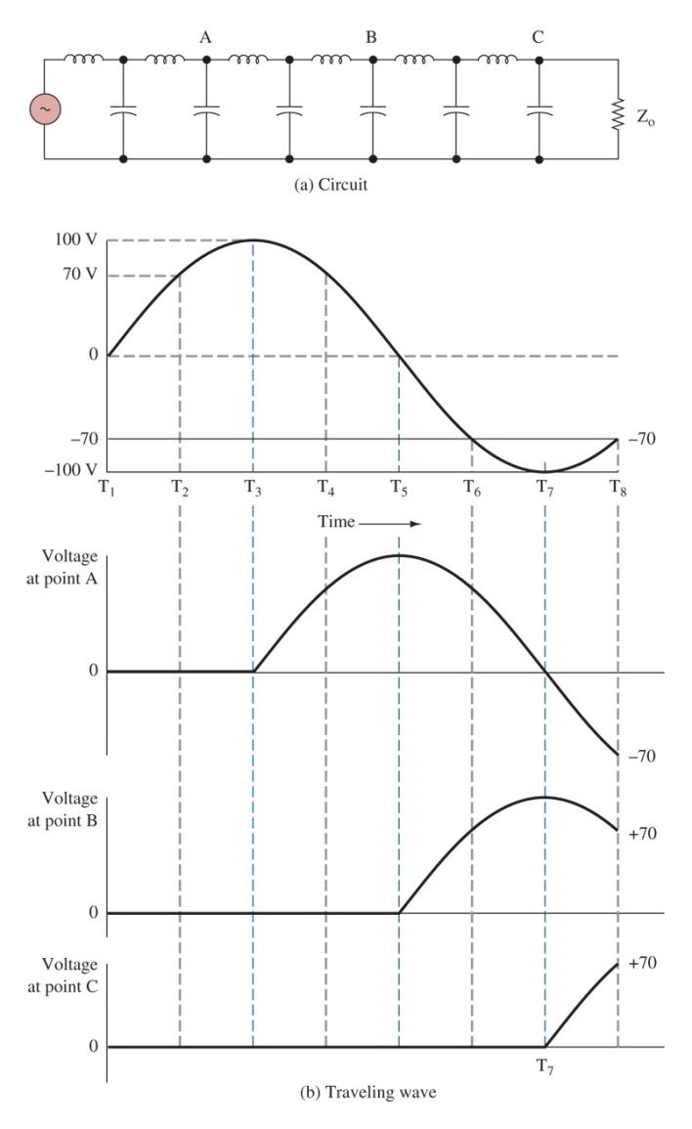
Traveling AC Waves
AC signals move as a wavefront
The instantaneous voltage along the points of the line reproduce the signal generator
All the power is absorbed by the termination resistor

Slide 33
12-6 Resonant Transmission Line
DC Applied to an Open-Circuited Line
Incident and Reflected Waves
DC Applied to a Short-Circuited Line
Standing Waves: Open Line
Standing Waves: Shorted Line

Slide 34
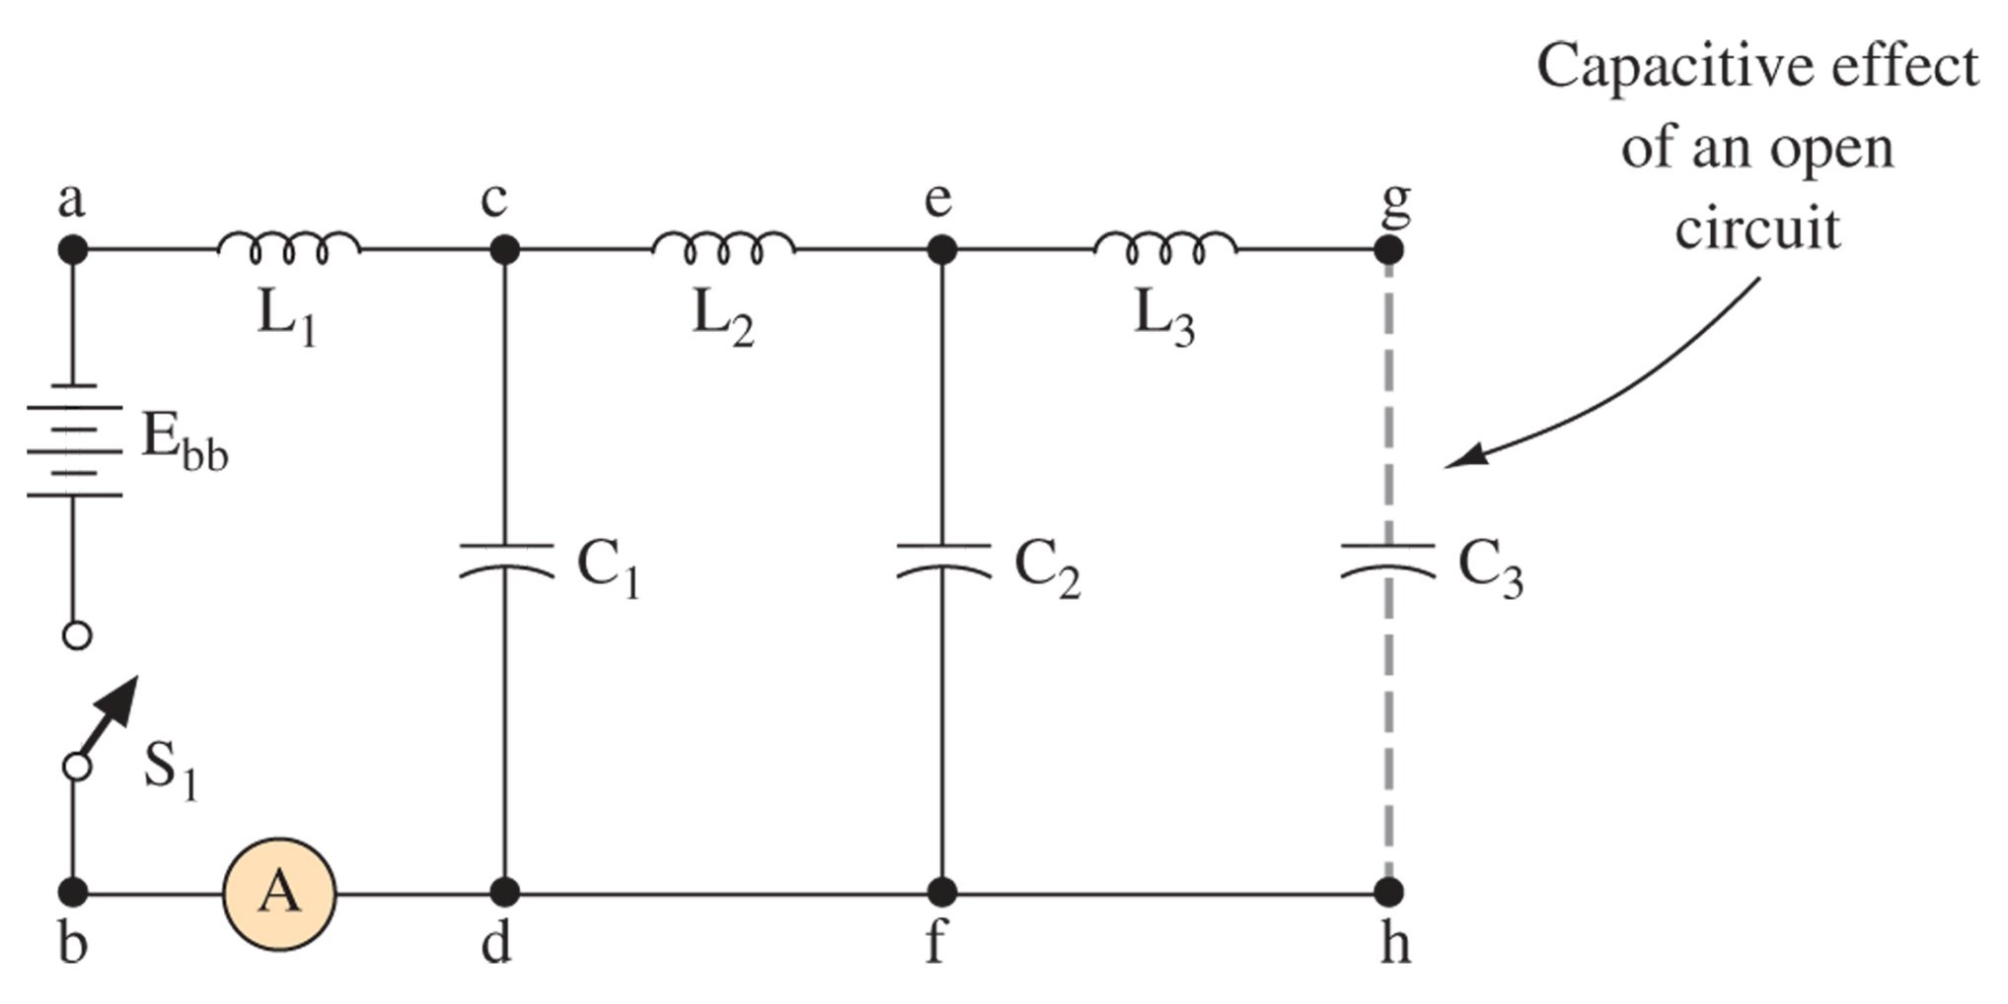
DC on an Open Circuit Line
Figure 12-16 Open-ended transmission line.
Voltage propagates to the end charging C3, then since no current can flow the charge in the inductors must dissipate into the capacitors, causes 2x voltage to be reflected back to the input

Slide 35
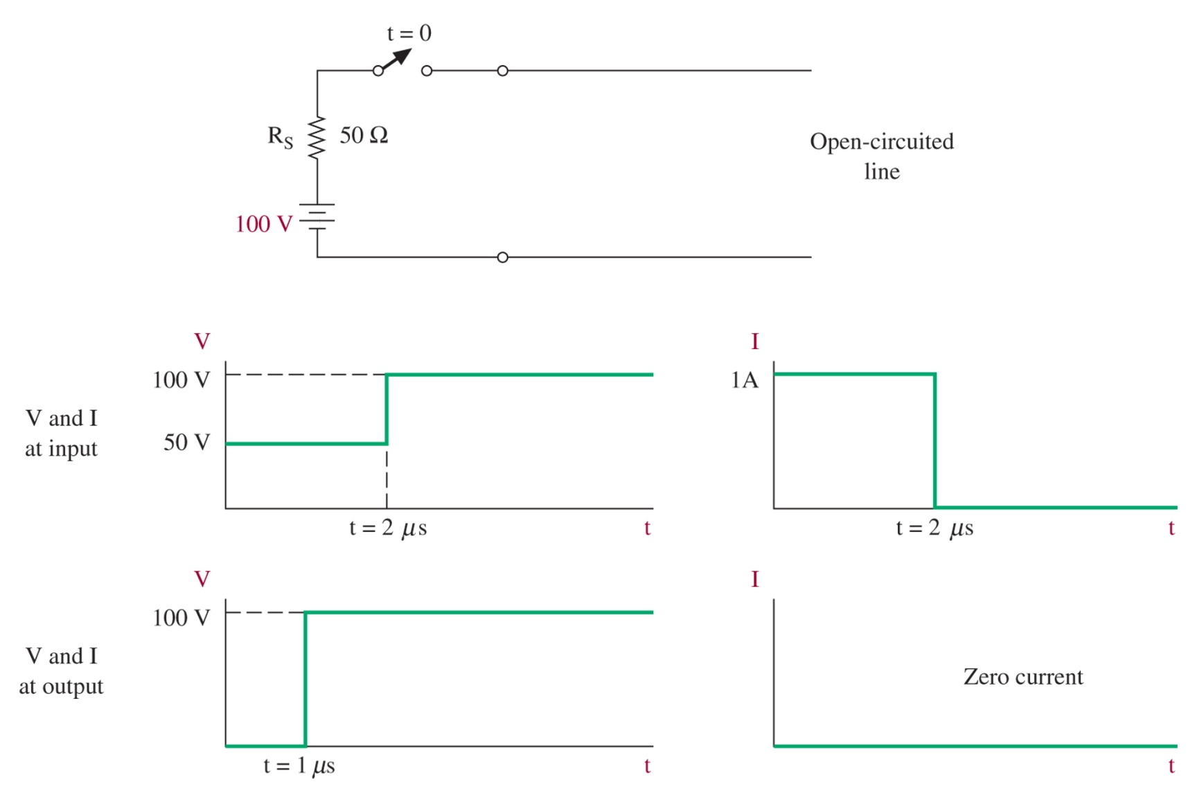
Incident and Reflected Waves
Reflected V in phase
Reflected I out of phase
Figure 12-17 Direct current applied to an open-circuited line.
In DC at 1us the load “sees” DC, but the source doesn’t “see” DC until 1us

Slide 36
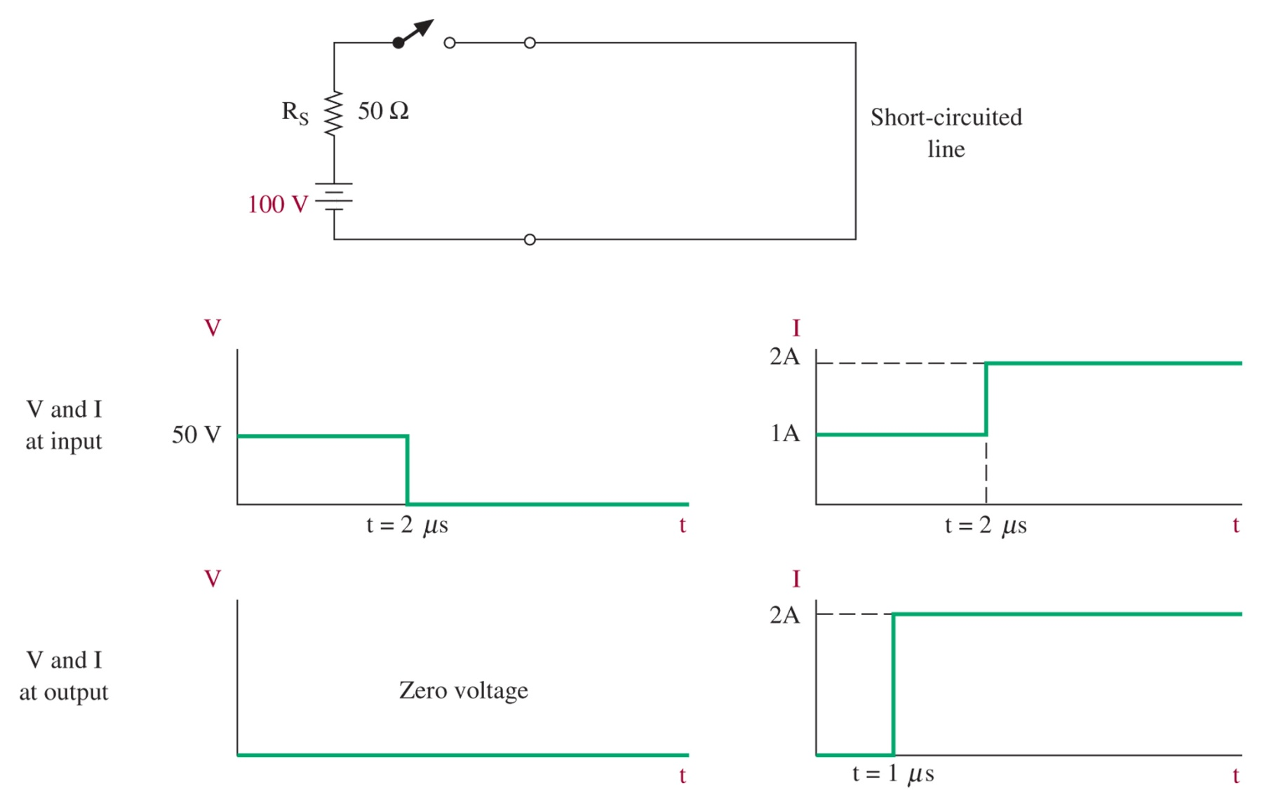
DC Applied to a Short-Circuited Line
Reflected V out of phase
Reflected I in phase
Figure 12-18 Direct current applied to a short-circuited line.

Slide 37
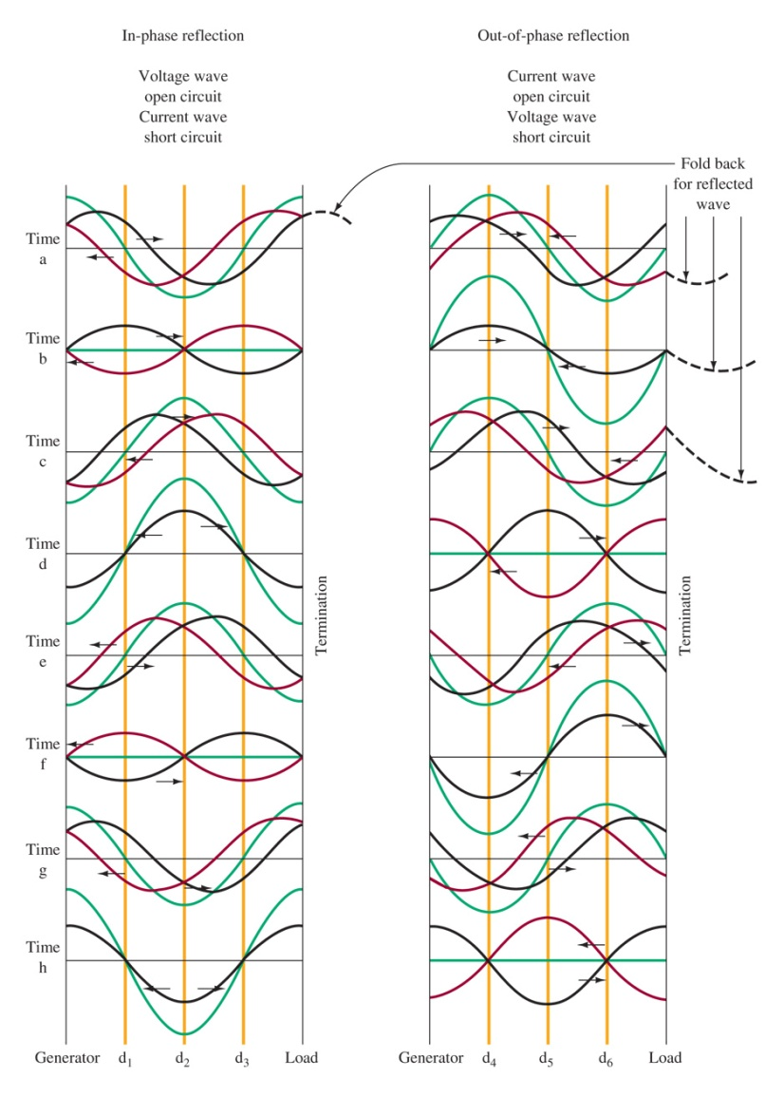
Standing Waves
When a line is not terminated appropriately a standing wave can develop, points in the line where the voltage and current never change

Slide 38
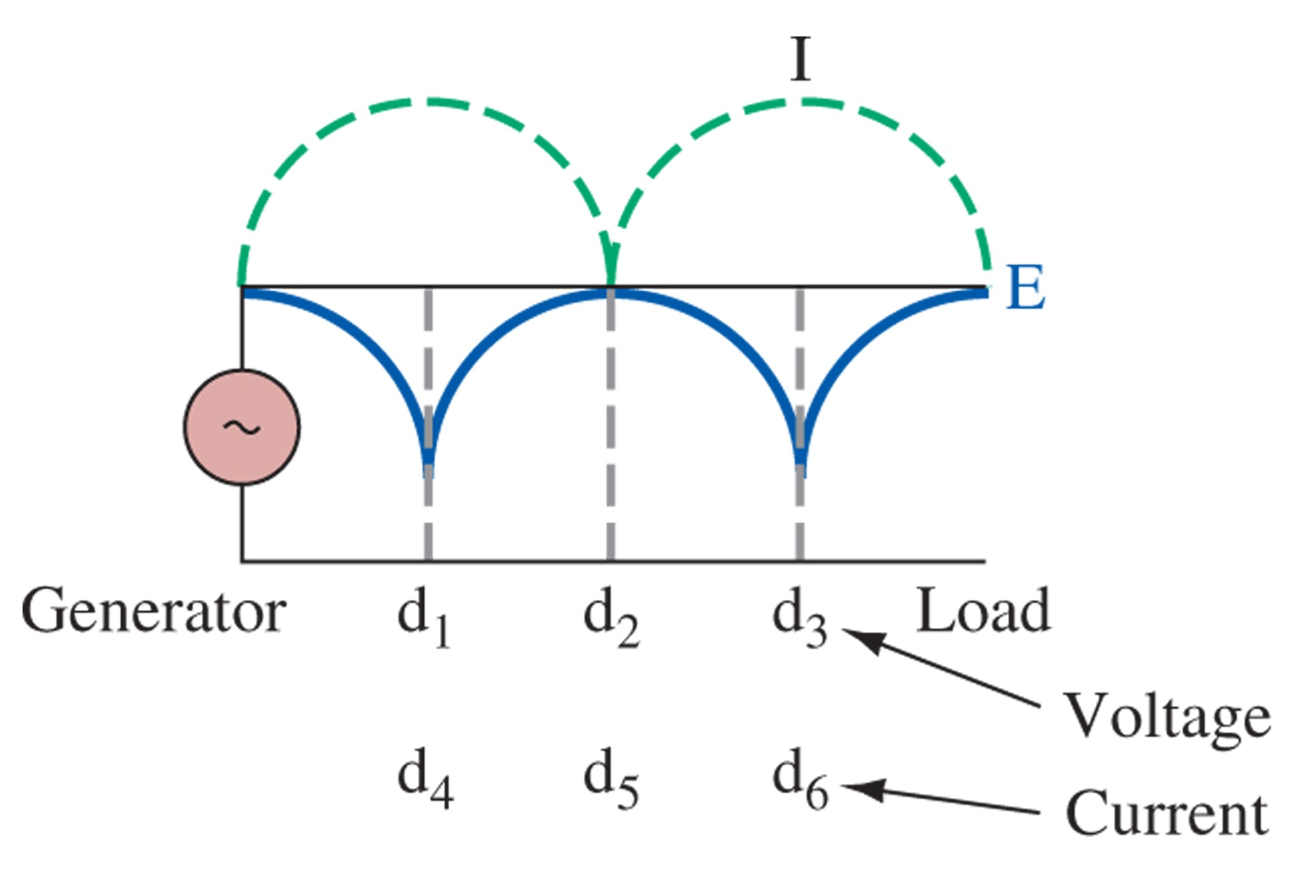
Standing Waves
Figure 12-20 Conventional picture of standing—waves open line.

Slide 39
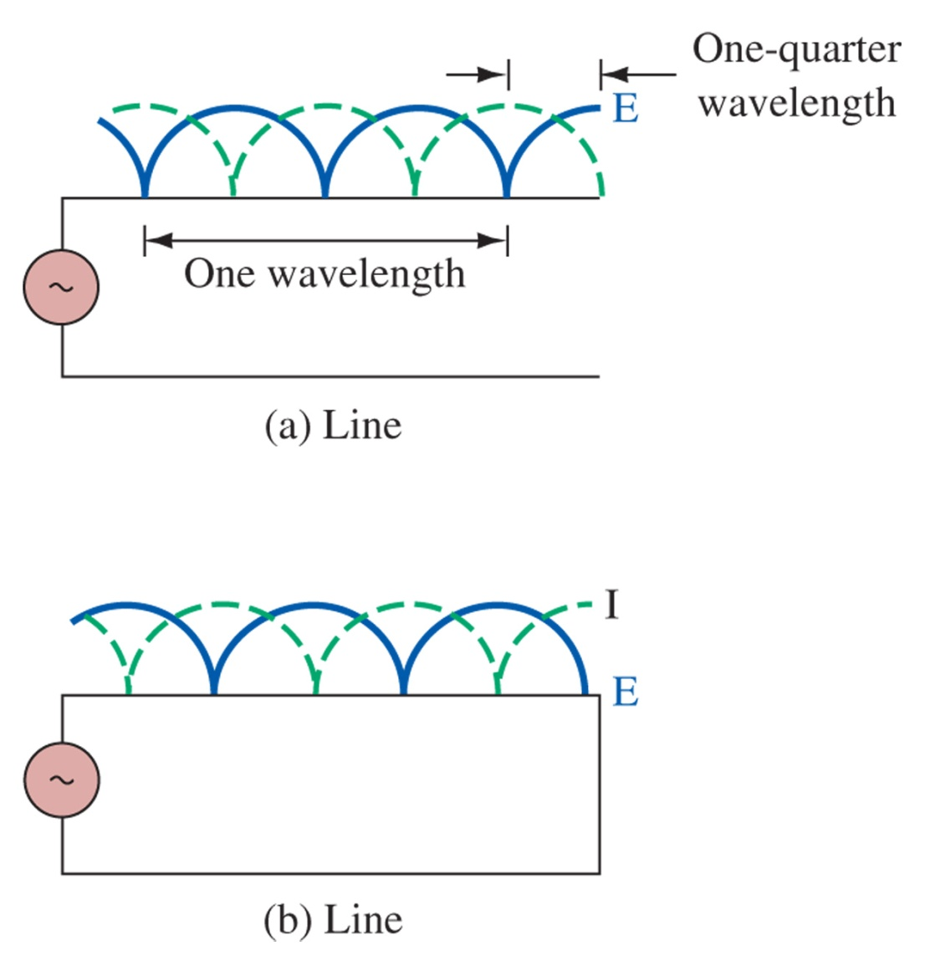
Figure 12-21 Standing waves of voltage and current.

Slide 40
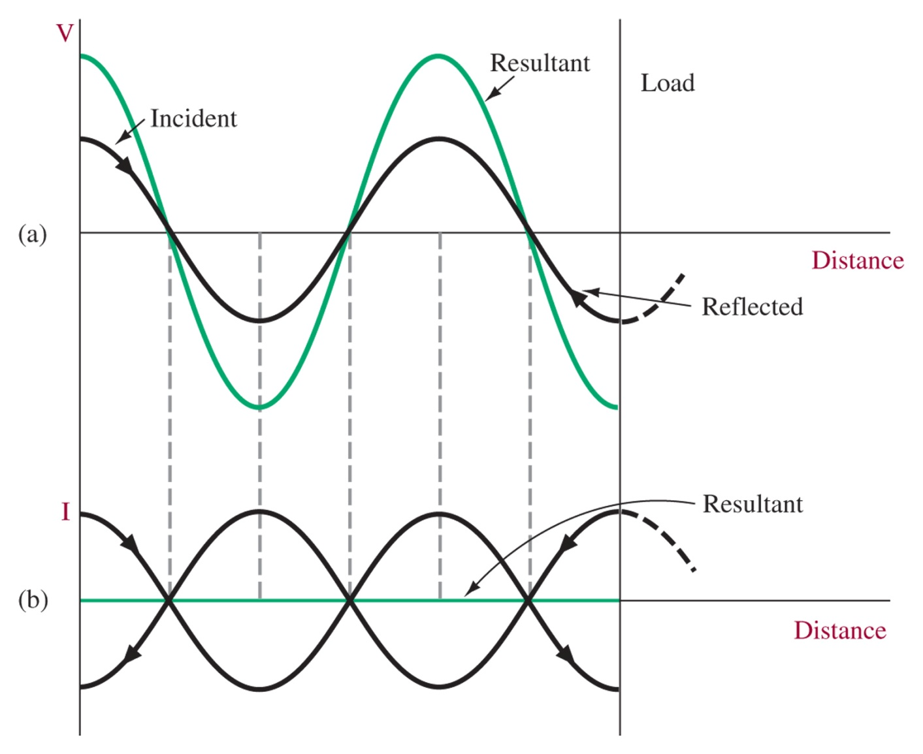
Figure 12-22 Diagram for Example 12-6.

Slide 41
12-7 Standing Wave Ratio
Reflection Coefficient:
Quarter-Wavelength Transformer
Electrical Length

Slide 42
Effects of Mismatch
The full generator power does not reach the load
The cable dielectric may break down as a result of high-value standing waves of voltage (voltage nodes).
The existence of reflections (and rereflections) increases the power loss in the form of I2R heating, especially at the high-value standing waves of current (current nodes)
Noise problems are increased by mismatches
“Ghost” signals can be created

Slide 43
Quarter-Wavelength Transformer
Figure 12-23 λ/4 matching section for Example 12-7.

Slide 44
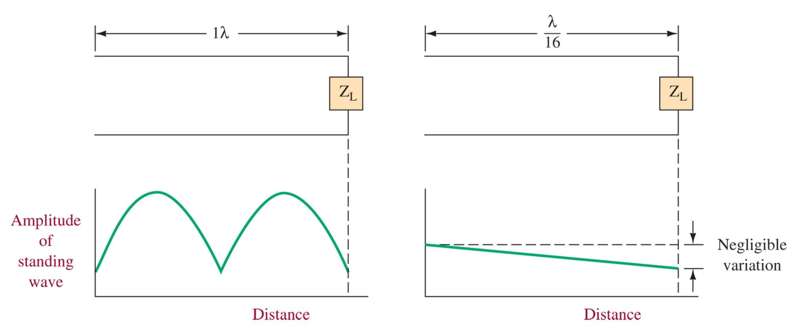
Electrical Length
Figure 12-24 Effect of line electrical length.
Transmission line effects are only important when the lines are electrically long. For telephone 300Hz signals λ=621 miles, so it doesn’t really matter. For 10 GHz signals λ=3 cm.

Slide 45
12-8 The Smith Chart
Transmission Line Impedance
Smith Chart Introduction
Using the Smith Chart
Corrections for Transmission Loss
Matching Using the Smith Chart
Stub Tuners

Slide 46
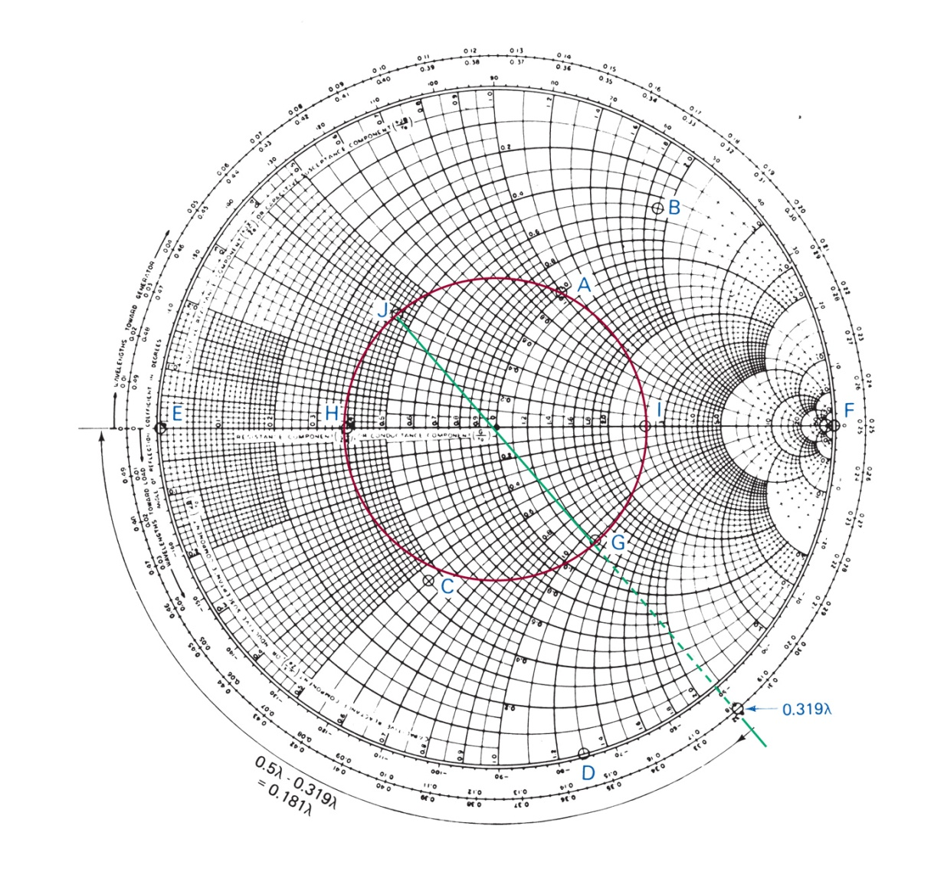
Smith Chart
Line impedance at a point
Figure 12-24 Smith chart.

Slide 47
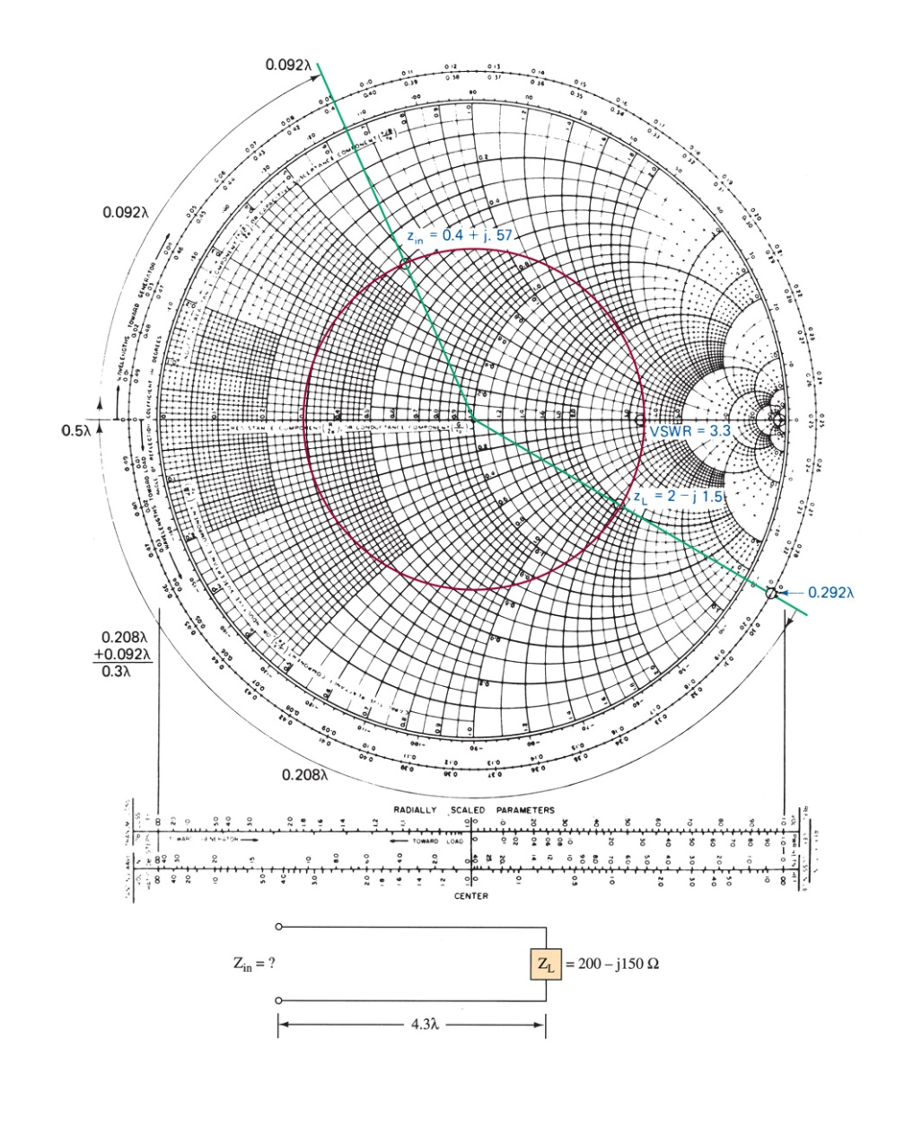
Figure 12-26 Smith chart for Example 12-8.

Slide 48
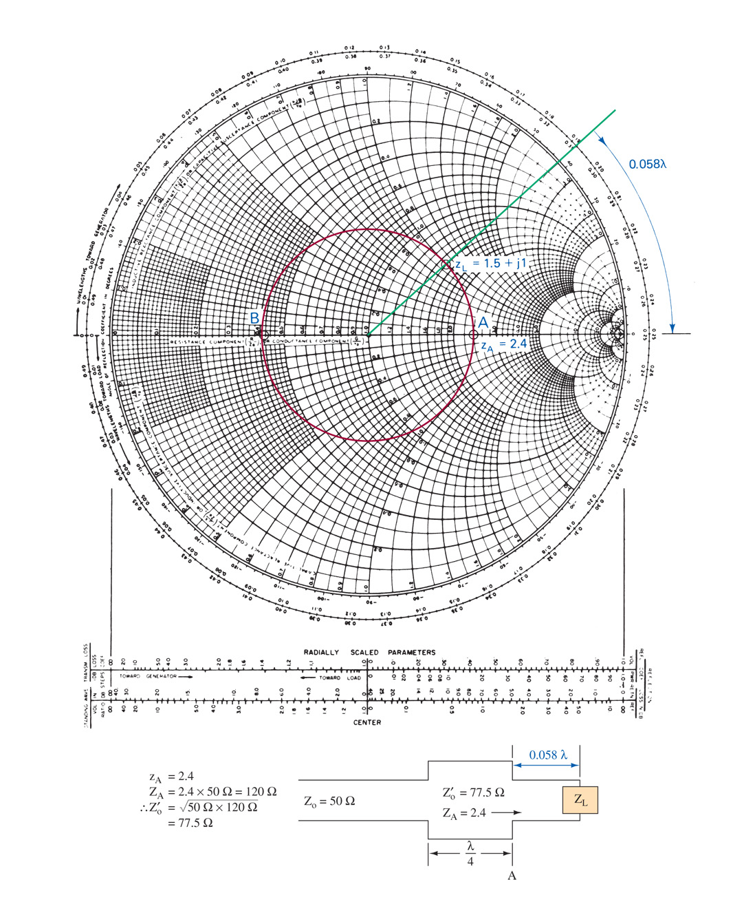
Figure 12-27 Smith chart for Example 12-9.

Slide 49
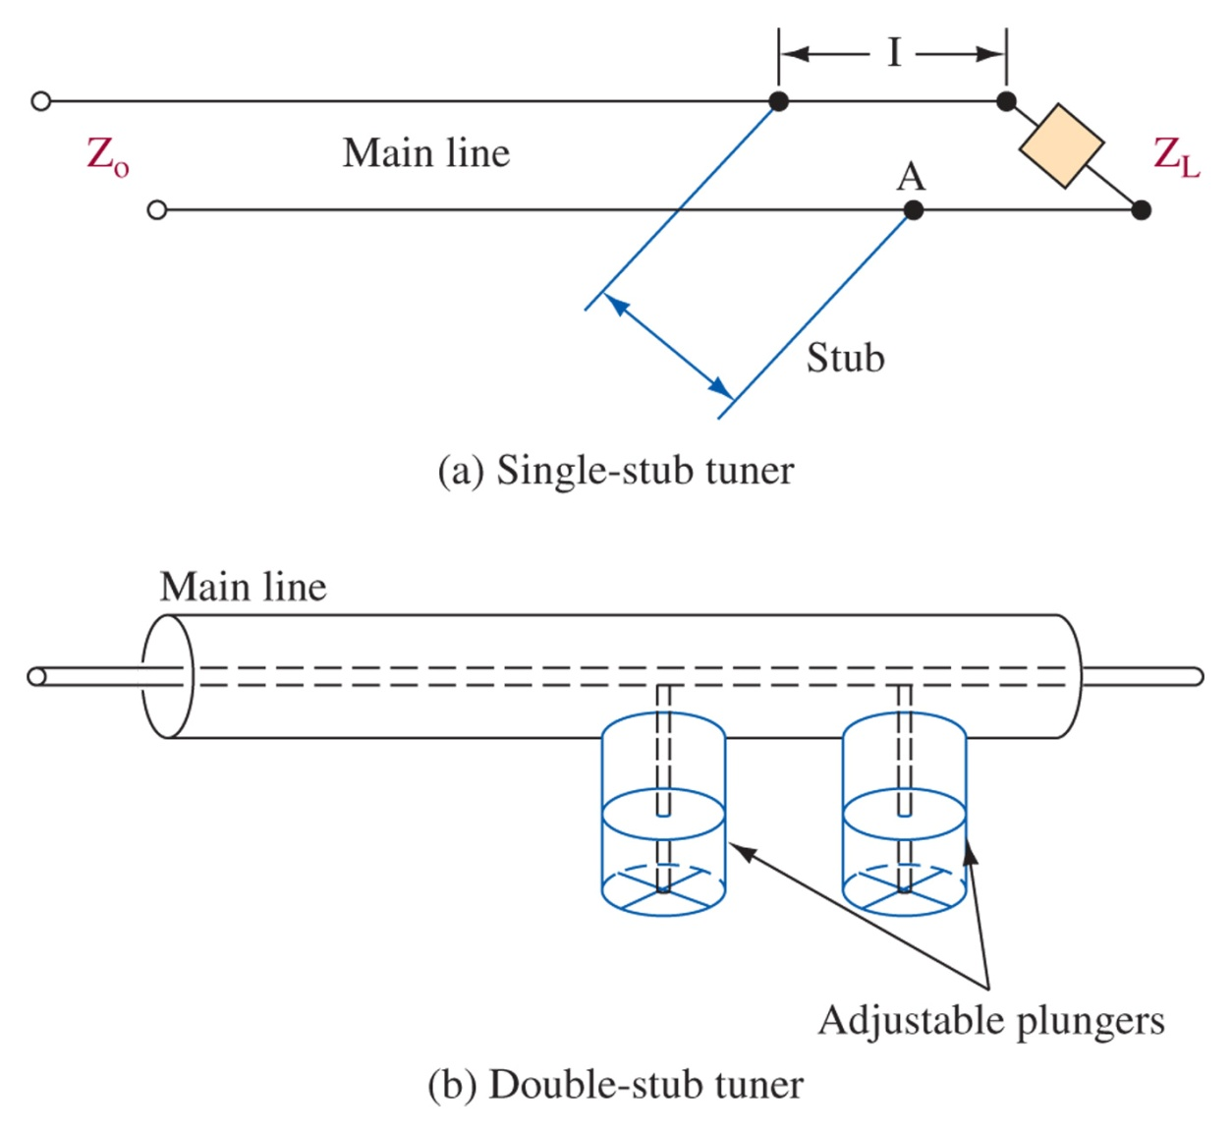
Figure 12-28 Stub tuners.

Slide 50
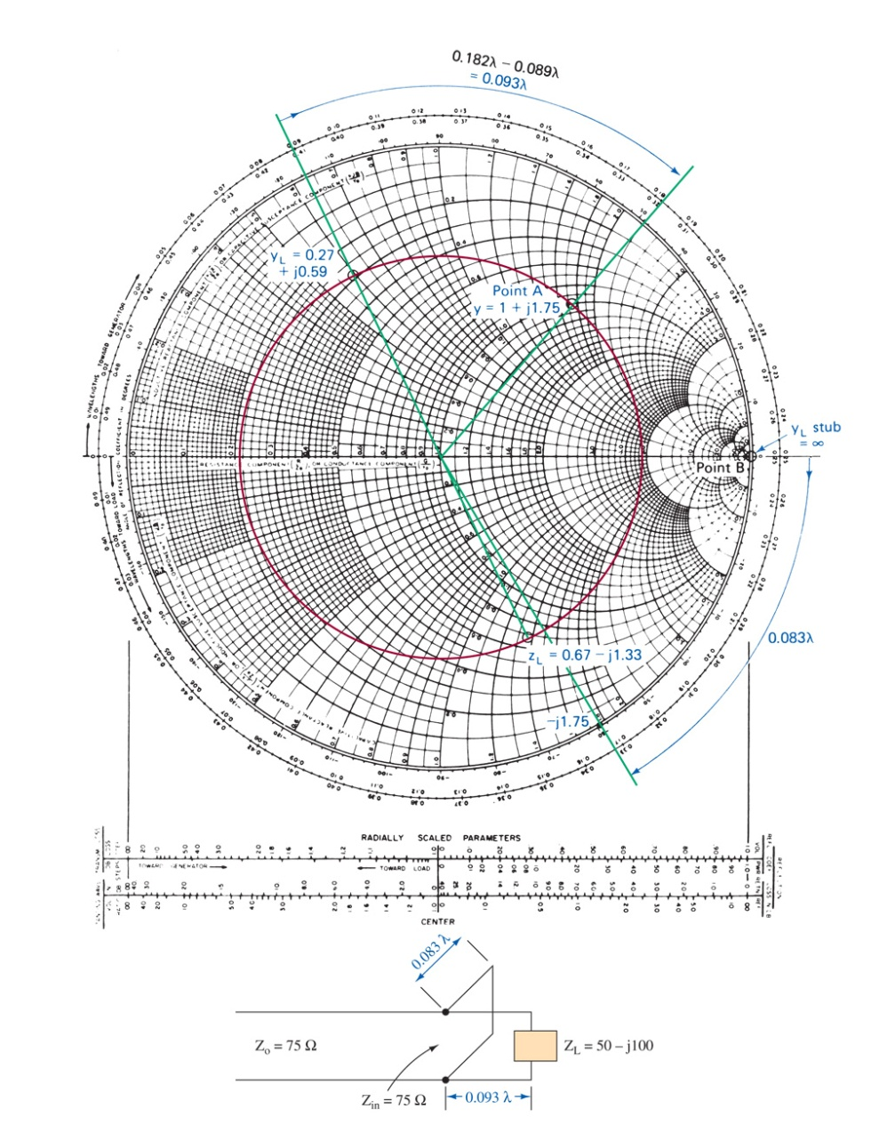
Figure 12-29 Smith chart for Example 12-10.

Slide 51
12-9 Transmission Line Applications
Discrete Circuit Simulation
Baluns
Transmission Lines as Filters
Slotted Lines
Time-Domain Reflectometery

Slide 52
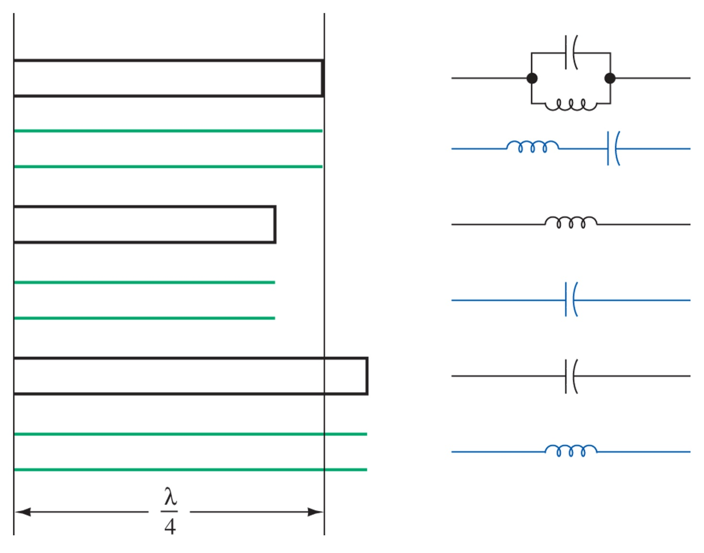
Figure 12-30 Transmission line section equivalency.

Slide 53
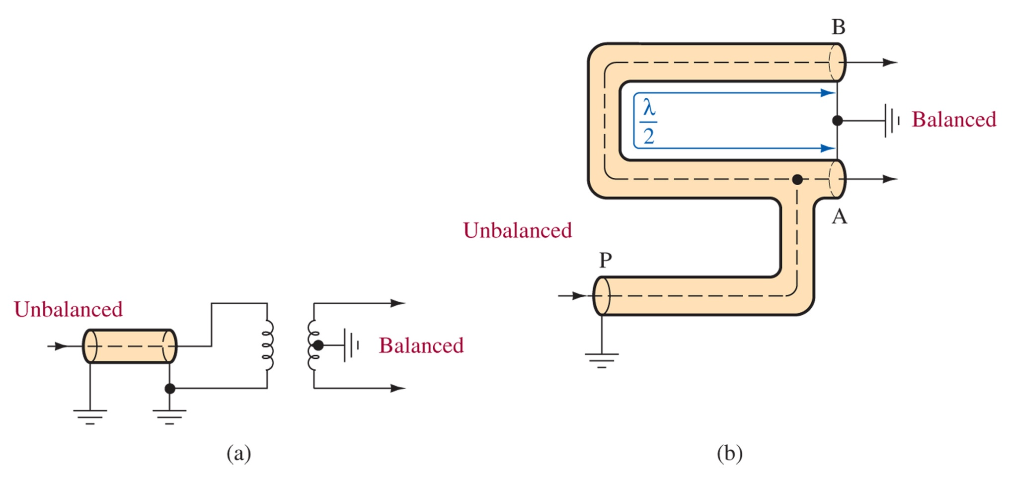
Figure 12-31 Baluns.

Slide 54
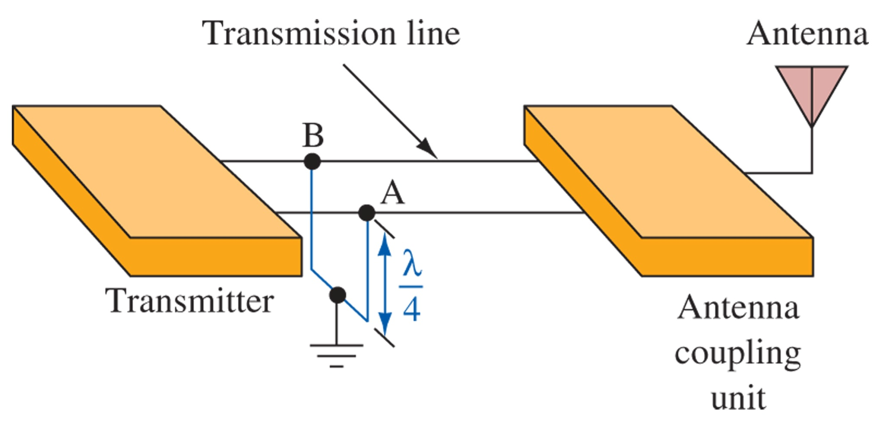
Figure 12-32 Quarter-wave filters.

Slide 55
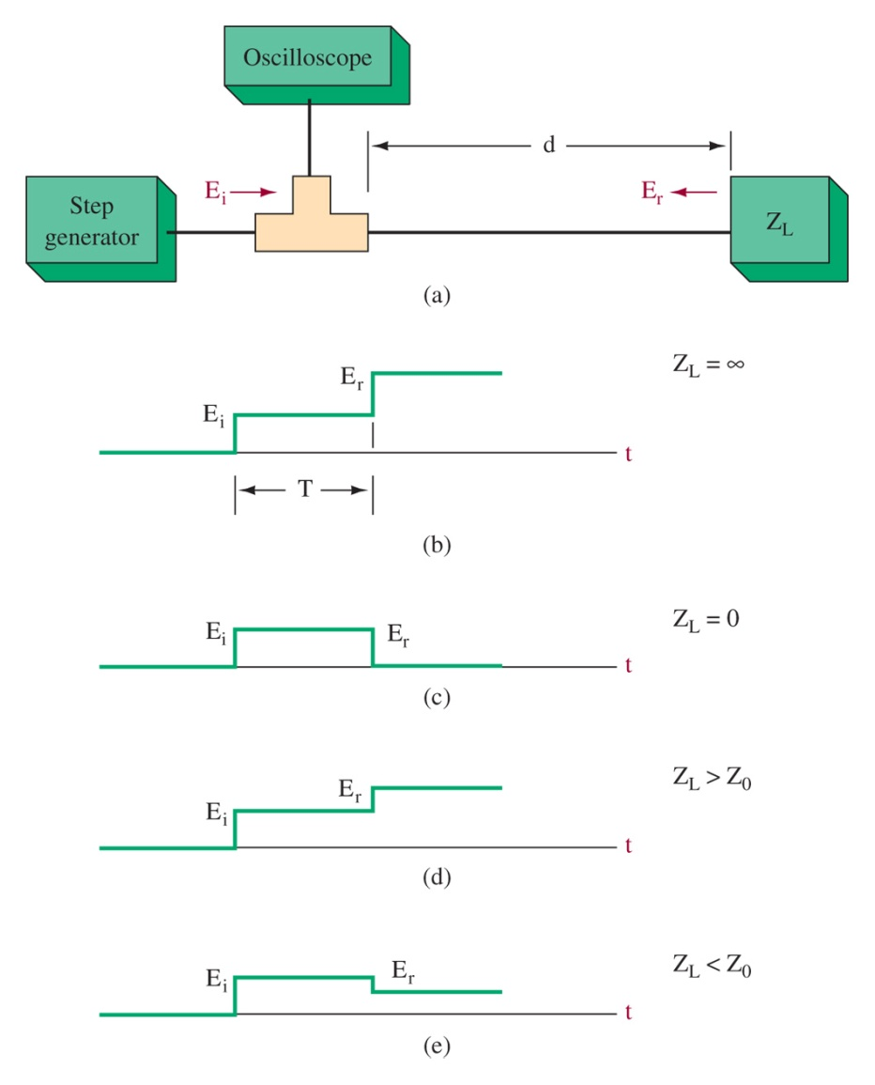
Figure 12-33 Time-domain reflectometry.

Slide 56
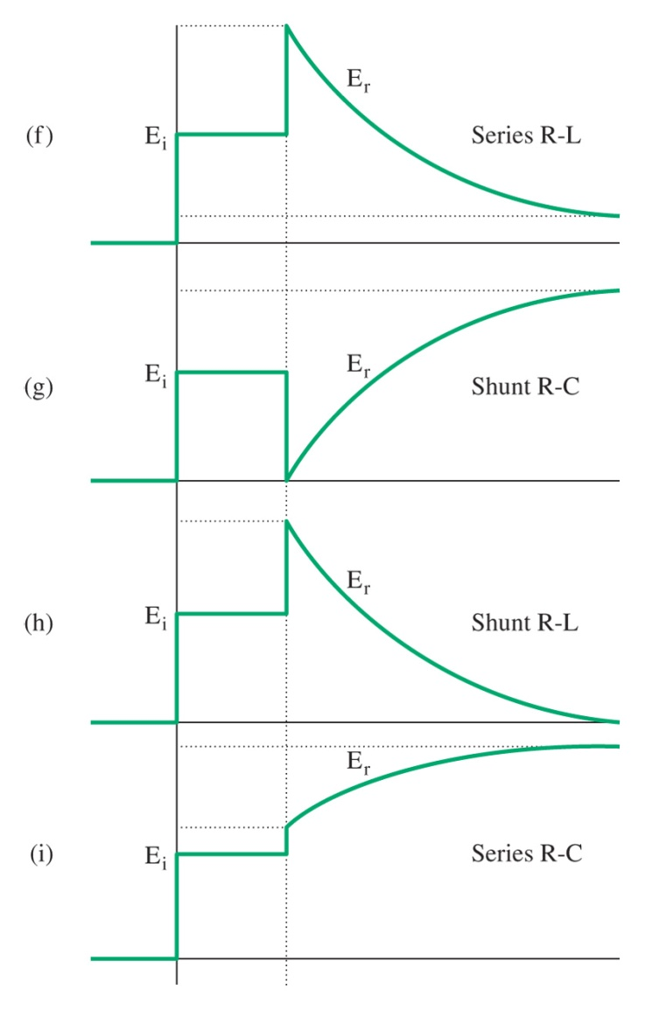
Figure 12-33 (continued) Time-domain reflectometry.

Slide 57
12-10 Troubleshooting
Common Applications
Losses on Transmission Lines
Interference on Transmission Lines
Cable Testing
Television Antenna Line Repair

Slide 58
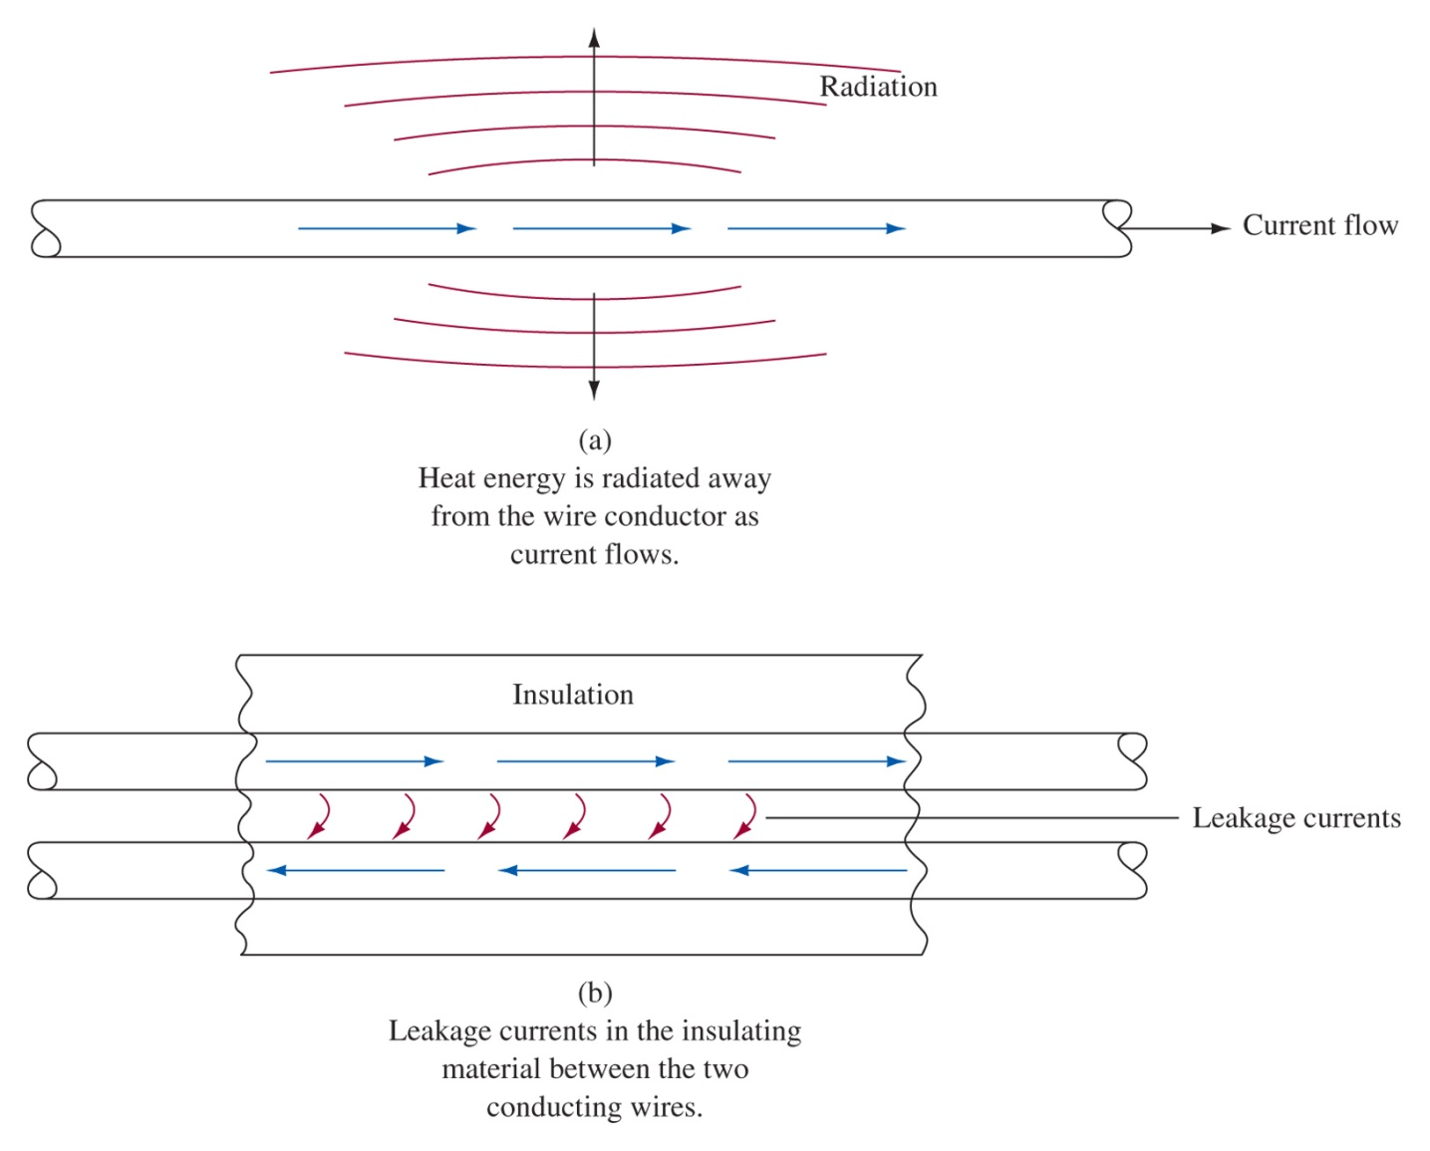
Figure 12-34 Heat radiation and leakage losses.

Slide 59
12-11 Troubleshooting w/ Multisim

Slide 60
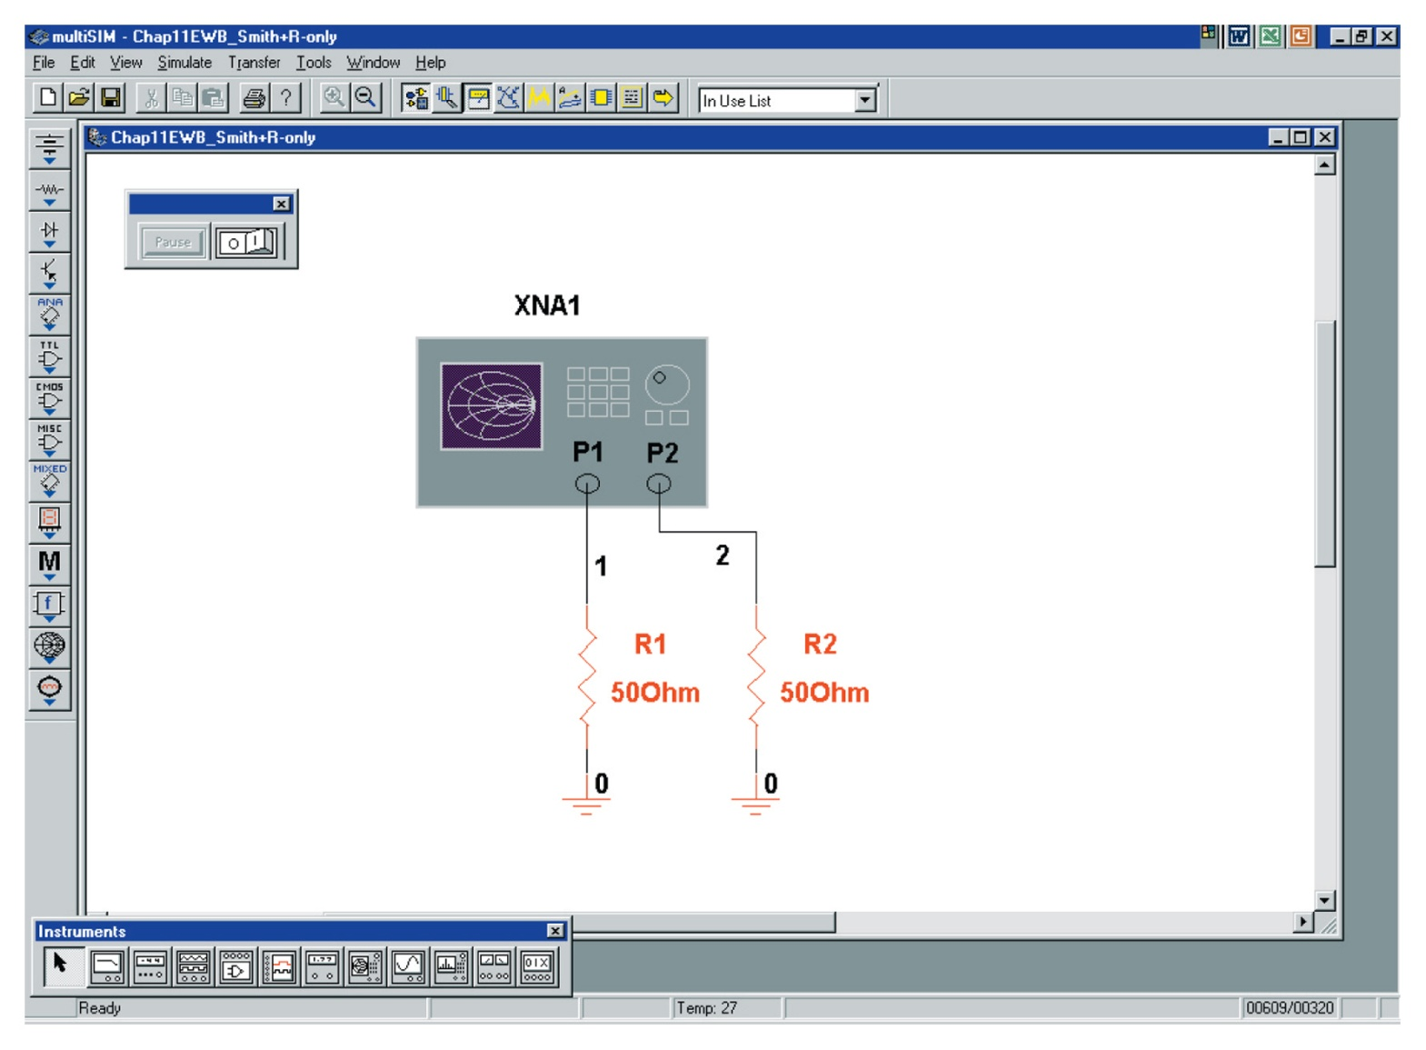
Figure 12-35 An example of using the Multisim Network Analyzer to analyze a 50-Ω resistor.

Slide 61
Figure 12-36 The Smith chart for the test of the 50- Ω resistor.

Slide 62
Figure 12-37 The Smith chart result for the simple RC network.

Slide 63
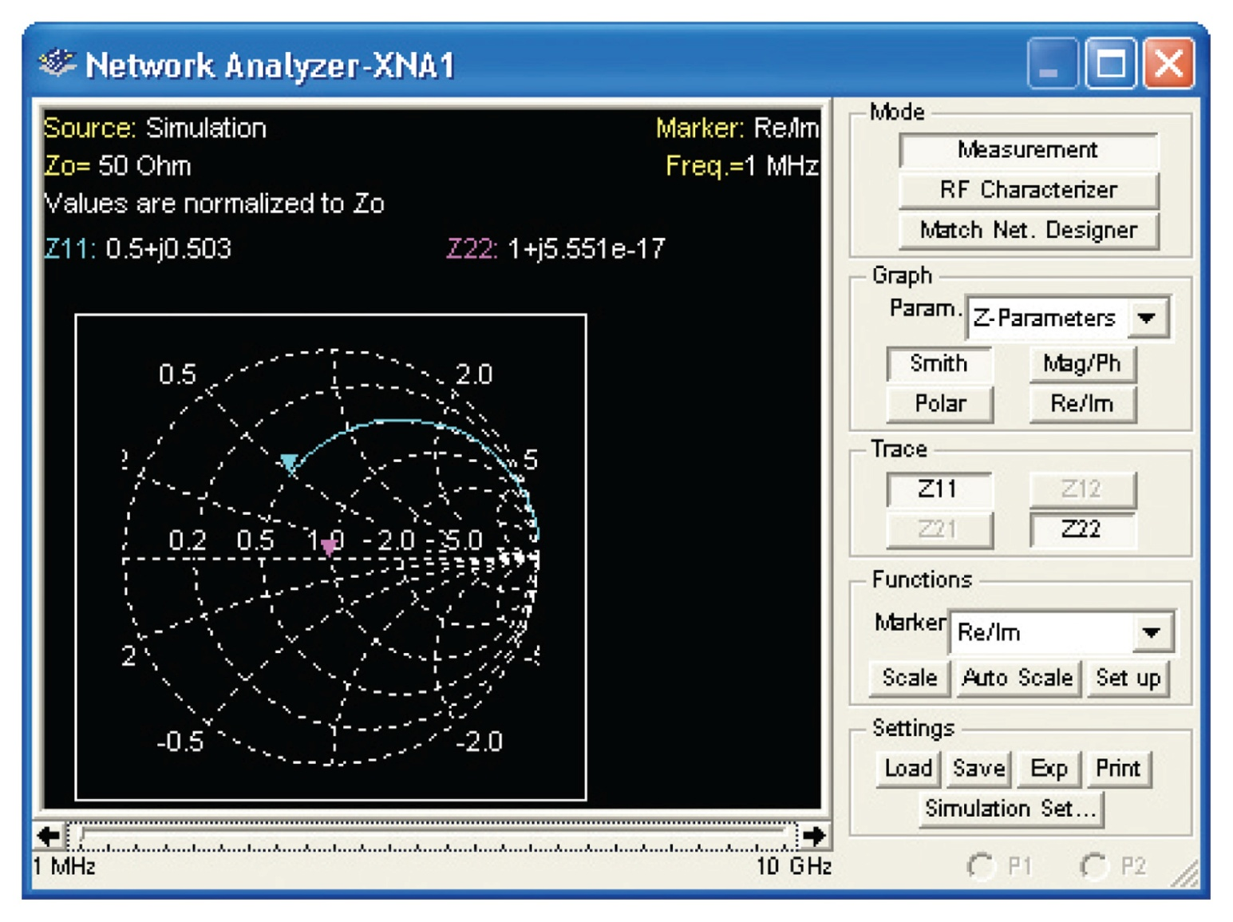
Figure 12-38 The Smith chart result for the simple RL network.

