Slide 1
EE 350 / ECE 490 Analog Communication Systems
Ch. 17 – Television

Slide 2
Objectives
Develop an understanding of a digital television system, including HDTV, SDTV, MPEG2, AC-3, and 8VSB
Develop an understanding of digital television transmission, reception, and monitoring
Describe the operation of a TV system, including the separation of audio and video functions
Explain the interlaced scanning process and transmitter/receiver synchronization
Calculate the effect between resolution and bandwidth
Describe the operation of a receiver using a detailed block diagram
Explain the basis of adding color without adding additional bandwidth to the signal
Describe the color CRT construction and operation
Analyze the audio system when the stereo sound feature is included
Explain the steps for troubleshooting a receiver system logically

Slide 3
17-1 Introduction
Developed in the 1920’s
Feasible 1930’s
Broadcasting 1940’s
One of the most powerful developments in communications, impacting nearly everyone’s life.

Slide 4
17-2 Digital Television
Basics of Digital Television: Video Signal
Basics of Digital Television: Audio Signal
Basics of Digital Television: Transmission
8VSB Exciter
Basics of Digital Television: Reception and Coverage

Slide 5
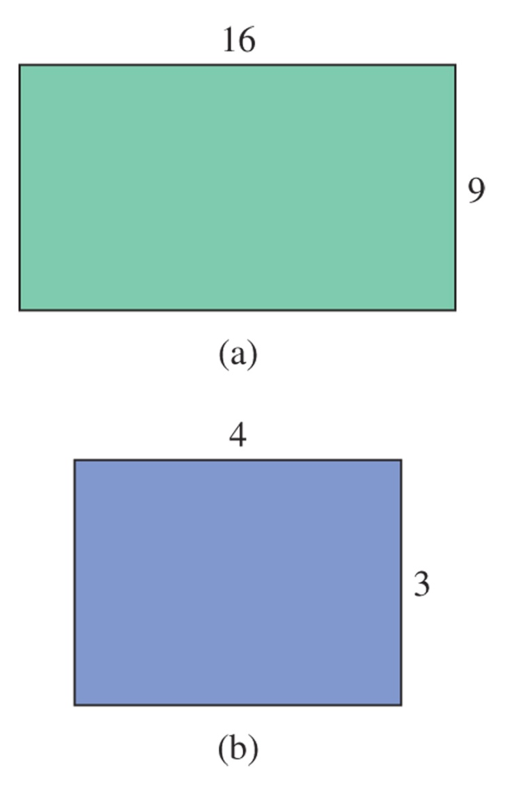
Screen Ratio
ATSC allows transmission of HDTV in the 16x9 screen format.
Digital Standard Definition Television (SDTV) is also supported allowing for transmission of programming in the 4x3 format at NTSC comparable resolution

Slide 6
Digital Video Signal
ITU-R 601 4:2:2 is used to sample analog component video at 3.375 MHz base rate.
10 bit sampling is used.
This results in a total of 270 Mbps of video data
MPEG2 compression is used to reduce that to less than 19 Mbps

Slide 7
Digital Audio
ATSC mandates using Dolby AC-3
This give 5.1 channels (5x 20kHz + 1x 120Hz)
Total is 5.184 Mbps
Compressed to 384 kbps data stream

Slide 8
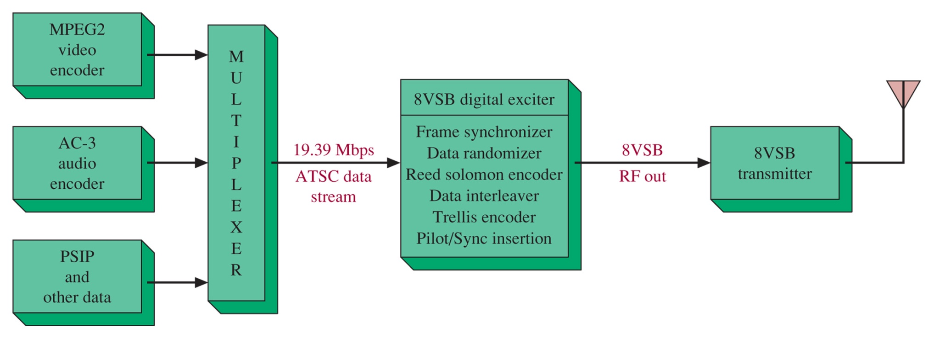
Digital Transmission
Figure 17-2 A block diagram of the ATSC digital transmission system.
Compressed MPEG2 video, AC-3 audio, and PSIP info are multiplexed into 19.39 Mbps data stream to feed the 8VSB exciter

Slide 9
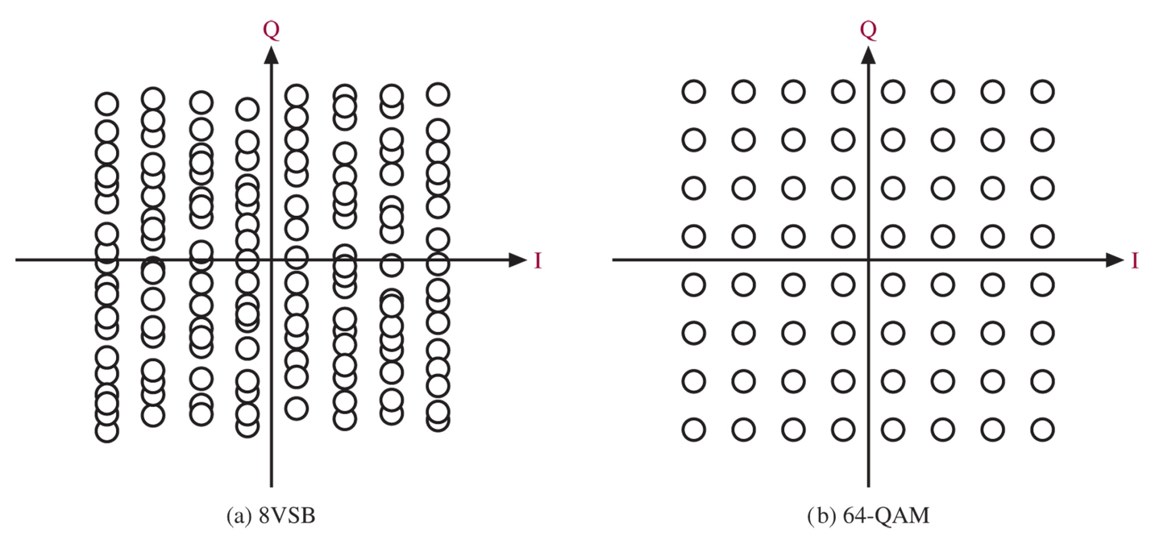
8VSB
Figure 17-3 (a) The 8VSB and (b) the 64-QAM constellations. (Courtesy of Harris Broadcast.)
Similar to QAM. Packs 3 bits into each “symbol” for transmission. This requires transmitting one of 8 levels (8VSB). The constellation looks similar to 64-QAM, but the receiver is simpler, and error rates are lower.

Slide 10
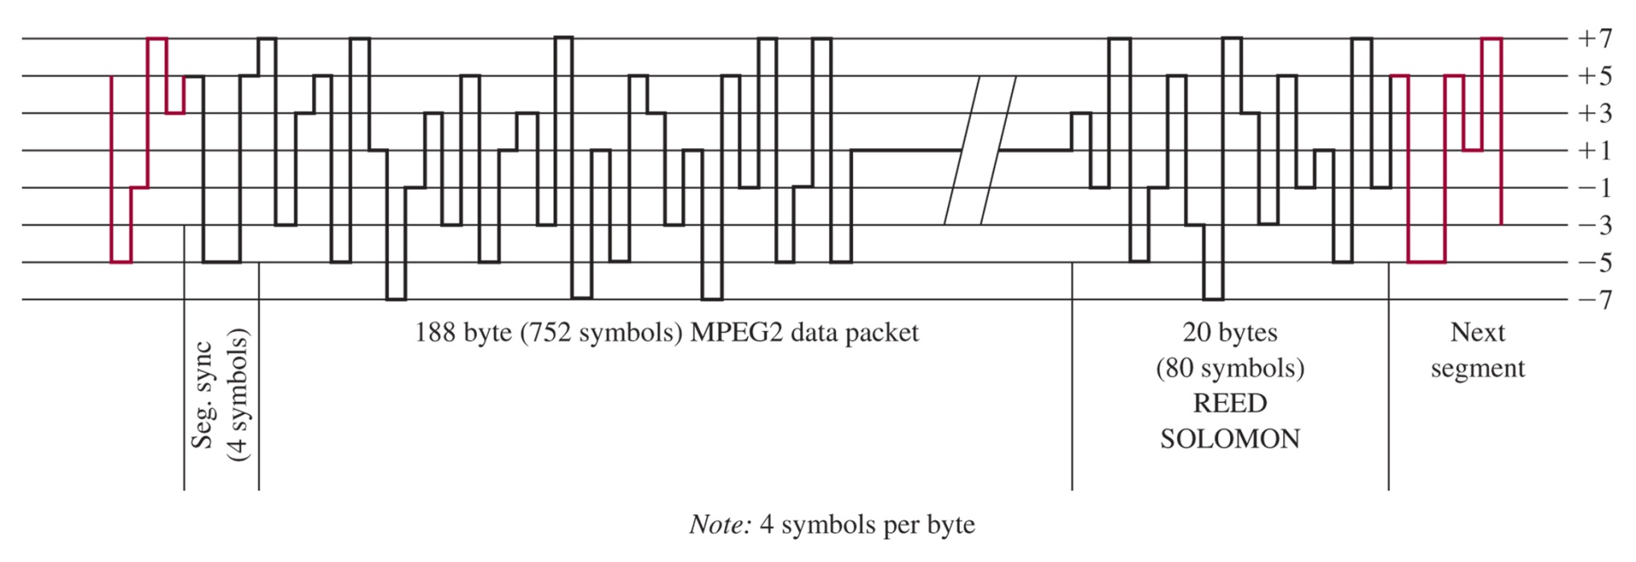
8VSB Exciter
Figure 17-4 The 8VSB segment sync. (Courtesy of Harris Broadcast.)

Slide 11
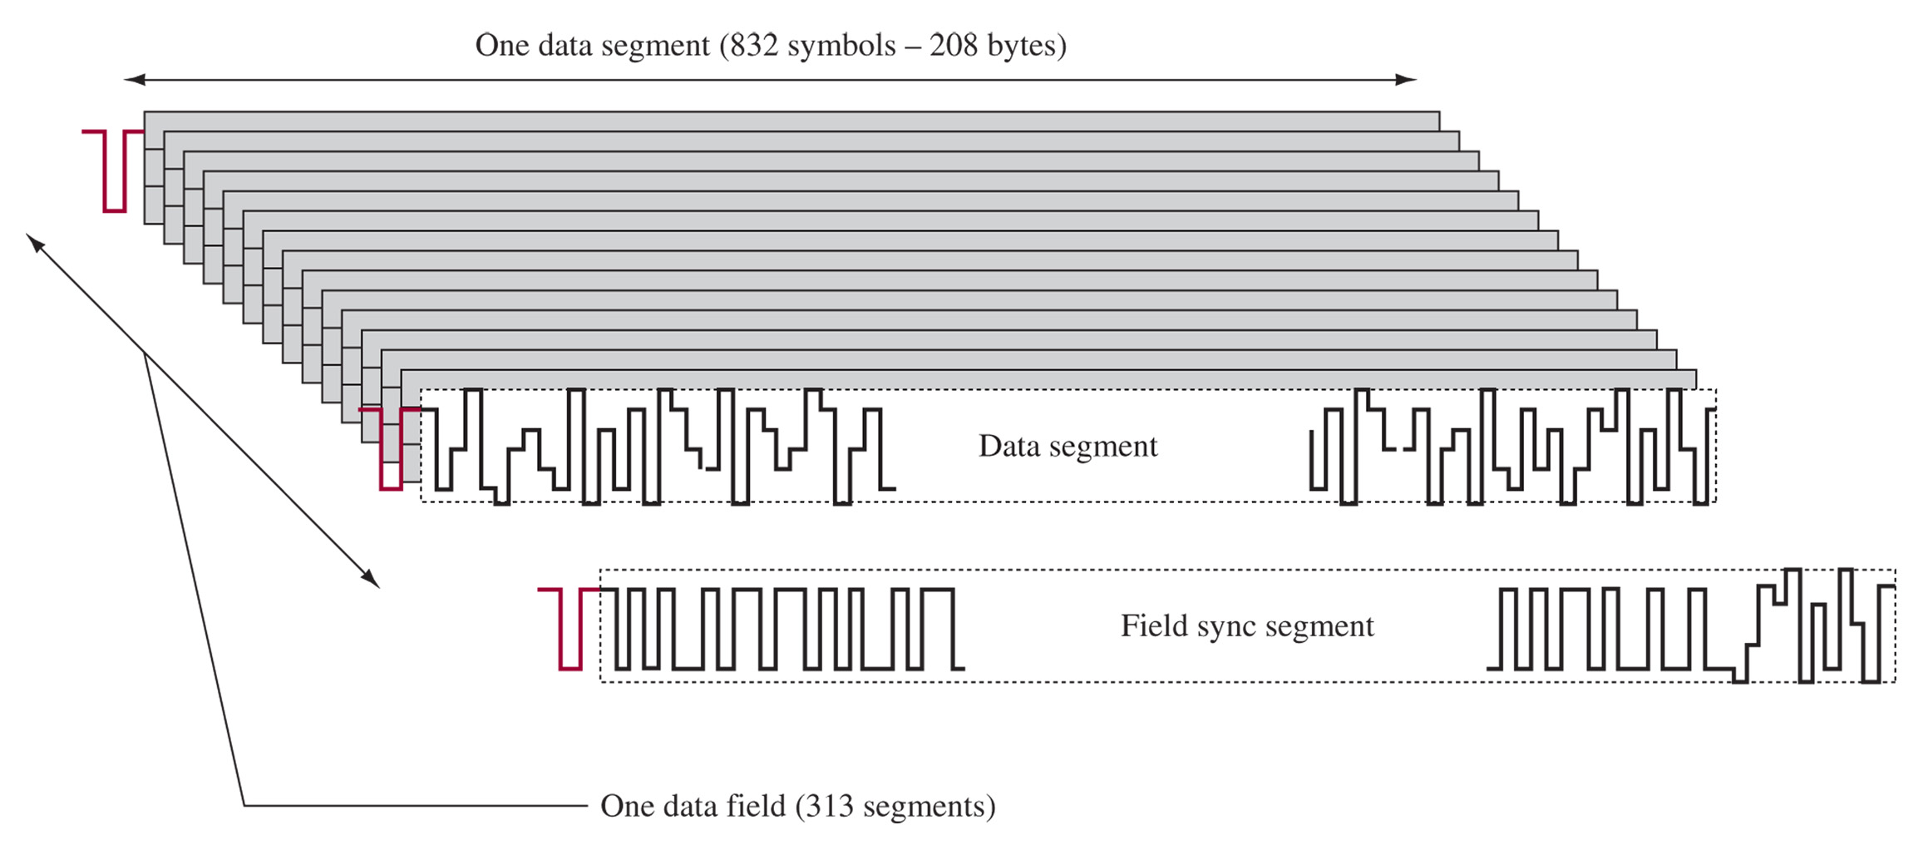
Frame Sync
Figure 17-5 The 8VSB frame sync. (Courtesy of Harris Broadcast.)

Slide 12
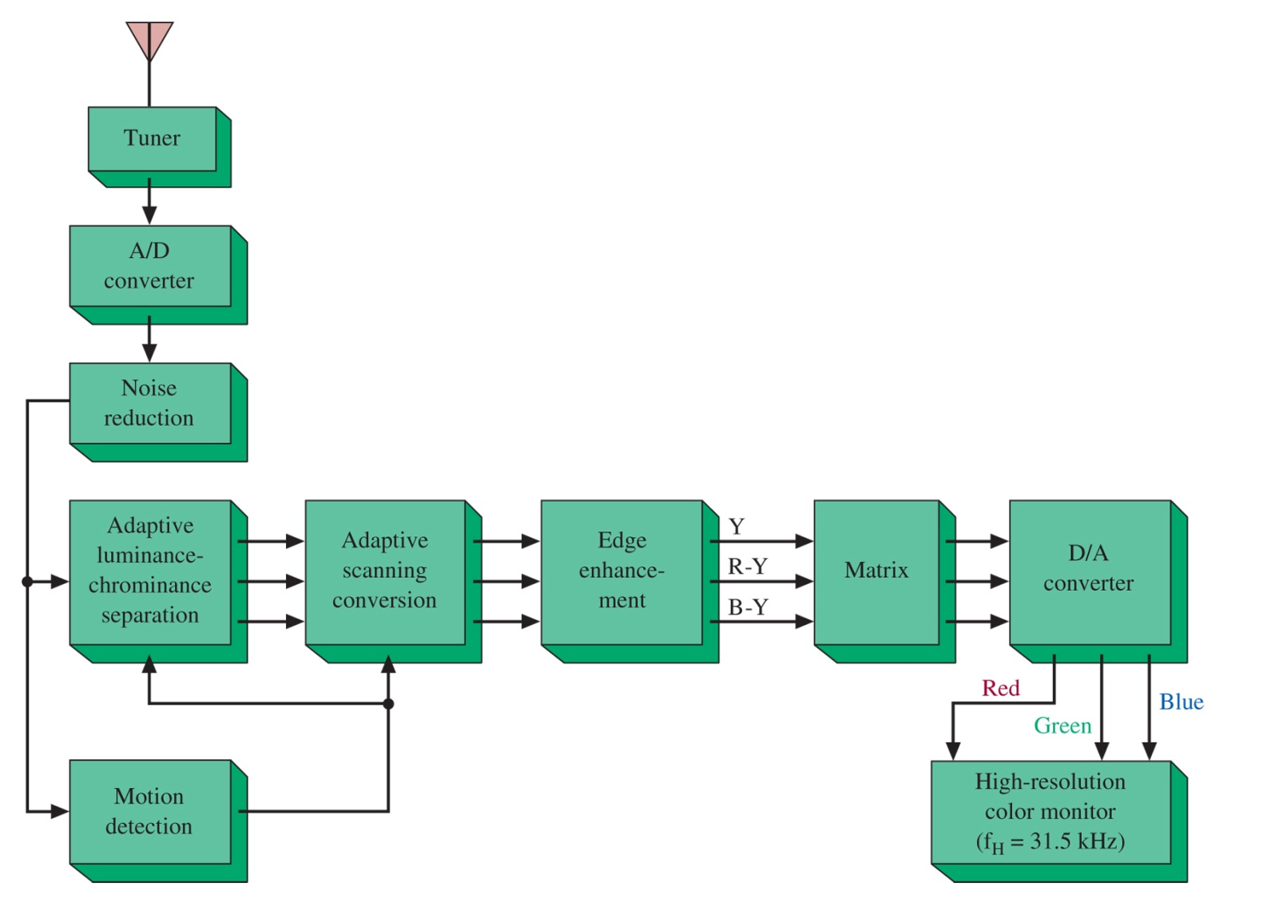
Digital Reception
Digital Video Format | Bit Rate (Mbps)
640 x 480 | 184
720 x 480 | 207
1280 x 720 | 553
1920 x 1080 | 1244
Figure 17-6 Digital TV processing.

Slide 13
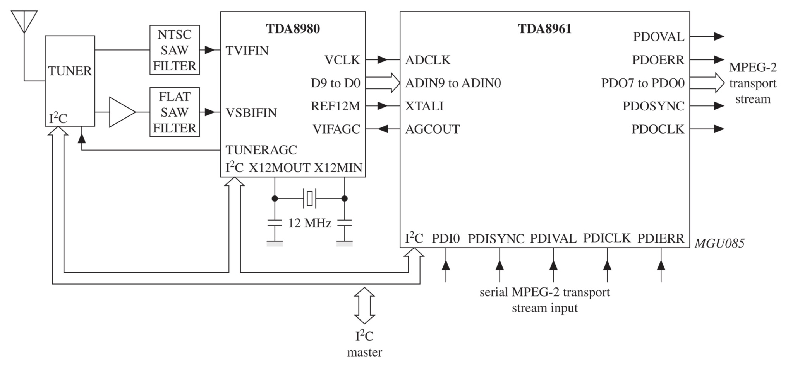
Figure 17-7 Front-end design for a hybrid TV system using the TDA8980 and TDA8961.

Slide 14
17-3 Monitoring the Digital Television Signal
Verifying the Multiplexed Data Path
PSIP – Program and System Information Protocol
Real-Time DTV Analysis and Measurements
The 8VSB Modulation Detail
Multipath Detail
DTV RF Spectrum

Slide 15
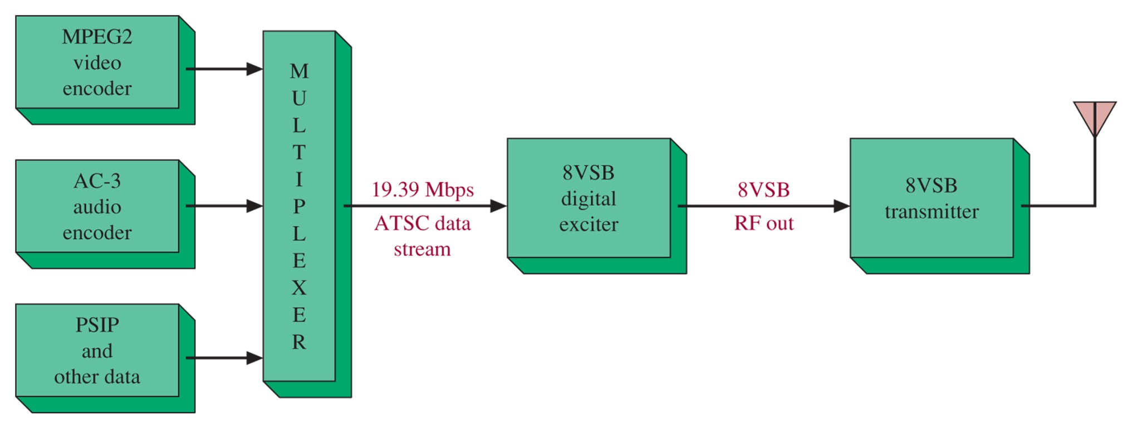
ATSC Transmission Verification
Figure 17-8 A simplified block diagram of the ATSC digital transmission system.

Slide 16
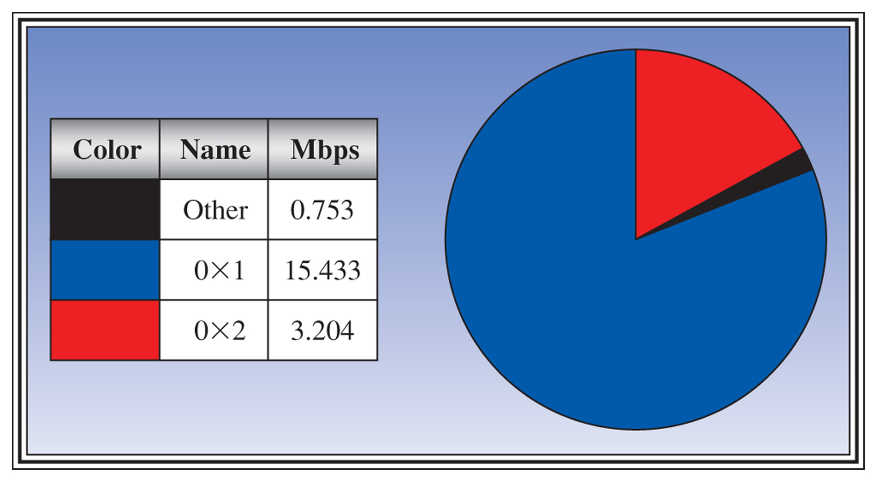
Figure 17-9 An example of using a pie chart to monitor the ATSC digital transport stream.

Slide 17
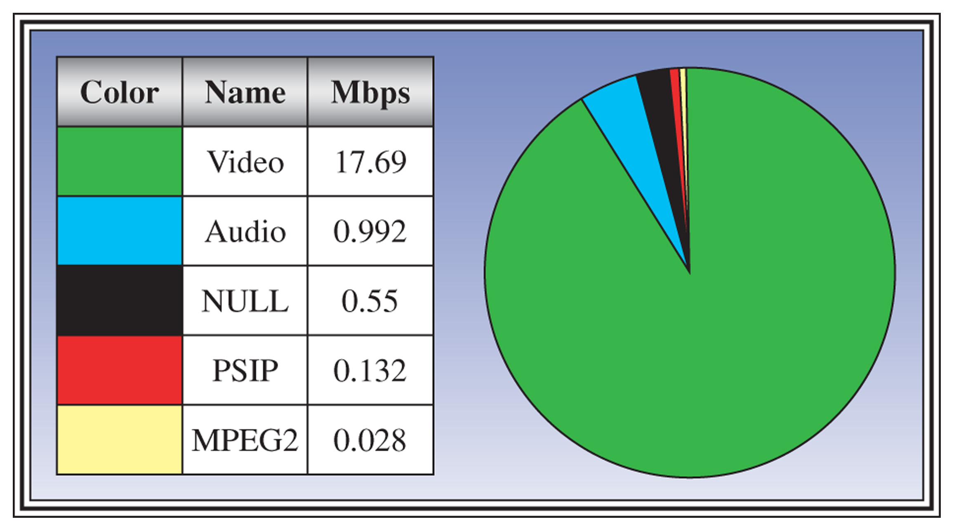
Figure 17-10 An example of the pie chart used to monitor the PSIP and other multiplexed data.

Slide 18
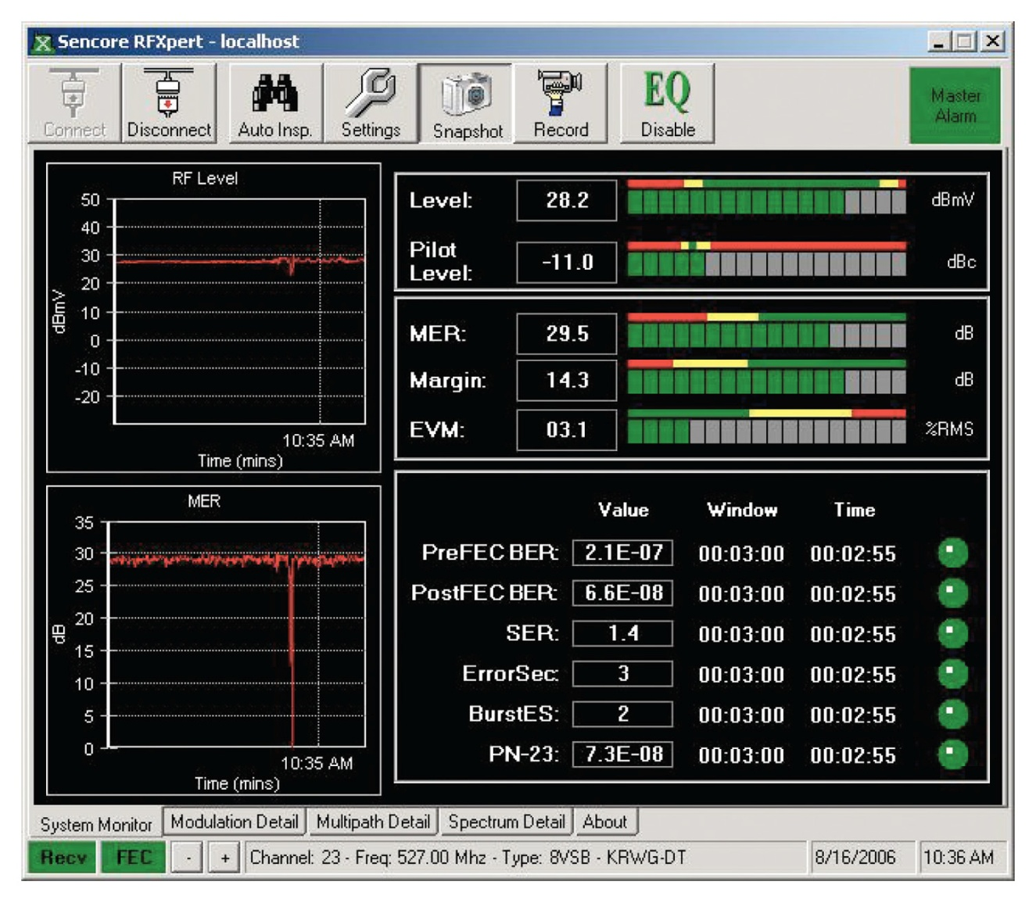
Figure 17-11 The system monitor screen for a DTV signal.

Slide 19
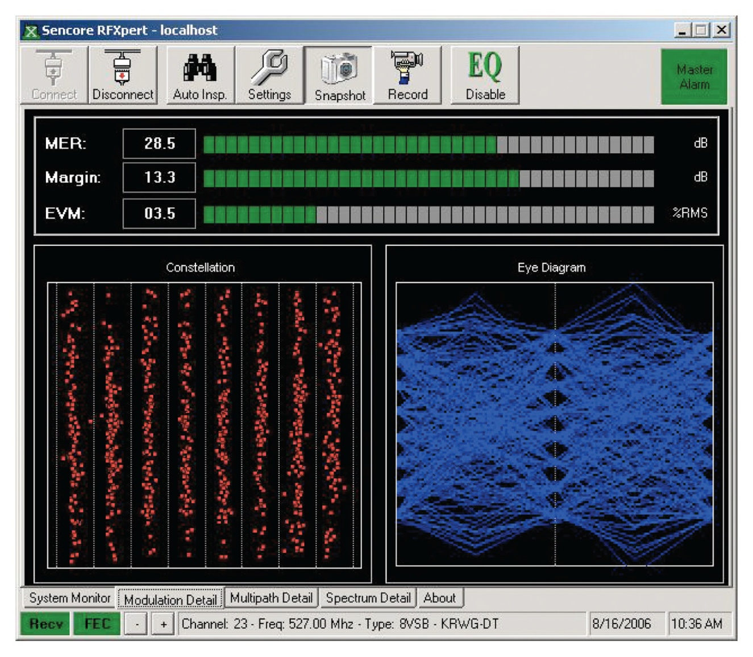
8VSB Modulation Detail
Seven eyes should be open
Constellation should show eight perfectly vertical lines
Figure 17-12 The display of the 8VSB constellation and the 8VSB eye diagram as displayed in the modulation detail screen.

Slide 20
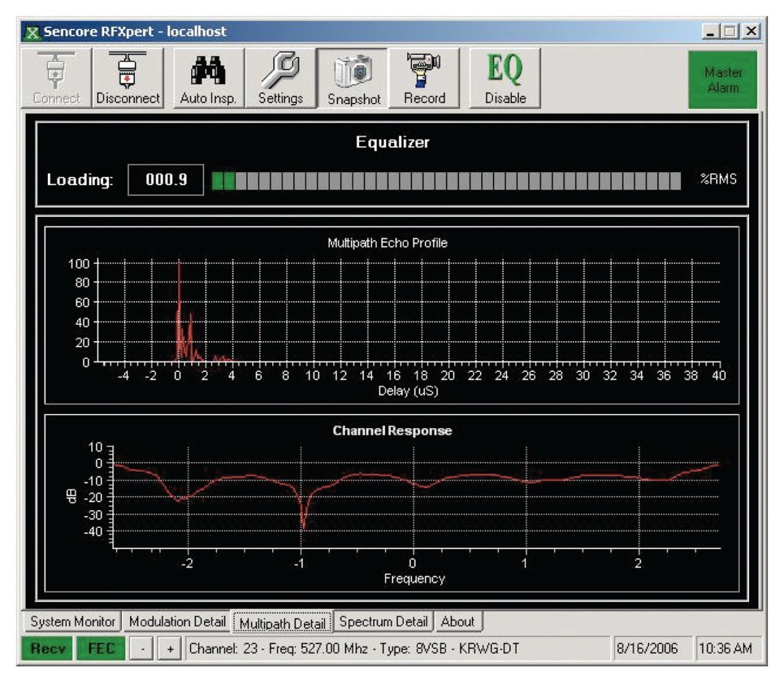
Multipath Detail
Figure 17-13 The multipath detail screen showing a minimal amount of multipath echo.

Slide 21
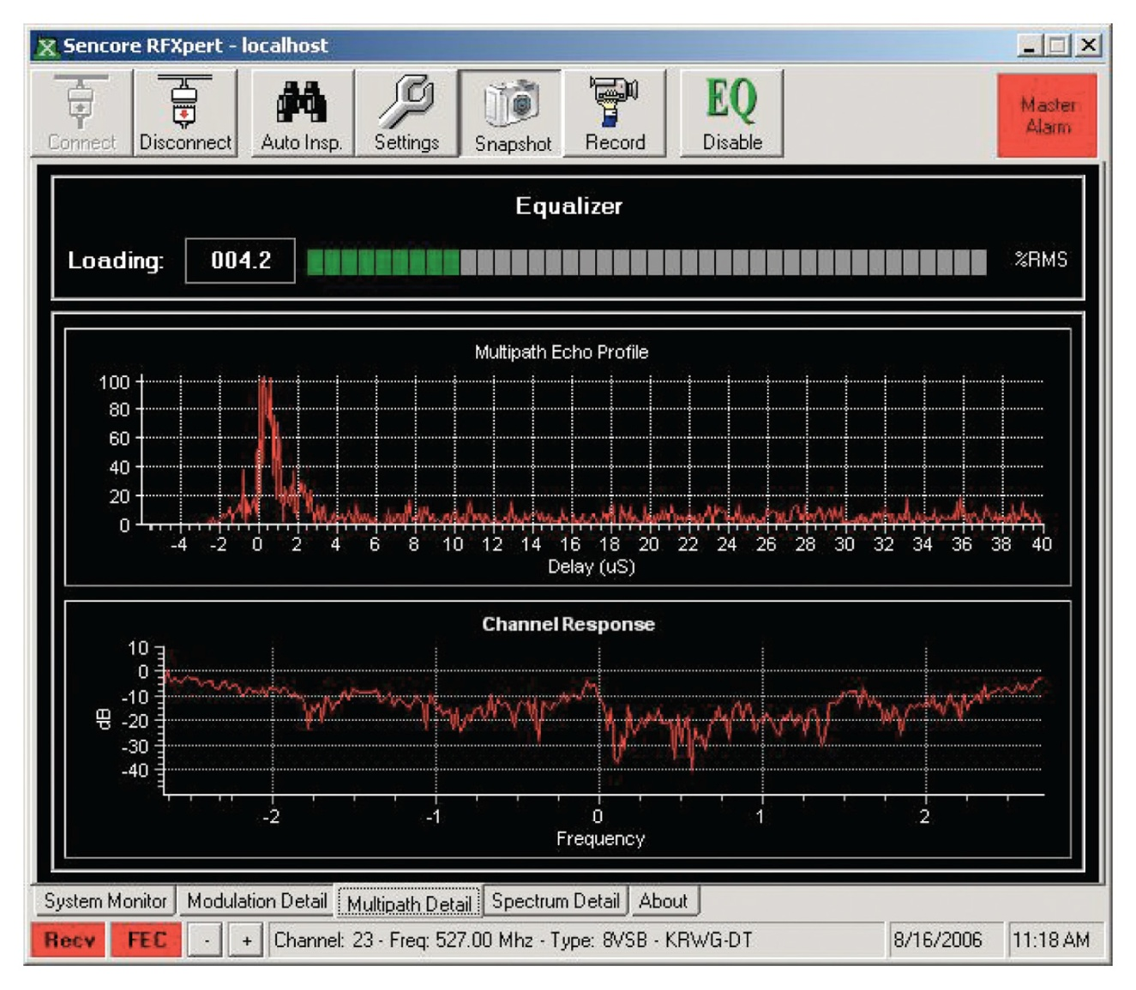
Multipath Echo
Figure 17-14 The multipath detail screen showing a significant amount of multipath echo.

Slide 22
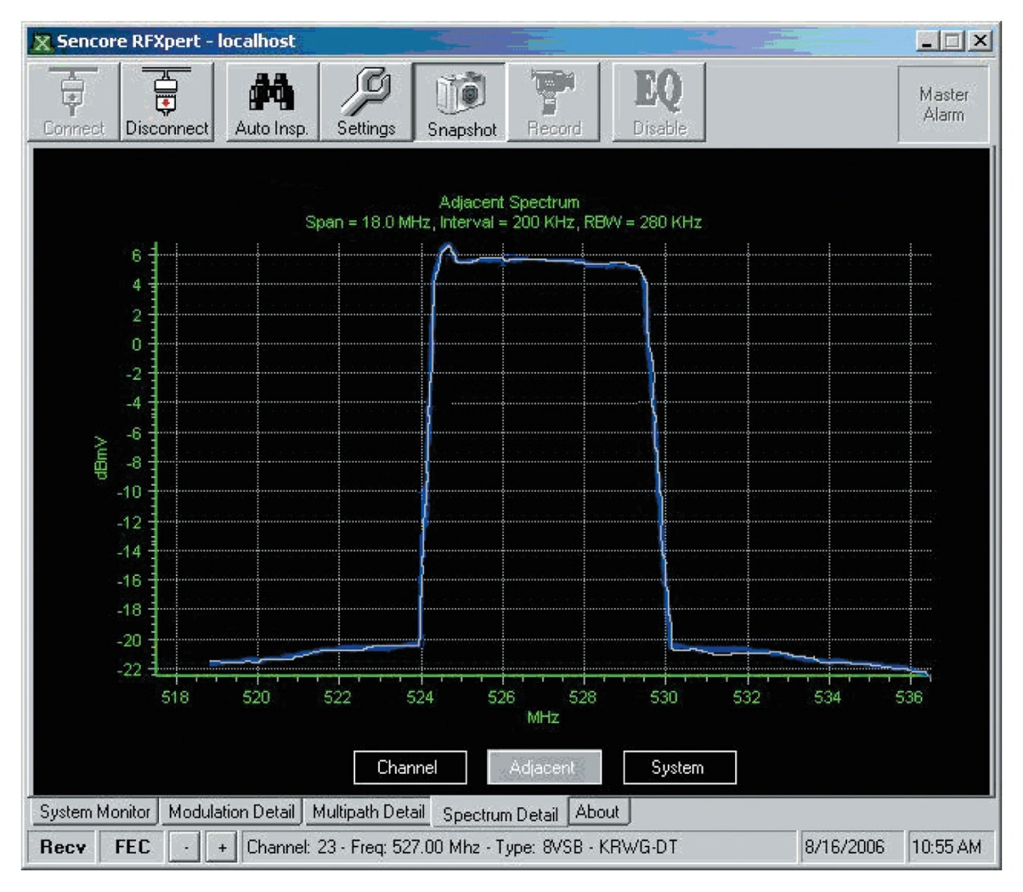
DTV RF Spectrum
The Spectrum is flat across the 6 MHz bandwidth (thanks to the randomizer).
Bump at beginning is from the pilot (.31 MHz into spectrum)
This is channel 23 (524 – 530 MHz)
Figure 17-15 The RF spectrum for a DTV signal.

Slide 23
17-4 NTSC Transmitter Principles
Audio is FM modulated on a +/- 25 kHz deviation transmitting 30-15 kHz audio signals (not at noise resistant as FM radio)
Video is AM modulated onto carrier
This keeps audio and video from interfering with each other during reception

Slide 24
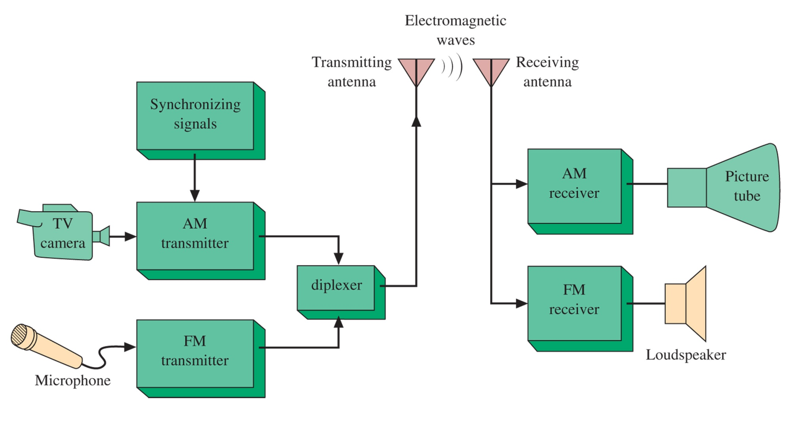
Figure 17-16 Simplified TV system.

Slide 25
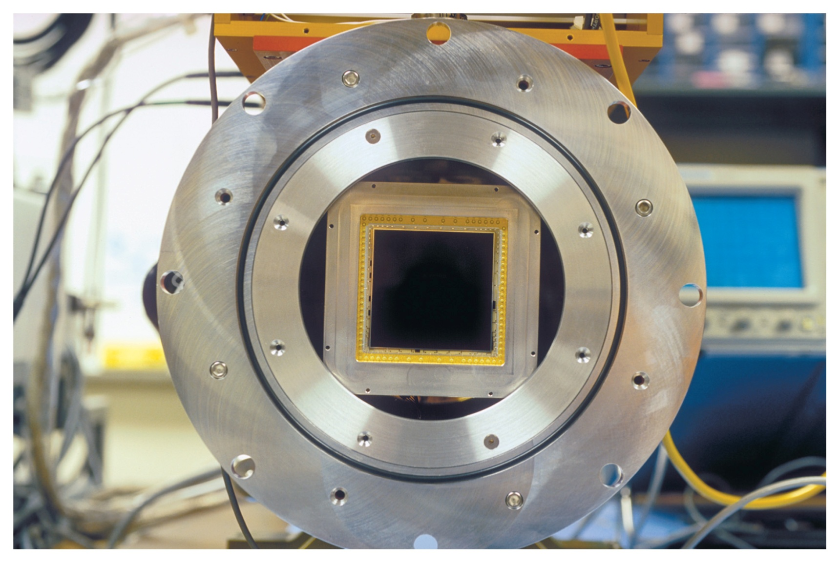
CCD
Figure 17-17 An example of a CCD imaging device. (Courtesy of Hamaqmatsu Corp.)

Slide 26
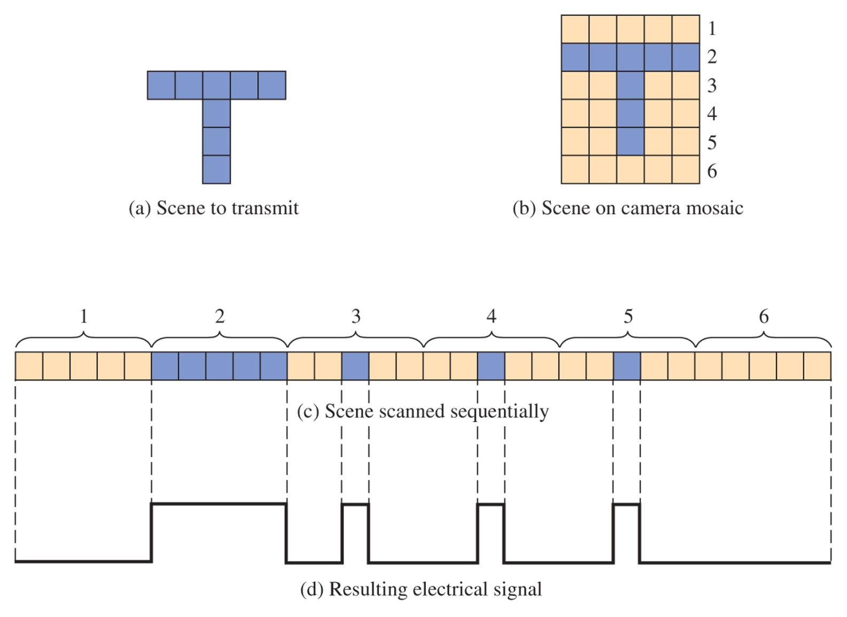
Figure 17-18 Simplified scanning representation.

Slide 27
17-5 NTSC Transmitter/Receiver Synchronization
Interlaced Scanning
Horizontal Synchronization
Vertical Synchronization
NTSC uses 525 (485 visible) horizontal lines

Slide 28
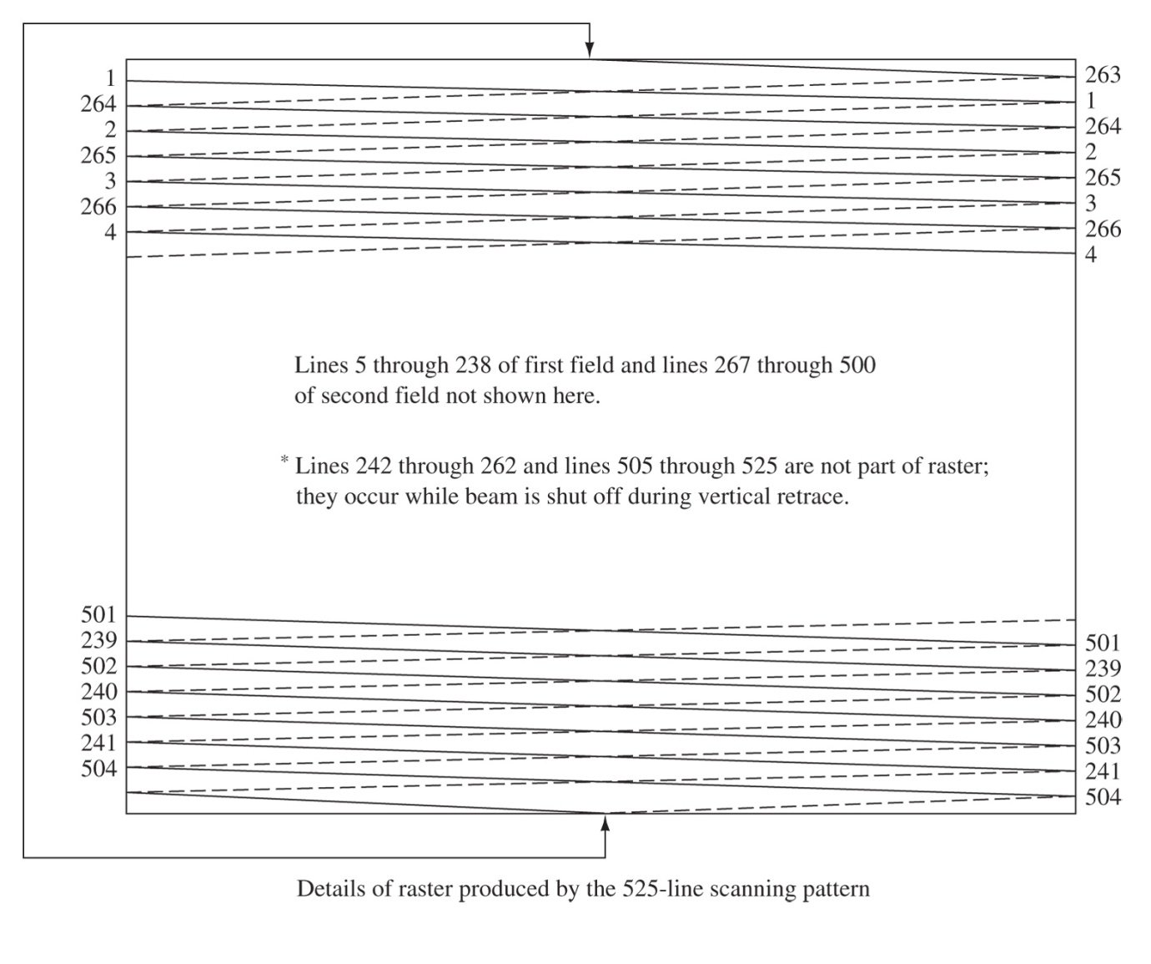
Interlaced Scanning
Figure 17-19 Interlaced scanning is a trick to prevent noticeable “flicker”

Slide 29
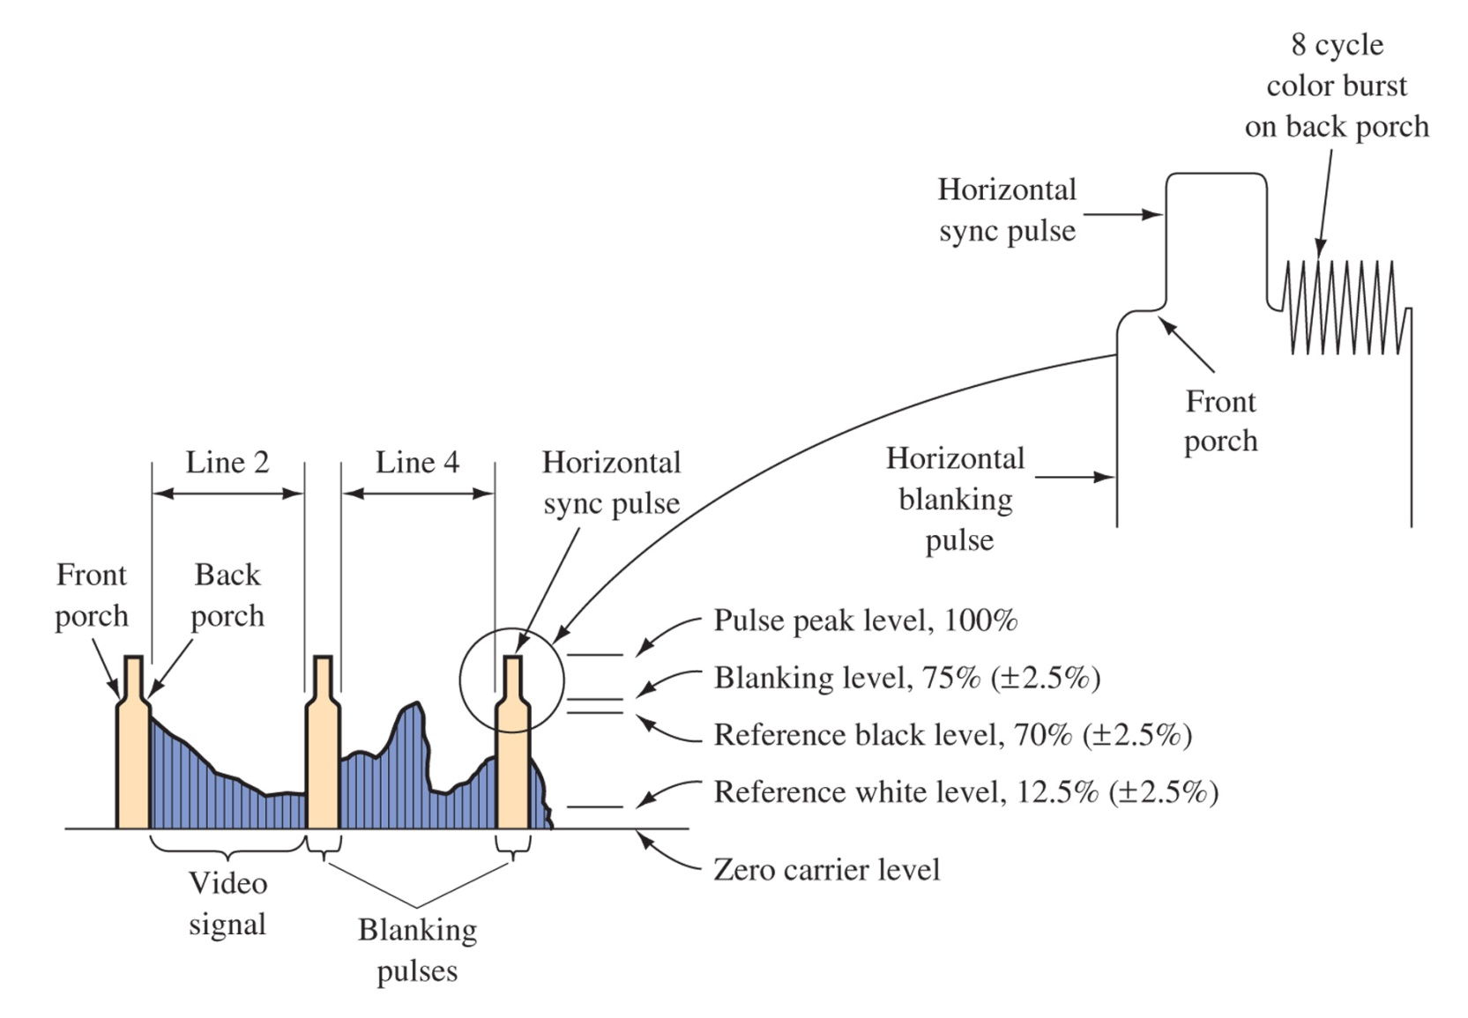
Horizontal Sync
Figure 17-20 Horizontal sync pulses. Occur at rate 525 x 30 = 15.75 kHz

Slide 30
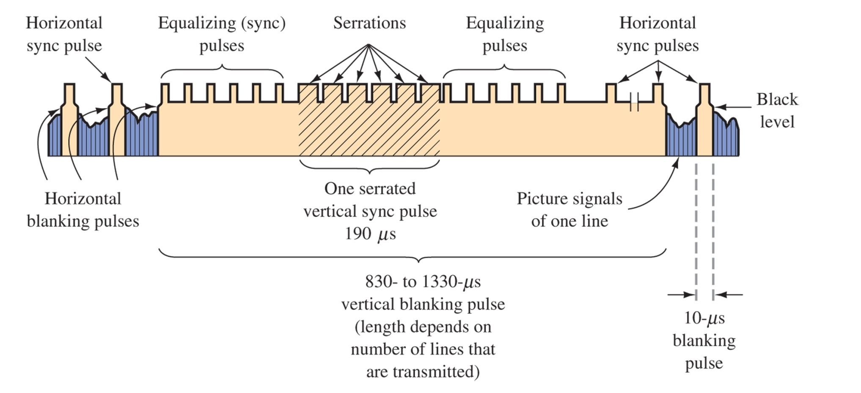
Vertical Sync
Figure 17-21 Vertical retrace interval video signal.

Slide 31
17-6 Resolution
Maximum modulation is 4 MHz
Horizontal lines yield about .7 x 485 or 339 lines of resolution
Number of vertical lines is 4MHz x 53.5 us x 2 = 428

Slide 32
17-7 The NTSC Television Signal
Figure 17-22 Transmitted TV signal. Considered Vestigial Sideband Operation

Slide 33
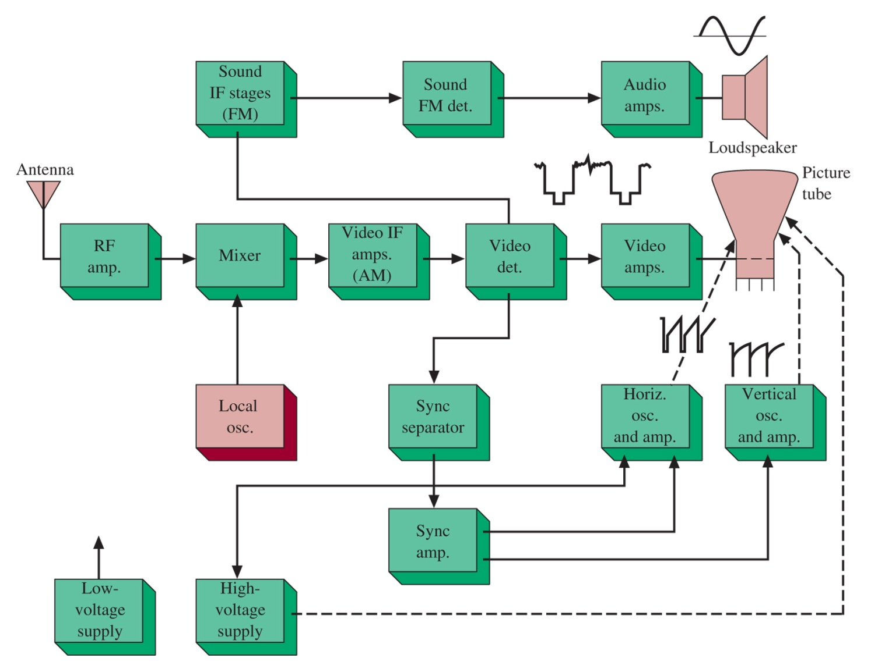
Figure 17-23 TV receiver block diagram.
17-8 Television Receivers

Slide 34
17-9 The Front End and IF Amplifiers
IF Amplifiers
Stagger Tuning
SAW Filters
IF Amplifier Response
Wavetraps

Slide 35
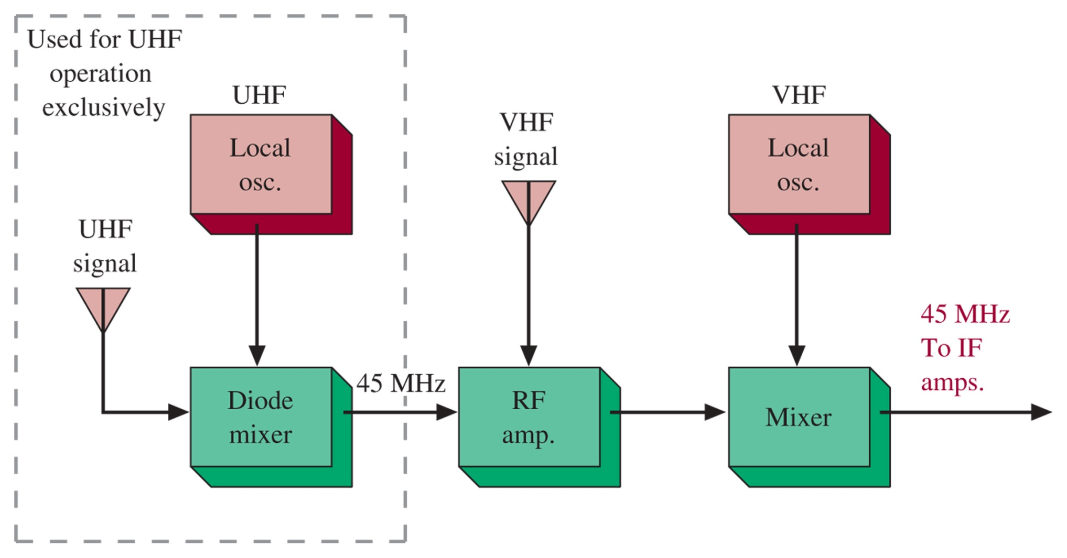
Figure 17-24 VHF/UHF tuner block diagram.
Only UHF or VHF operates at once, not simultaneously. IF amplifies both video and sound

Slide 36
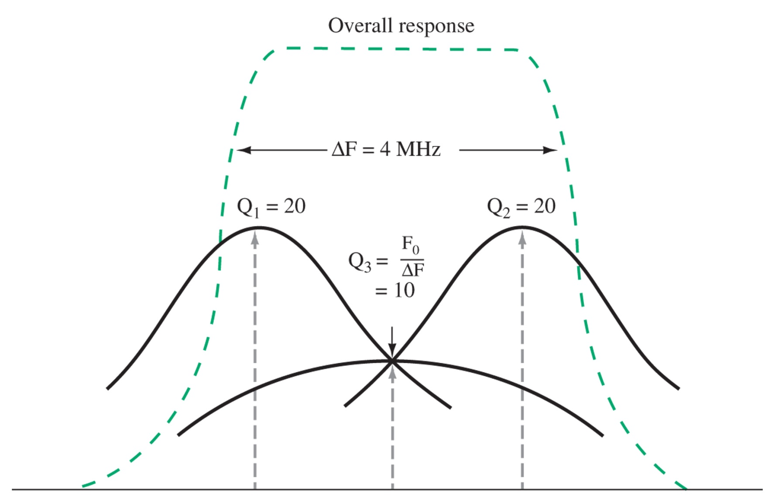
Stagger Tuning
Figure 17-25 Stagger tuning. For wideband performance, three LC tuned circuits are cascaded to obtain the desired response. Note that the passband is only 4 MHz, this compensates for the vestigial sideband at the lower end of the spectrum.

Slide 37
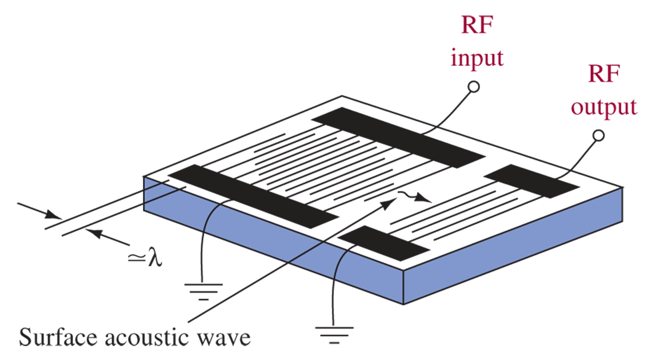
SAW Filters
Figure 17-26 SAW filter. Use piezoelectric materials to create a mechanical oscillation

Slide 38
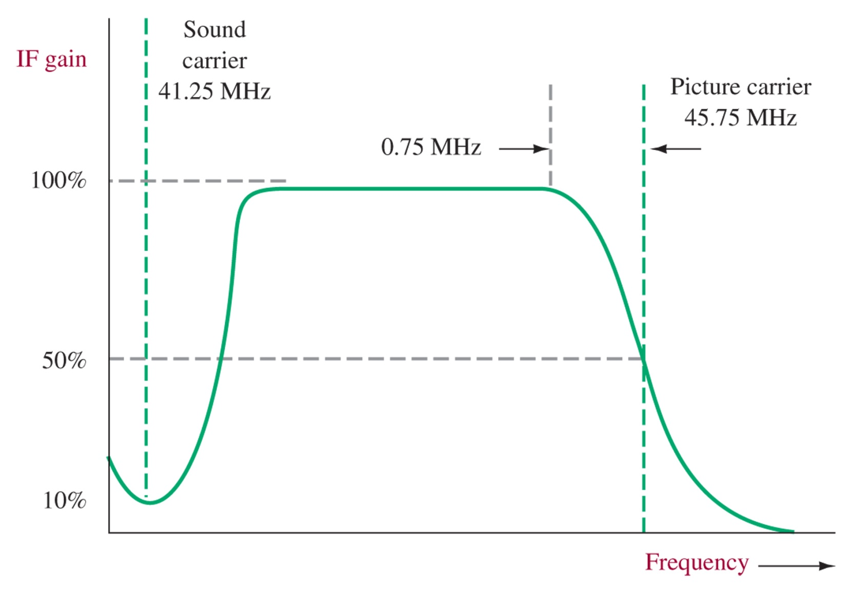
IF Amplifier Response
Figure 17-27 Ideal IF response curve. Sharp attenuation of the sound carrier to prevent interference.

Slide 39
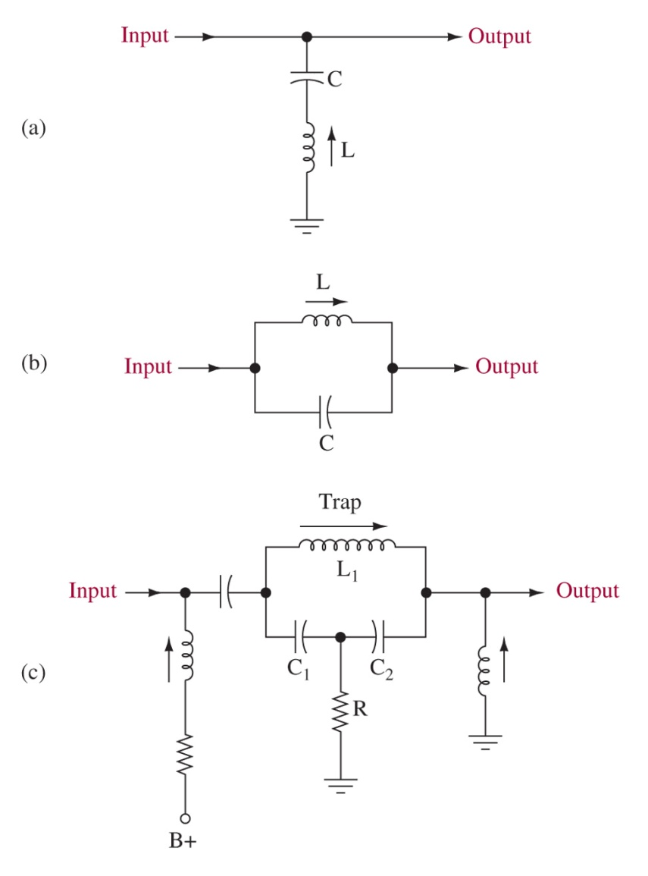
Wavetraps
A high-Q bandstop circuit is used to attenuate the
Figure 17-28 Wavetraps.

Slide 40
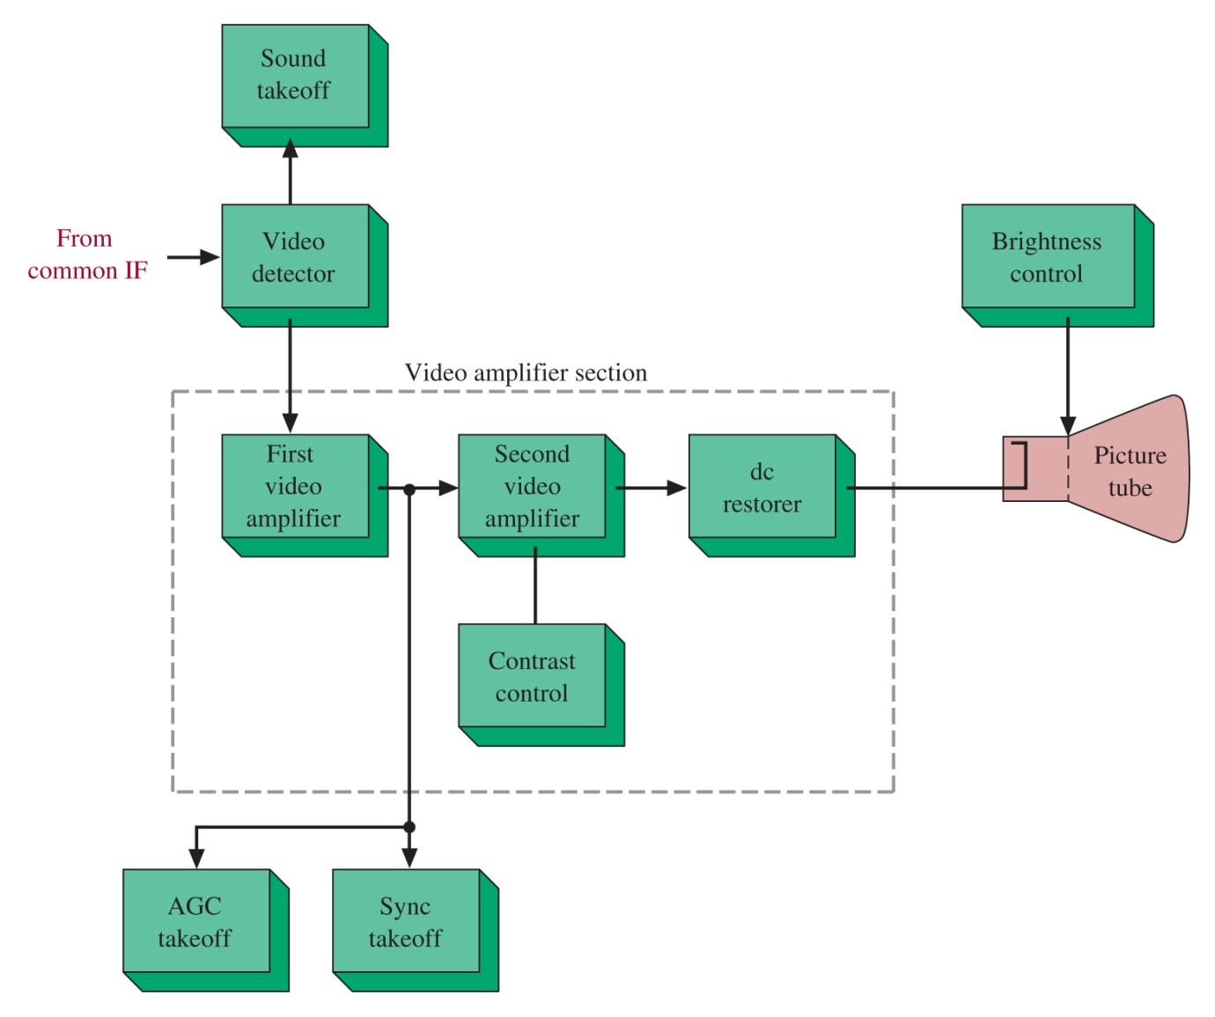
Figure 17-29 Video section block diagram.
17-10 The Video Section

Slide 41
17-11 Sync and Deflection
Horizontal Deflection and High Voltage
Horizontal Deflection Circuit

Slide 42
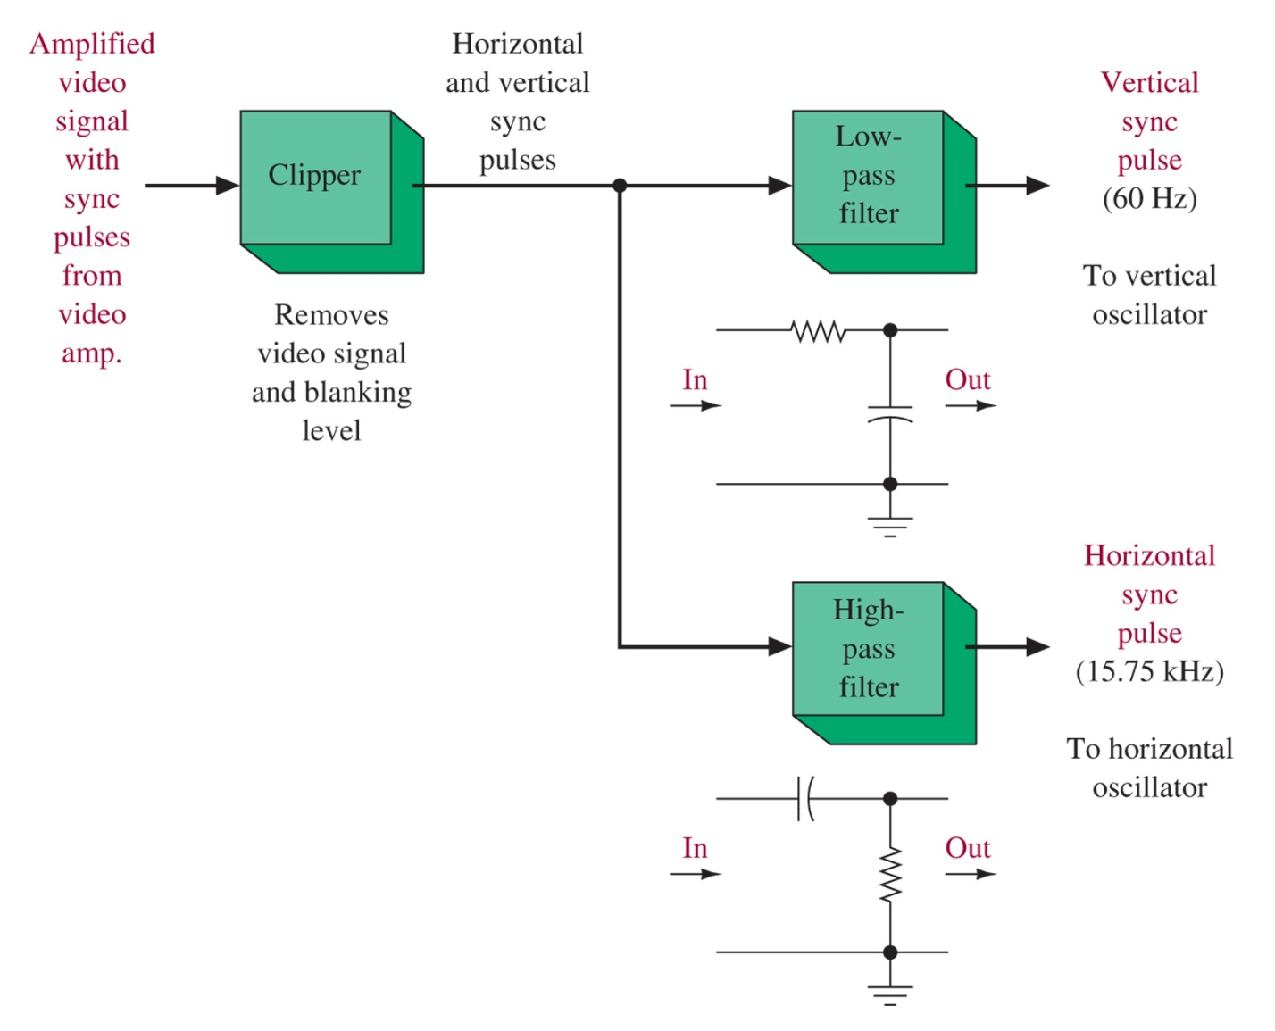
Figure 17-30 Sync separator.

Slide 43
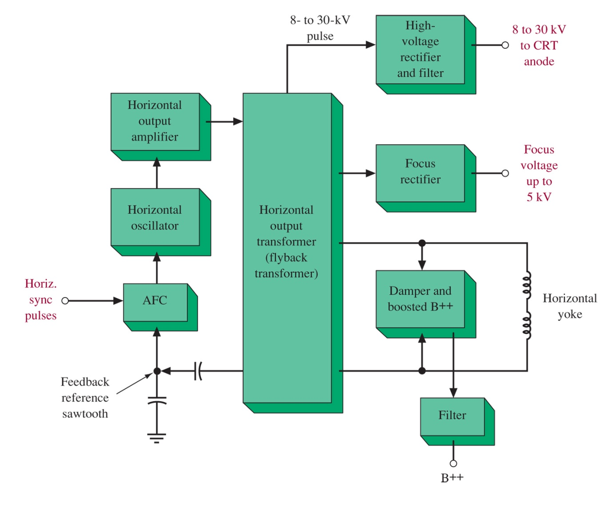
Figure 17-31 Horizontal deflection block diagram.

Slide 44
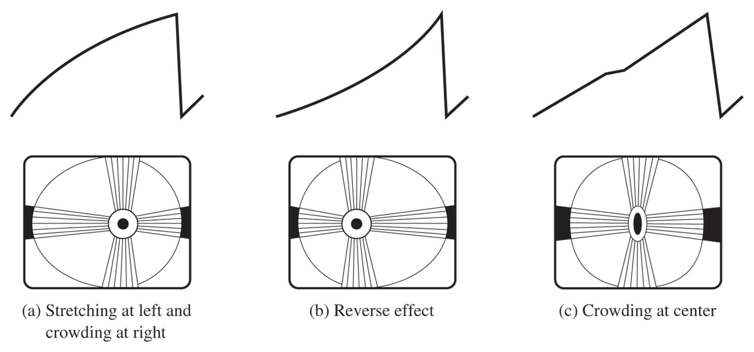
Figure 17-32 Nonlinear horizontal scanning. (From Bernard Grob, Basic Television Principles and Servicing, 4th ed., 1977; Courtesy of McGraw-Hill, Inc., New York.)

Slide 45
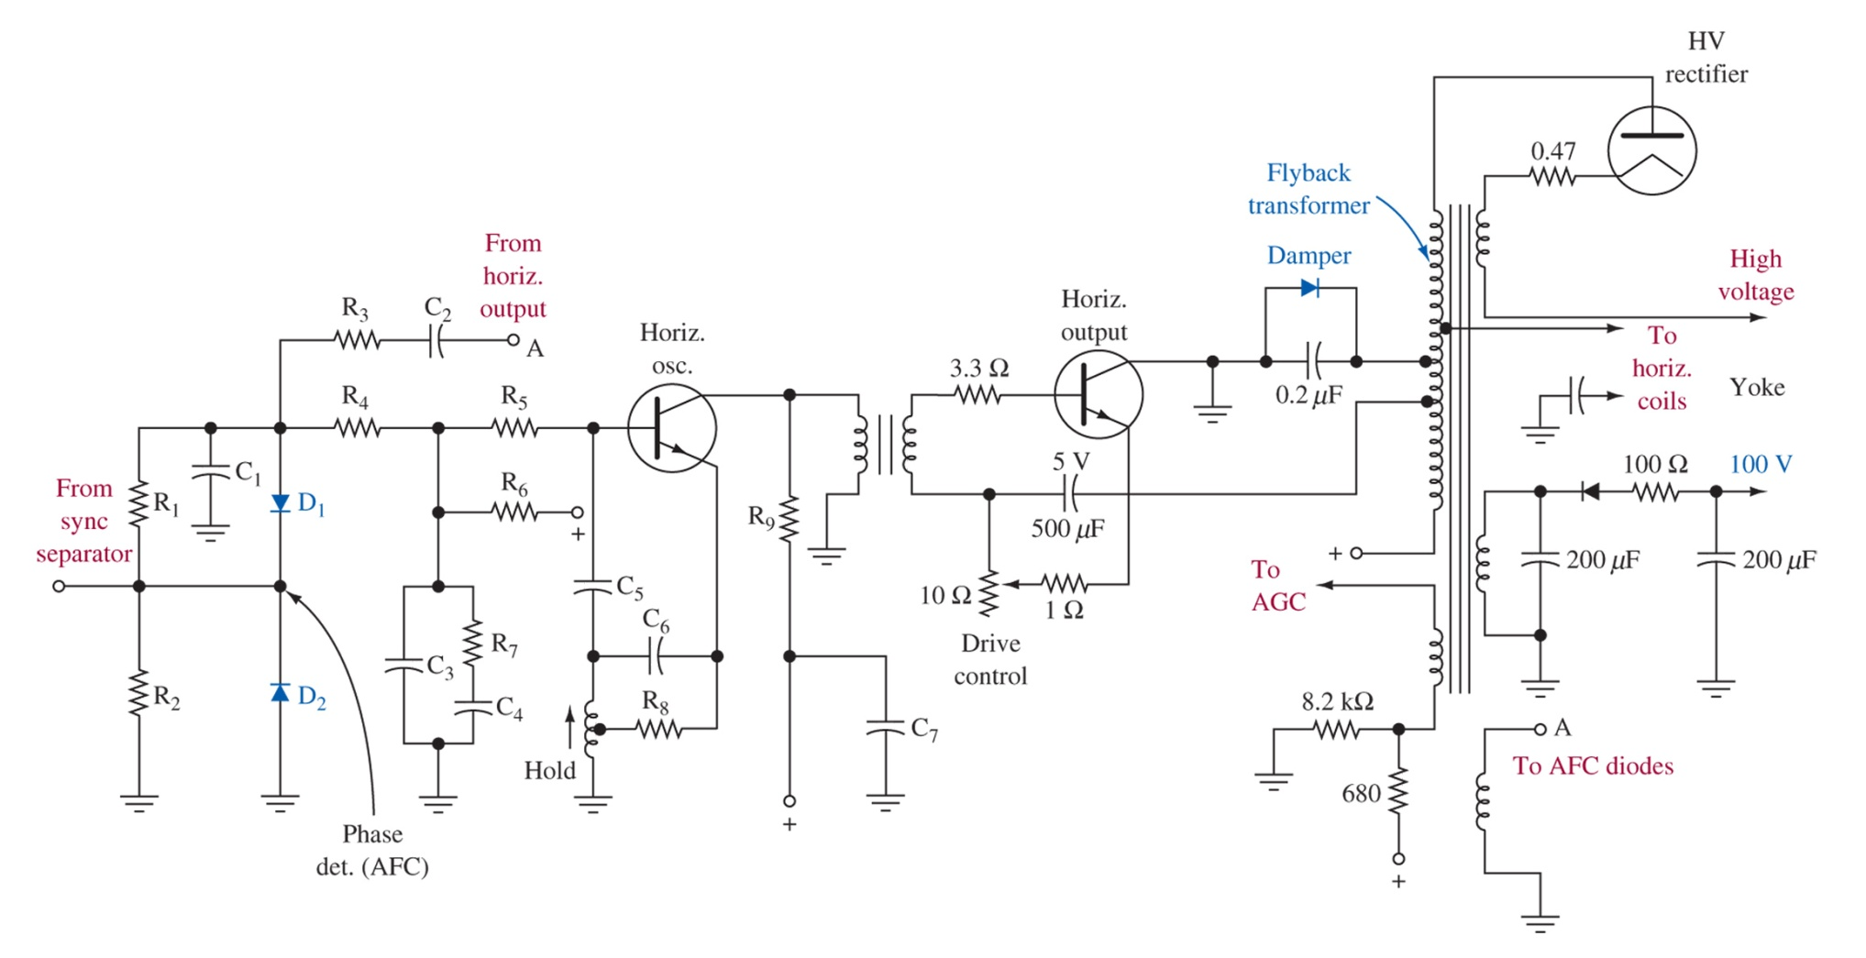
Figure 17-33 Horizontal system schematic.

Slide 46
17-12 Principles of NTSC Color Television
Color Receiver Block Diagram
The Color CRT and Convergence

Slide 47
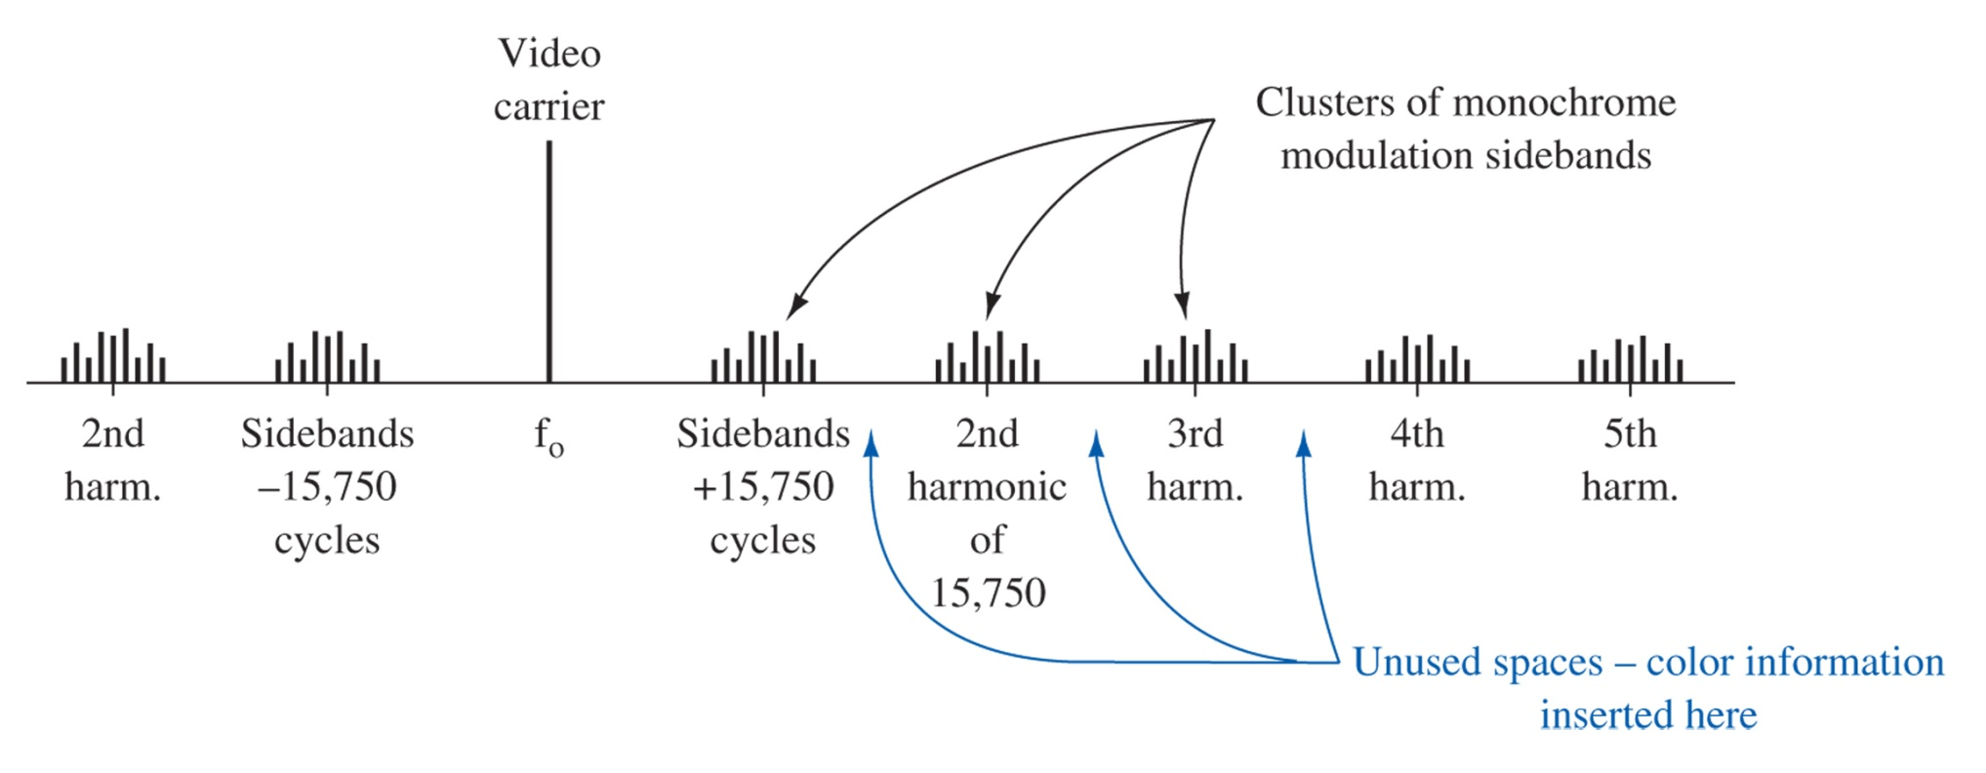
Figure 17-34 Interleaving process.

Slide 48
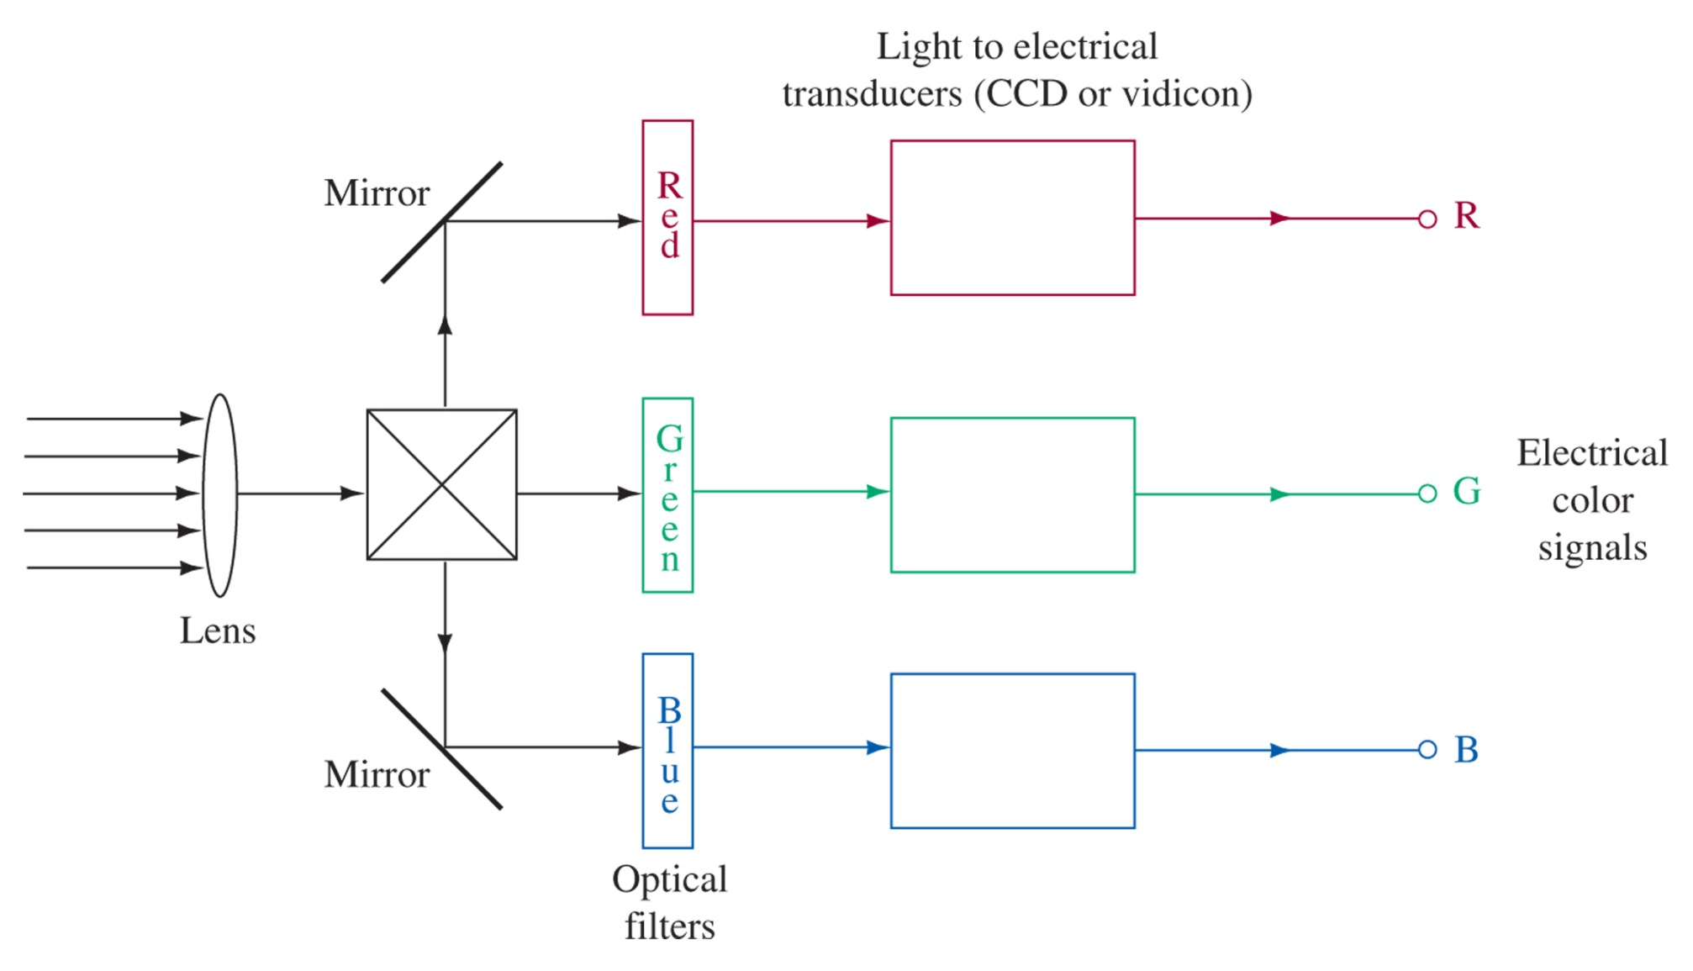
Figure 17-35 Generating the electrical color signals (color camera).

Slide 49
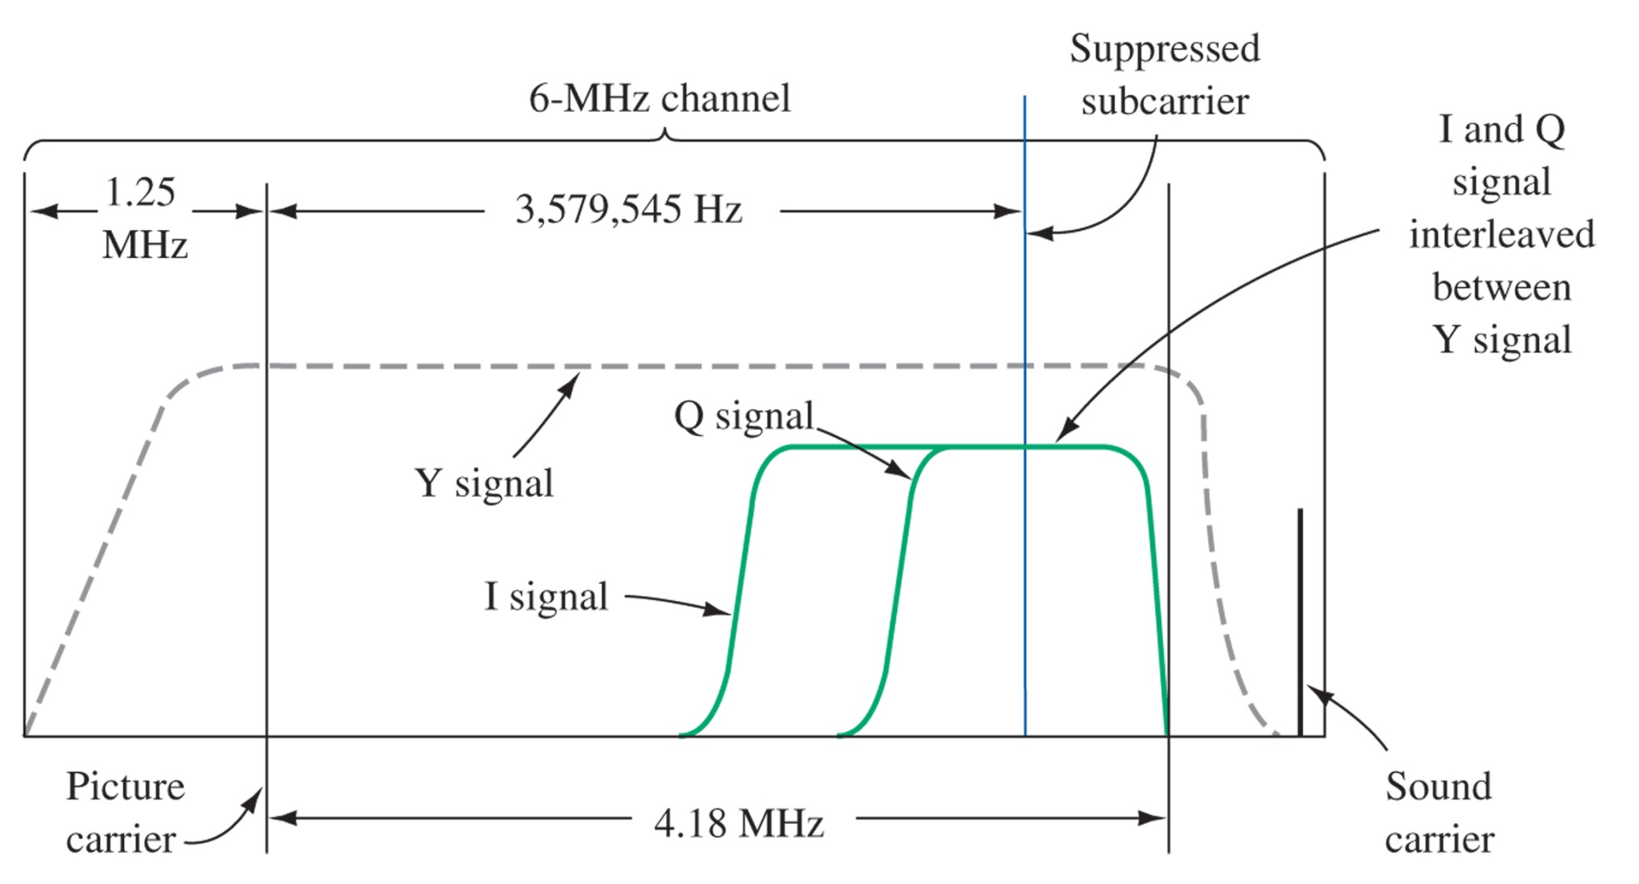
Figure 17-36 Composite color TV transmission.

Slide 50
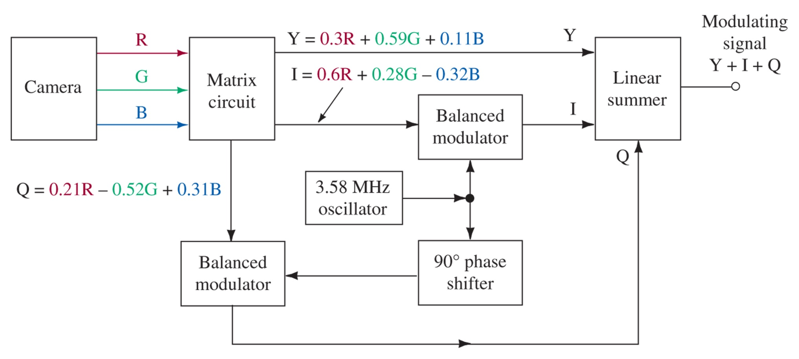
Figure 17-37 The composite color modulating signal.

Slide 51
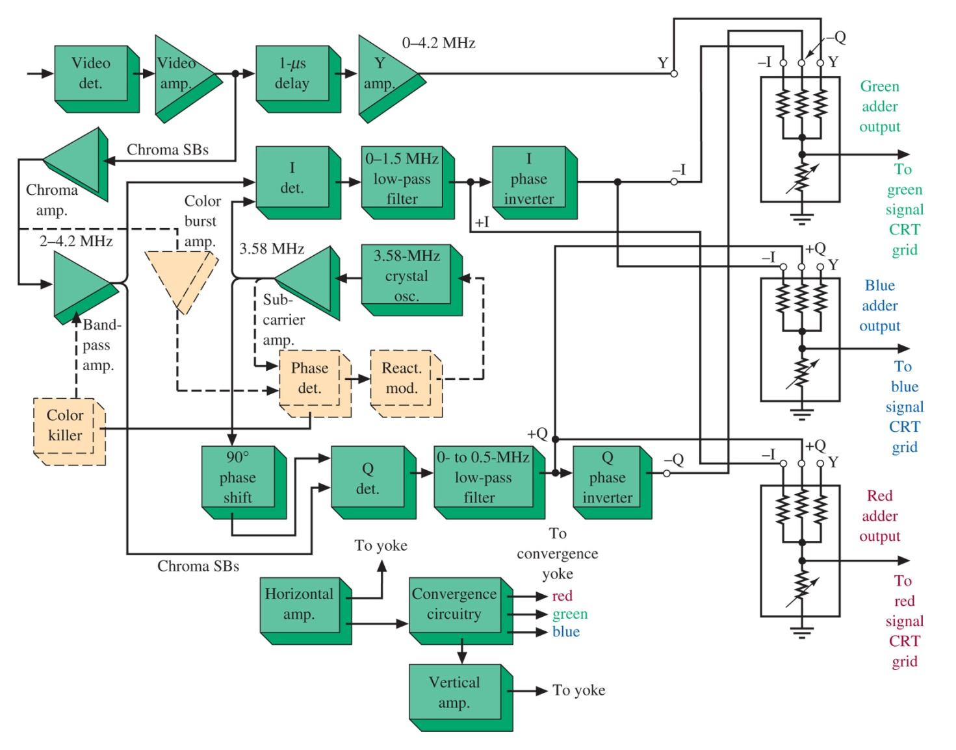
Figure 17-38 Color receiver block diagram.

Slide 52
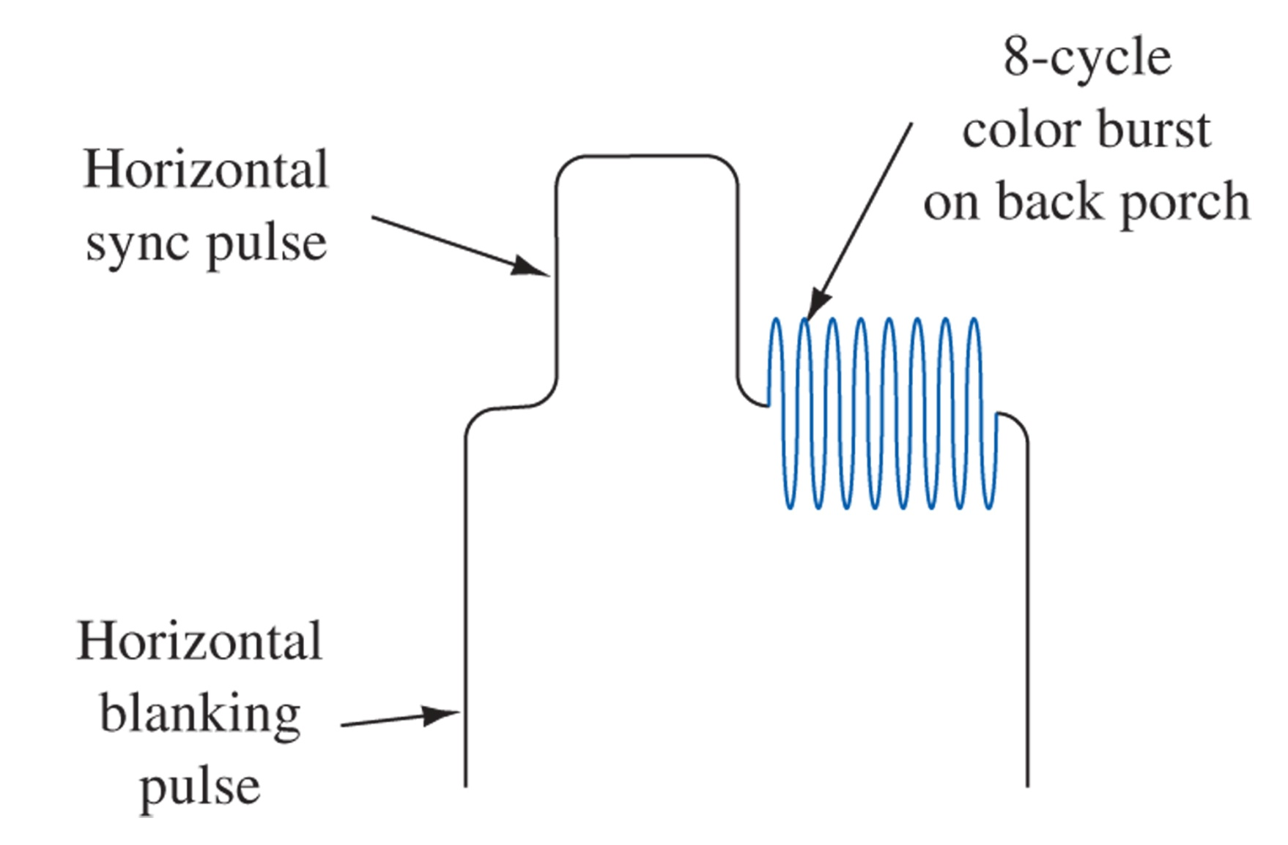
Figure 17-39 Color burst.

Slide 53
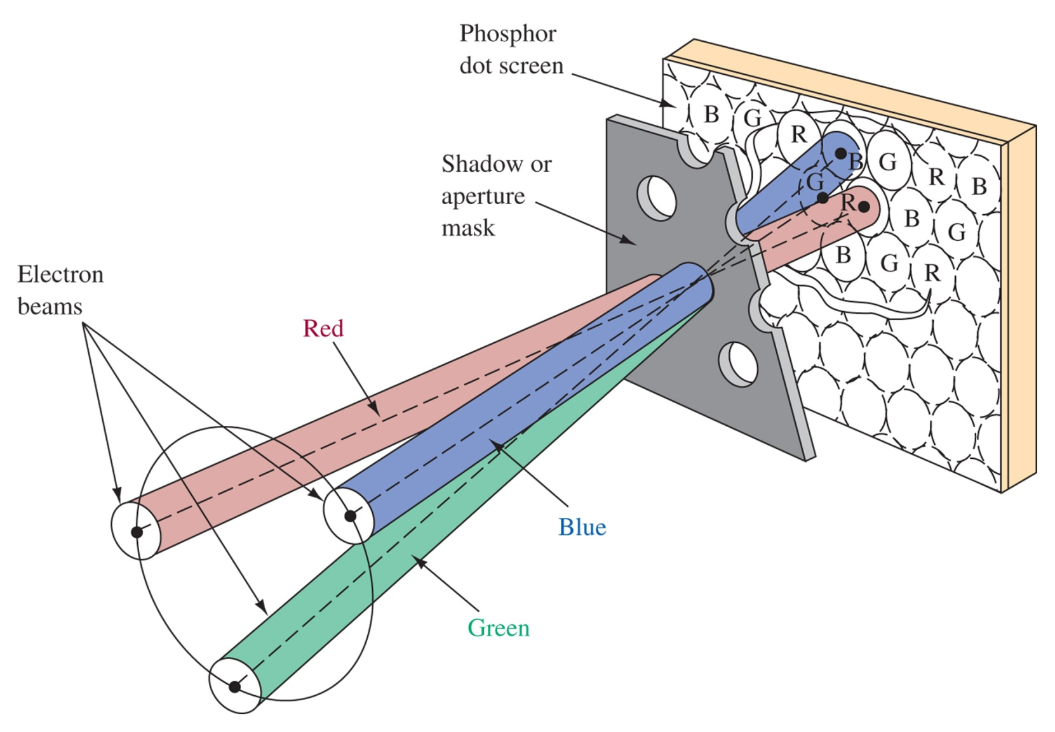
Figure 17-40 Color CRT construction.

Slide 54
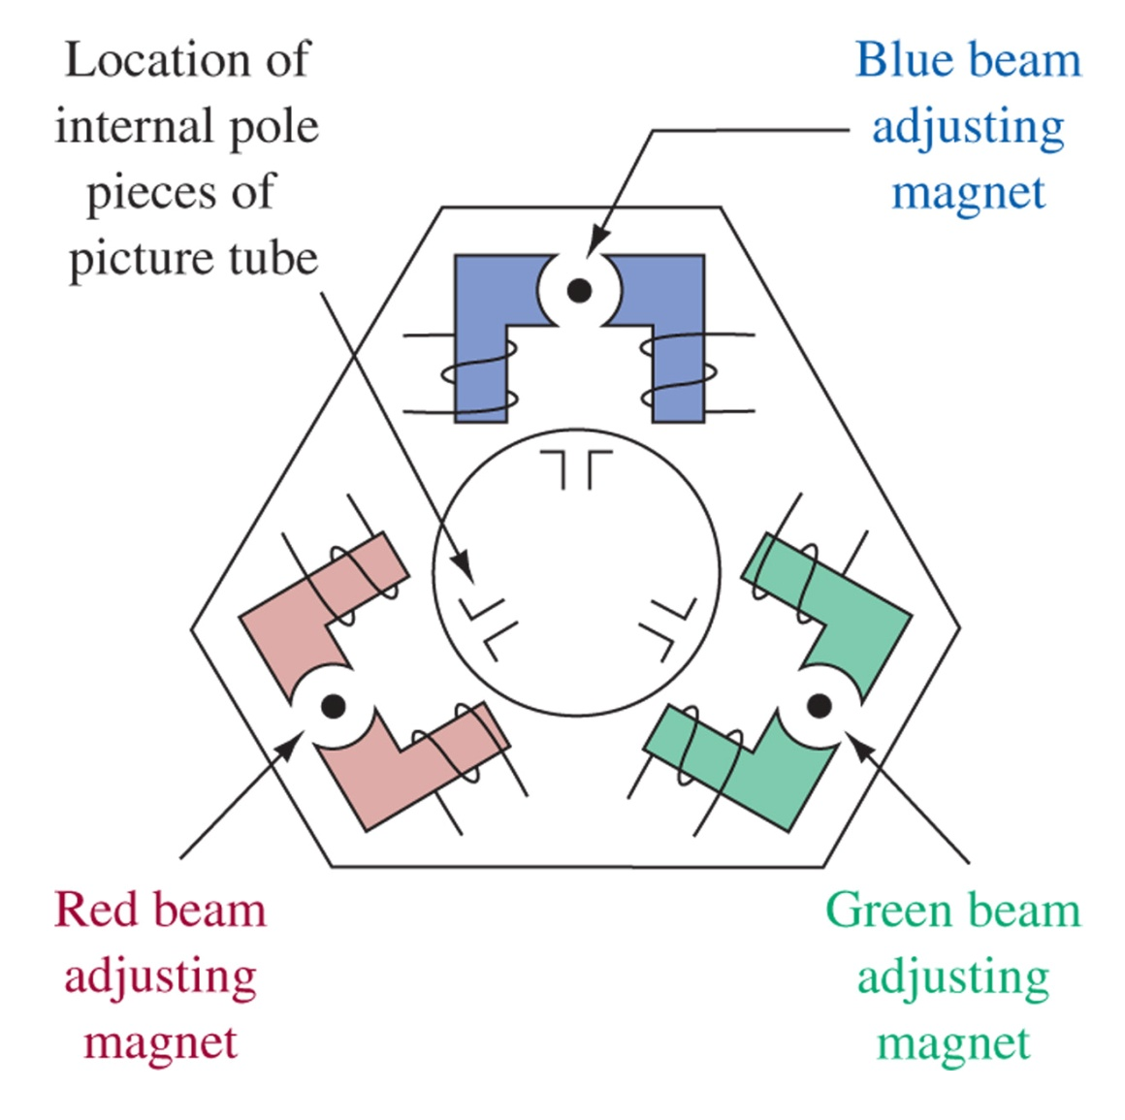
Figure 17-41 Color convergence yoke.

Slide 55
Plasma Displays
Each subpixel operates like a fluorescent lamp.
The same phosphors as a CRT are used to generate the colors from the UV emitted by the gas in the pixel.
Brightness is achieved by PWM circuitry for each subpixel allowing billions of colors.

Slide 56
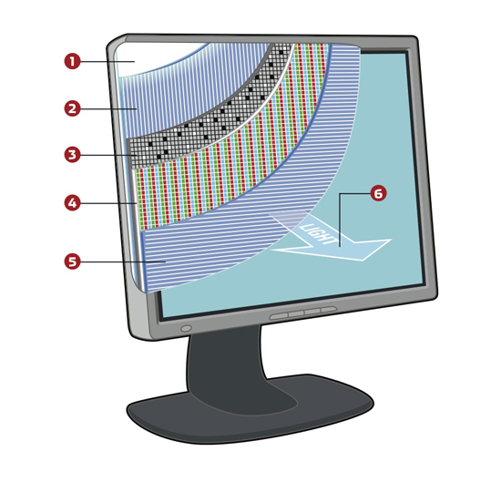
LCD Displays
Light passes through two perpendicular polarizers. A liquid crystal aligns with the front and the twist of the molecule changes the polarization of the light, allowing it to pass through. A transistor can change the charge, untwisting the molecule, which stops the light from passing through. This couples with individual color filters for each pixel.

Slide 57
17-13 Sound and Picture Improvements
Figure 17-42 Zenith/dbx stereo system.

Slide 58
17-14 Troubleshooting

Slide 59
17-15 Troubleshooting w/ Multisim

Slide 60
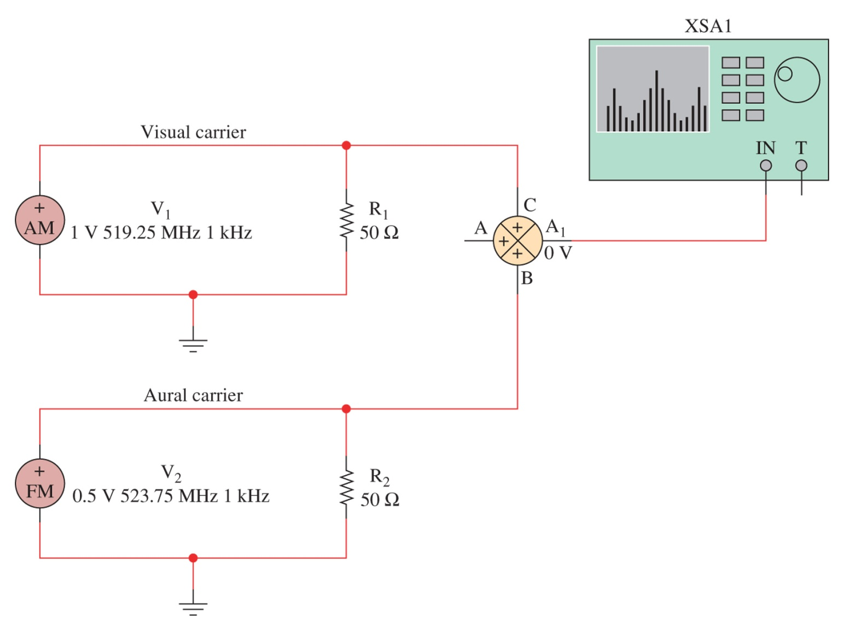
Figure 17-43 The Electronics WorkbenchTM Multisim circuit used to simulate the frequency spectra for a UHF television signal.

Slide 61
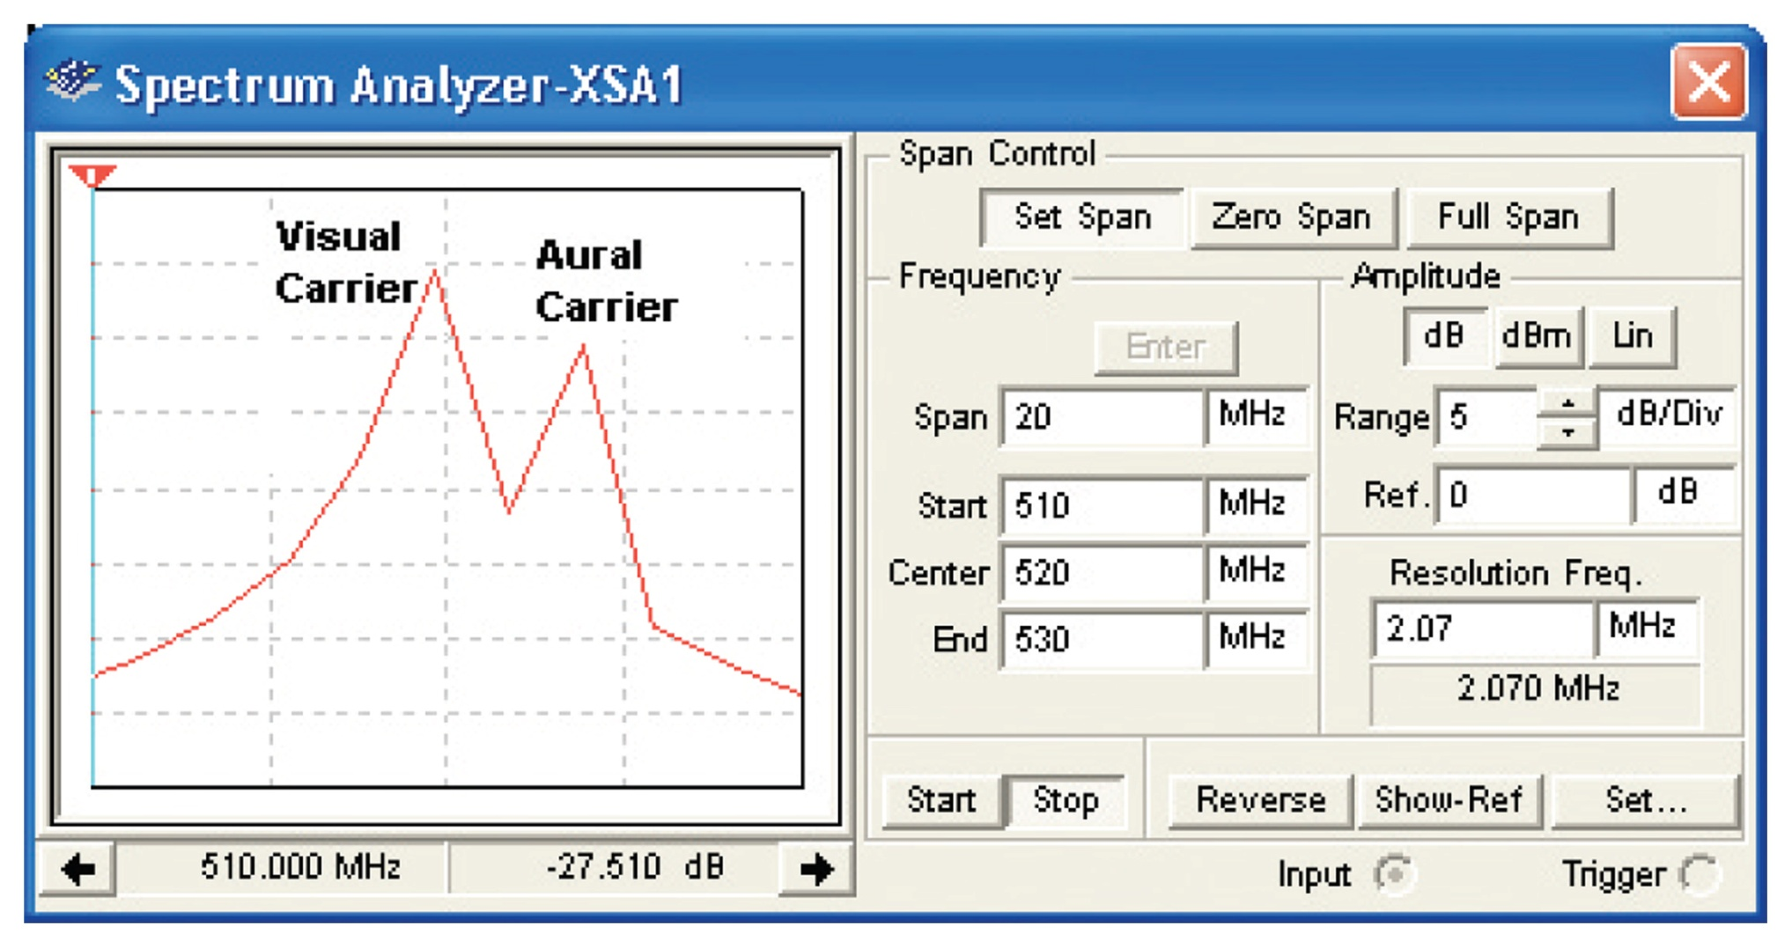
Figure 17-44 The Electronics WorkbenchTM simulation of the frequency spectra for a channel 22 television signal.

Slide 62
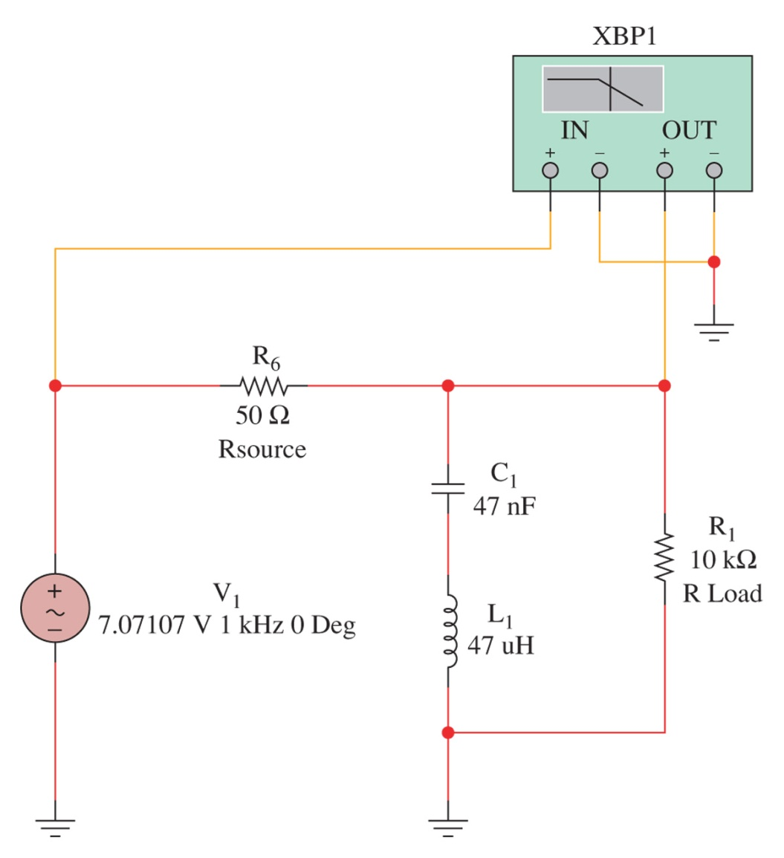
Figure 17-45 The Electronics WorkbenchTM Multisim circuit of a high-Q bandstop circuit, or wavetrap.

Slide 63
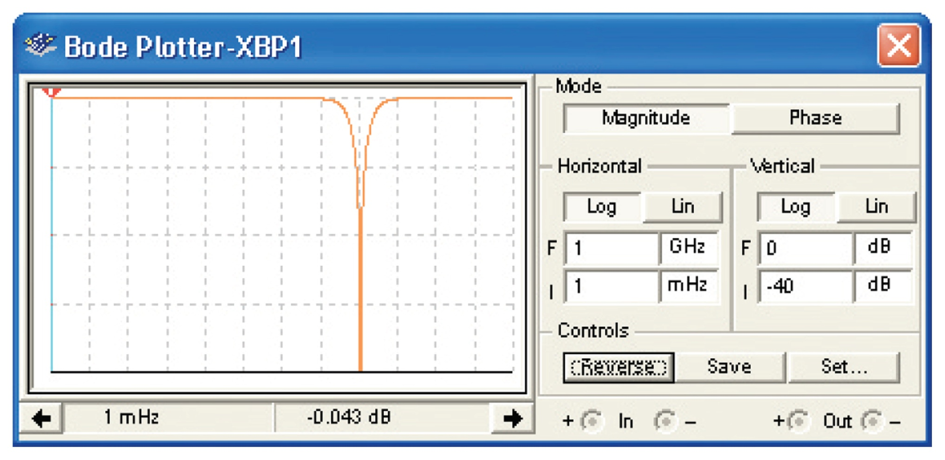
Figure 17-46 The Bode plotter output for the wavetrap filter.

