Slide 1
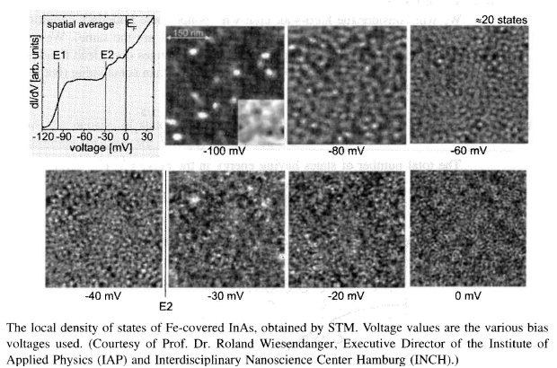
EE 315/ECE 451 Nanoelectronics I
Ch 8 – Particle Statistics and Density of States
Derived from lecture notes by R. Munden 2010

Slide 2




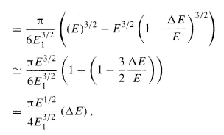
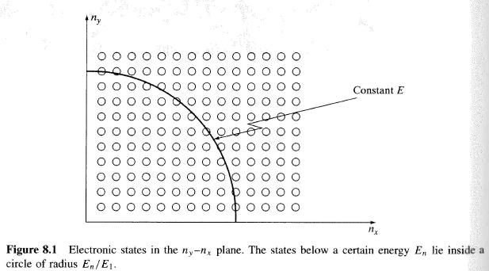
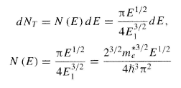
8.1 Density of States
Imagine the hard walled box, and the energy states available:
# states in sphere of radius En:
Octant of sphere

Slide 3

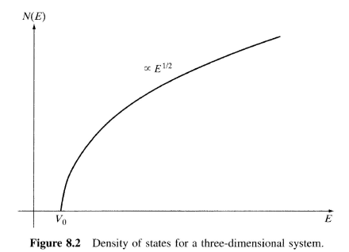
DoS 3D System
Accounting for Spin. Potential and L³ = 1 for density per unit volume:
Notes:
States in a 3-Dimensional Spherical volume

Slide 4

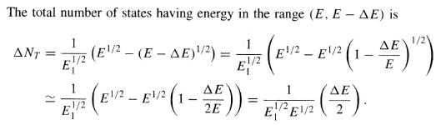

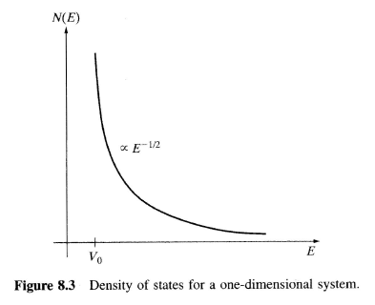
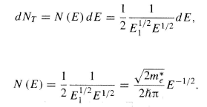

8.1.1 Density of States in Low Dimensions
For One Dimensional Quantum Wire
With spin and potential:
Notes:
Quantum wire – only a one dimensional object as the “wire” is too thin to have a cross sectional area that contains particles.

Slide 5
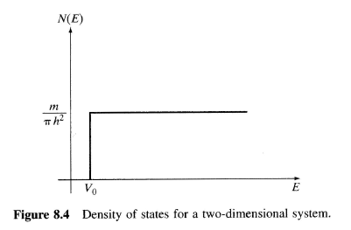


8.1.1 Density of States in Low Dimensions
For 2D Quantum Well
For 0D Quantum Dots
Although real materials are 3D, quantum confinement in small materials can approximate low dimensional structures, like quantum dots.
Notes:
Similarly for 2-d (a 2-d quantum well) and “0-d” (the quantum dot – only one spot for the “states” and the “2” accounts spin)

Slide 6

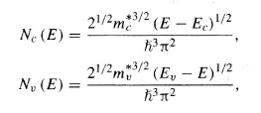

8.1.2 Density of States in a Semiconductor
In 3D materials:
We can use in semiconductors by substituting effective mass for band structure and Ec for potential
In Silicon (with transverse and longitudinal effective mass) and 6 fold symmetry of the conduction band:
Notes:
E_{c} – Conduction band limit
In Silicon, the effective mass varies with direction due to the crystal structure.

Slide 7



8.2 Classical and Quantum Statistics
Classical or Boltzman Distribution (distinguishable particles – e.g.molecules):
Fermi-Dirac Distribution (indistinguishable, exclusive particles – e.g. electrons):
Bose-Einstein Distribution (indistinguishable, non-exclusive particles – e.g. photons and phonons):
Notes:
At high energies all three distribution are equal!

Slide 8
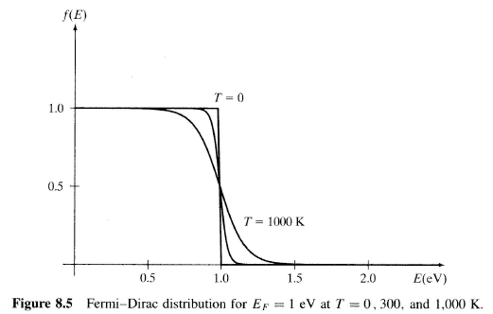


Fermi Distribution
“Ripples on the Fermi sea”
Occupied
Unoccupied
Notes:
The probability of being either unoccupied or occupied is the union of all cases so P = 1
The Fermi energy is the maximum energy occupied by an electron at 0K. By the Pauli exclusion principle, we know that the electrons will fill all available energy levels, and the top of that "Fermi sea" of electrons is called the Fermi energy or Fermi level. One of the remarkable things about the Fermi energy is how large it is compared to the energies which electrons could gain by ordinary physical interactions with their environment.
See: http://hyperphysics.phy-astr.gsu.edu/hbase/solids/fermi.html

Slide 9

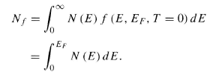

8.2.1 Carrier Concentration in Materials
3D confined box
Notes:
We are only considering electrons “in a box” – an electron gas model – valid in metals and in sufficiently highly doped semiconductors (note that this can be a sea of holes)
In a typical metal, E_{f} ~ 2-7 EV

Slide 10
8.2.2 The Importance of Fermi Electrons

Slide 11
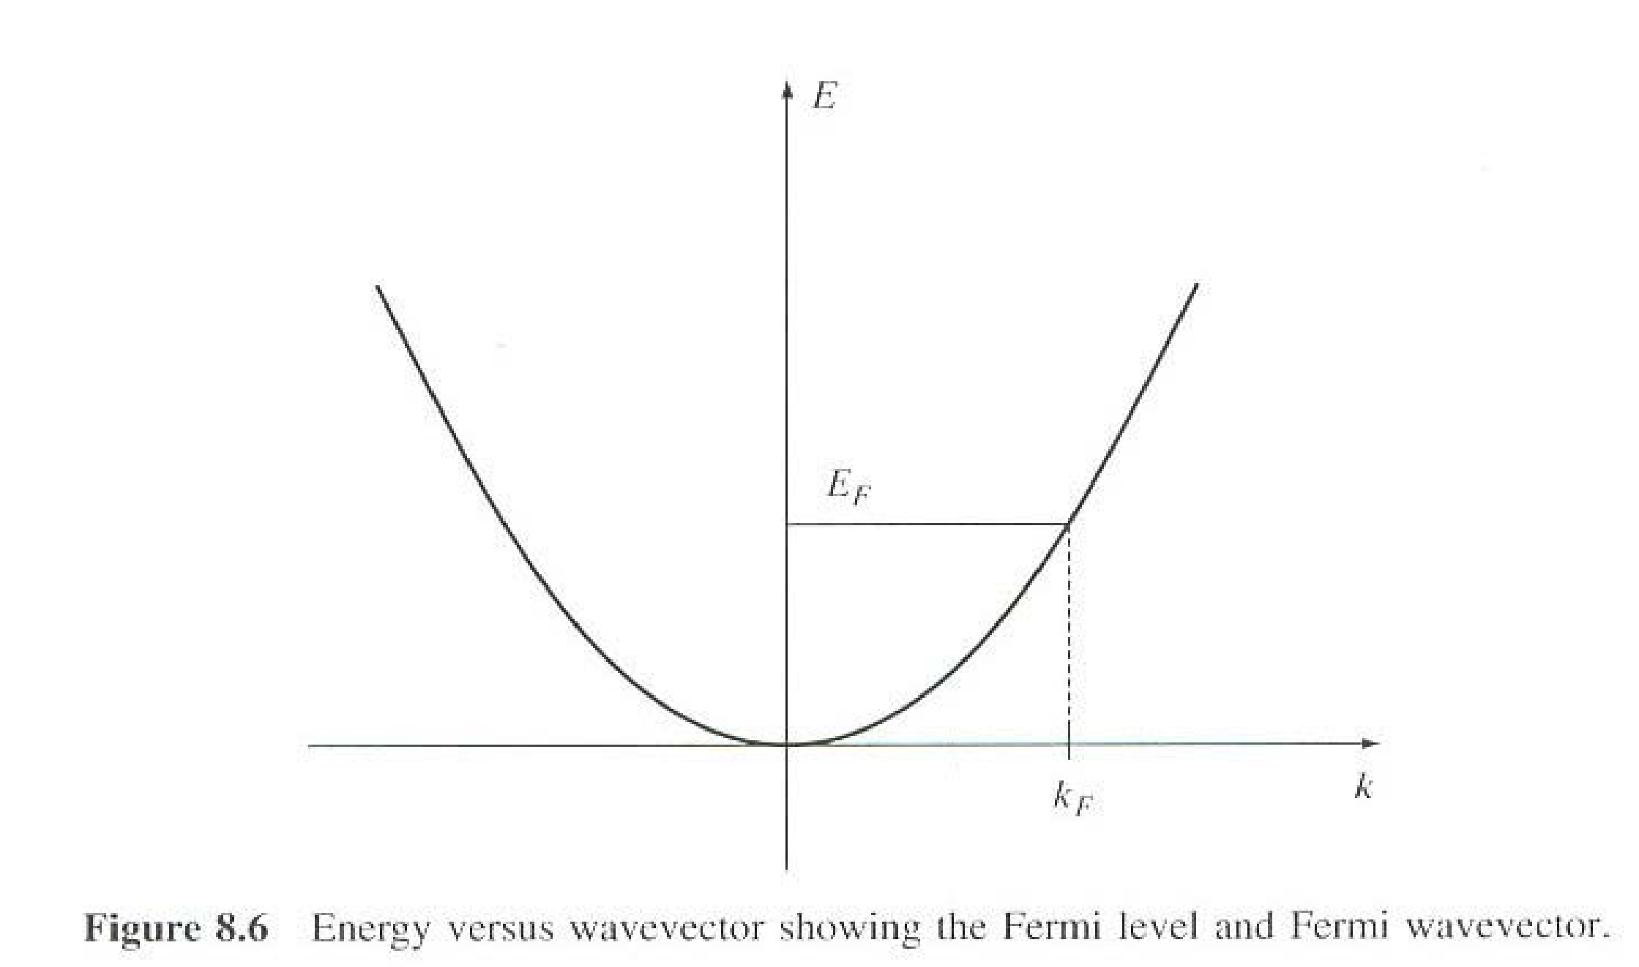
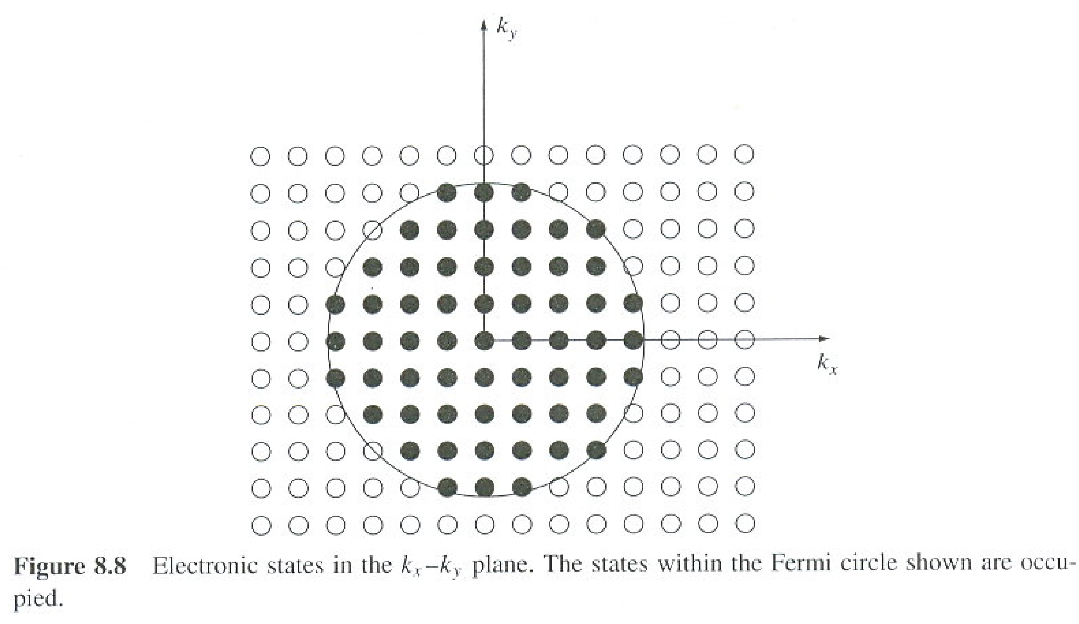
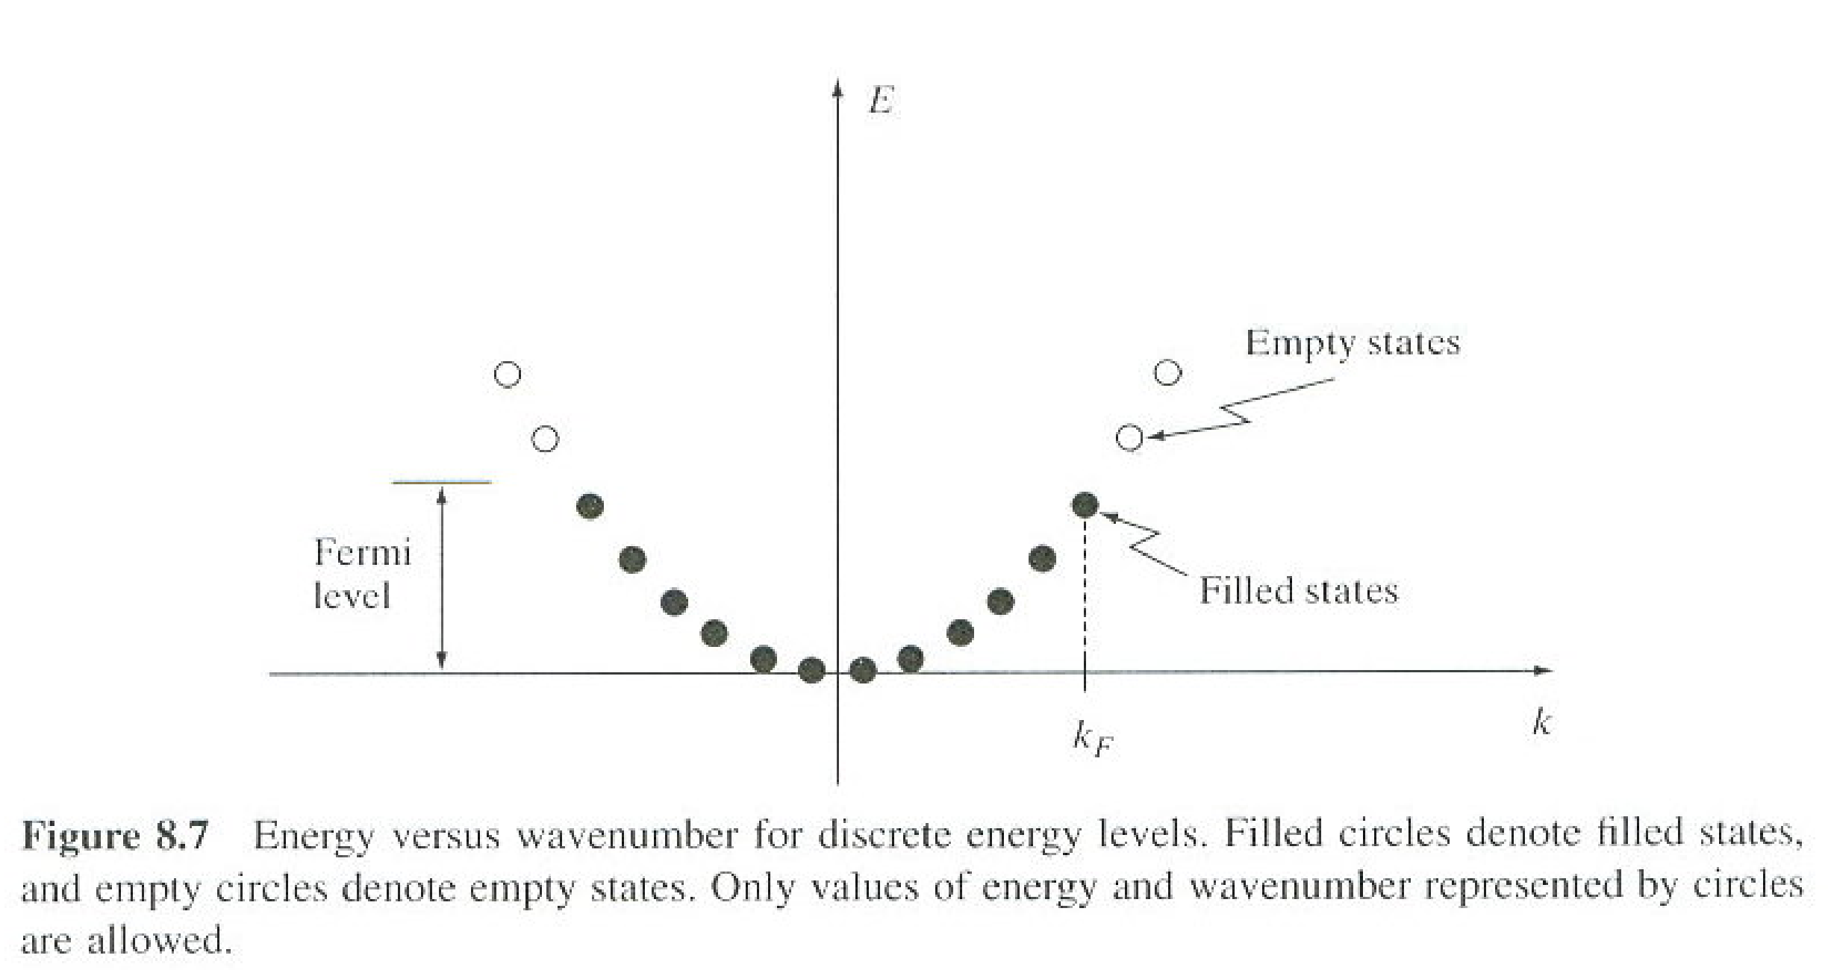
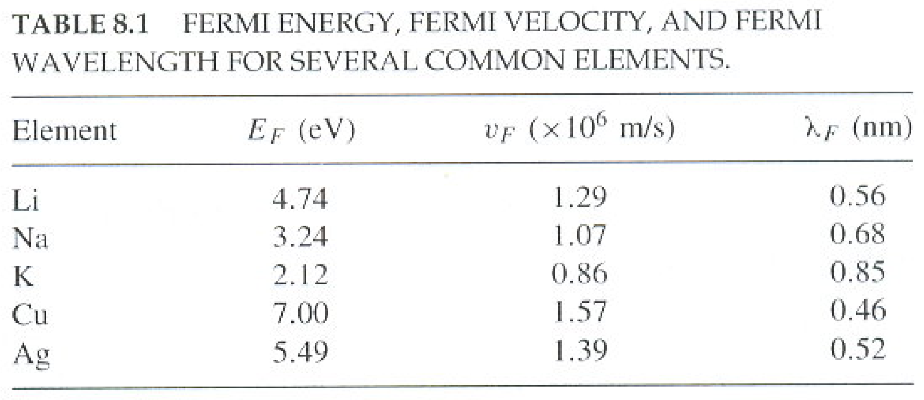
Electron States
Notes:
Electron drift velocity in metals is very slow so their energy is approximately the Fermi energy.

Slide 12
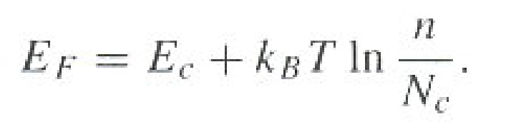
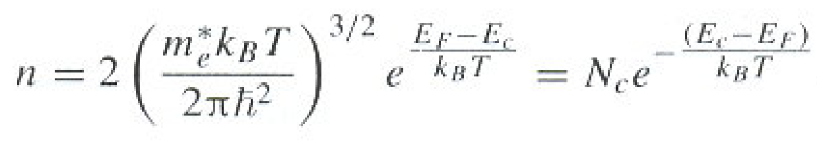
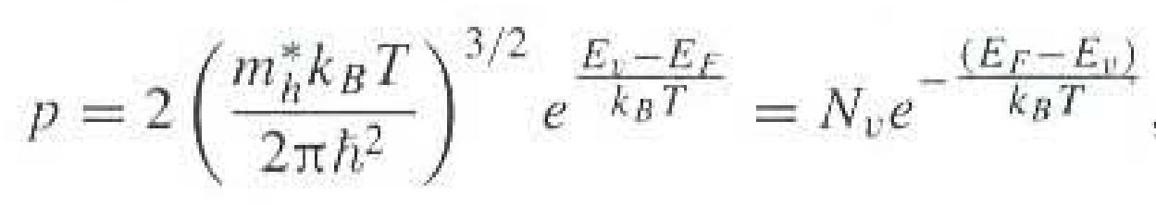
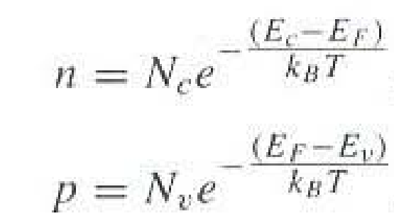
8.2.3 Equilibrium Carrier Concentration
Notes:
Now we are in a semiconductor!
n is the density of electron states and p is the density of the hole states.
Nc = effective density of states at the conduction band edge – for silicon ~ 2.8 x 10¹⁹ cm⁻³
Nv = effective density of states at the valence band edge

Slide 13
8.3 Main Points
the concept of density of states in various spatial dimensions, and the significance of the density of states;
how the density of states can be measured;
quantum and classical statistics for collections of large numbers of particles, including the Boltzmann, Fermi-Dirac, and Bose-Einstein distributions;
the role of density of states and quantum statistics in determining the Fermi level;
applications of density of states and quantum statistics to determine carrier concentration in materials, including in doped semiconductors.

Slide 14
8.4 Problems

