Slide 1
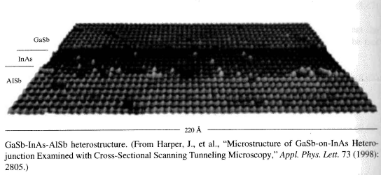
EE 315/ECE 451 Nanoelectronics I
Ch 9 – Models of Semiconductor Quantum Wells/Wires

Slide 2
9.1 Semiconductor Heterostructures and Quantum Wells

Slide 3
9.1 Continued
Notes:
You can analyze these semiconductor heterostructures to reasonable accuracy by replacing the crystal structure with a potential energy profile and using the “effective mass” appropriate to the material.

Slide 4
9.1 Continued
$\left(−\frac{ħ^{2}}{2∗m^{∗}\left(x\right)}∇^{2}+V\left(x\right)\right)Ψ\left(r\right)$=E$\left(r\right)$
Notes:
This is the effective mass version of Schrodinger’s equation where x is the linear position in the structure. You solve each region and then match the solutions at the boundaries.

Slide 5
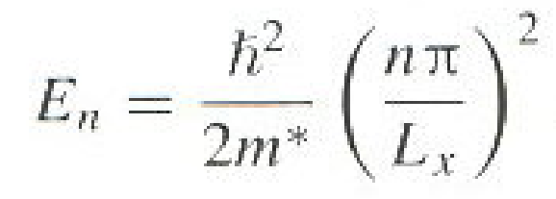
9.1.1 Confinement Models and Two-Dimensional Electron Gas
Where
Notes:
E_{n} is the bottom of the n^{th} subband.

Slide 6
9.
To see the discrete subbands
Notes:
The sharp peaks are “excitonic” effects at the onset of energy absorbtion

Slide 7
9.1.2 Energy Band Transitions in Quantum Wells
Notes:
Fermi’s “Golden Rule” for permitted transitions

Slide 8
9.1.2 Continued

Slide 9
9.1.2 Continued

Slide 10
9.1.2 Continued
Notes:
The dopant is usually silicon

Slide 11
9.2 Quantum Wires and Nanowires
Notes:
This is a one-dimensional structure

Slide 12
9.2 Quantum Wires and Nanowires - Continued
Notes:
H is the “Heaviside” function AKA Unit Step Function

Slide 13
9.2 Quantum Wires and Nanowires - Continued

Slide 14
9.3 Quantum Dots and Nanoparticles
Notes:
Bulk – Continuous state density, 2D – Discrete steps, 1D – Excitonic, 0D – Discrete values of E (delta functions)

Slide 15
9.3.1 Applications of Semiconducting Quantum Dots
Notes:
The rainbow

Slide 16
9.3.1 Applications of Semiconducting Quantum Dots
Notes:
Medical application of Quantum Dots – sorry for the lack of color

Slide 17
9.3.1 Applications of Semiconducting Quantum Dots
Notes:
Further medical applications

Slide 18
9.3.2 Plasmon Resonance and Metallic Nanoparticles
Notes:
Yet another medical example

Slide 19
9.3.2 Plasmon Resonance and Metallic Nanoparticles
Notes:
Light wavelength vs dot size

Slide 20
9.3.3 Functionalized Metallic Nanoparticles
Notes:
Manufacturing hollow gold “spheres”

Slide 21
9.4 Nanostructure Fabrication Techniques
Notes:
UV lithograph is used to build our current silicon technology.
Electron beam lithography can go smaller, bit is serial in nature and therefor slow and expensive in use.

Slide 22
9.4.1 Lithography

Slide 23
9.4.1 Lithography
Notes:
These are comparable in size to current UV lithography

Slide 24
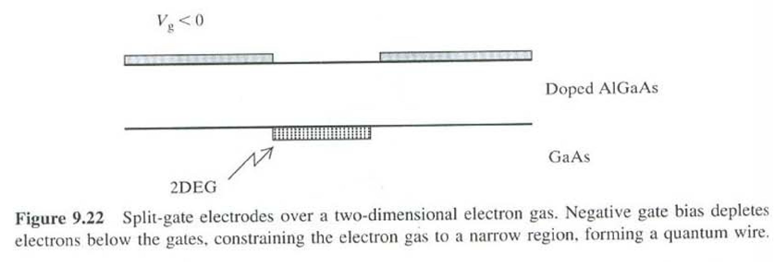
9.4.1 Lithography
Notes:
The pinch-off effect in MOS technologly used to produce a nano-wire

Slide 25
9.4.4 Self Assembly

Slide 26
9.4.4 Self Assembly
Notes:
Using chemistry (crystals) to promote “self assembly” – the Holy Grail of Nanoelectronics.
We just need to figure out how to self assemble useful structures.

Slide 27
9.4.4 Self Assembly
Notes:
And is how “life” started!

Slide 28
9.5 Main Points
the idea of Fermi wavelength and exciton Bohr radius as important length scales in deciding when quantum confinement effects are important;
the idea of a semiconductor heterostructure;
hard-wall and other confinement models for forming a quantum well;
energy subband structures in quantum wells and quantum wires;
interband, intersubband, and exciton transitions in quantum wells, and the existence of selection rules;
simples models of quantum dots including the importance of exciton effects and the exciton radius
applications of quantum dots, including their use as biological markers;
the idea of metal nanoparticles and plasmon resonance;
fabrication methods, including various lithography techniques, split-gate techniques and self-assembly.

Slide 29
9.6 Problems

