Slide 1
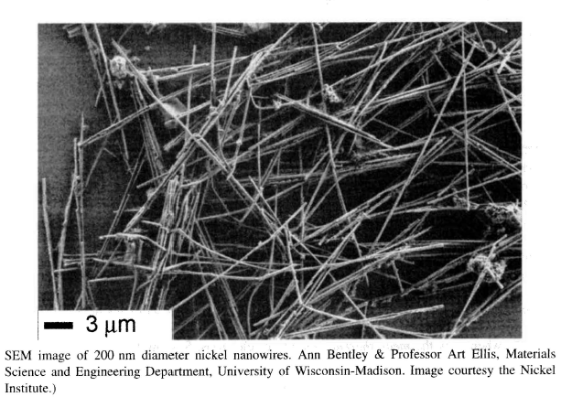
EE 315/ECE 451 Nanoelectronics I
Ch 10 – Nanowires, Ballistic Transport, and Spin Transport

Slide 2
10.1 Classical and Semiclassical Transport
How do these electrons actually move down a wire?
What about small wires?
Notes:
This section introduces “Ballistic Transport” which is the starting point in Prof. Datta’s video lectures.

Slide 3















10.1.1 Classical Theory of Conduction – Free Electron Gas Model
Energy of a particle
Classical Free Electron + collisions =
Drude Model
Thermal 3deg
Kinetic
Thermal velocity
@ Room Temp
Applied Electric Field
Drift velocity
Total Velocity
With Collisions
mobility
Classical current density
In Copper
Ohm’s Law
Conductivity
Semiconductors
Notes:
OK electron drift in an electric field is slow. But the reaction to a change in potential propagates at near light speed.
And we have Ohm’s law!

Slide 4
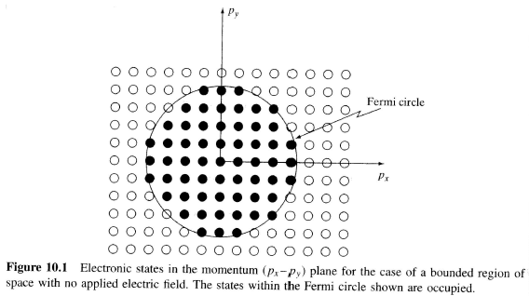



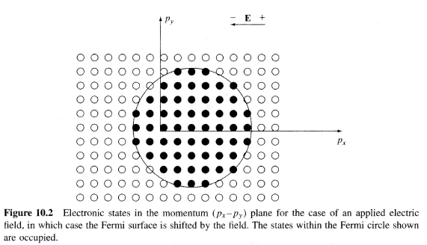

10.1.2 Semiclassical Theory of Conduction – Fermi Gas Model
We should apply the quantum principles we know – use the Fermi Gas
With no applied field, there is a –p for every +p, like random thermal motion
Fermi velocity
For copper
With applied field
Shift in momentum
Net velocity
Notes:
Vd for copper is about -0.00435 m/sec for a 1 volt/m E field (the minus sign is due to the neg. charge on an electron)

Slide 5



Mean Free Path
Length travelled before a collision with the lattice
Which is about 100 lattice constants (3.61 A) -> infrequent collisions
Compared to the thermally derived mean free path
Which is about 8 lattice constants -> frequent collisions
In pure copper at 4K we get an answer consistent with Bloch
8 million lattice constants!

Slide 6
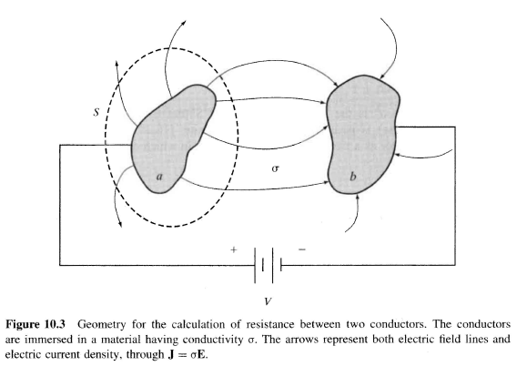




10.1.3 Classical Resistance and Conductance
Ohm’s Law
Path between two electrodes
3D Resistance
Sheet resistance for thin materials
Notes:
Basic EE and Physics

Slide 7
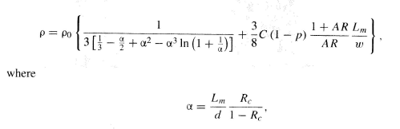
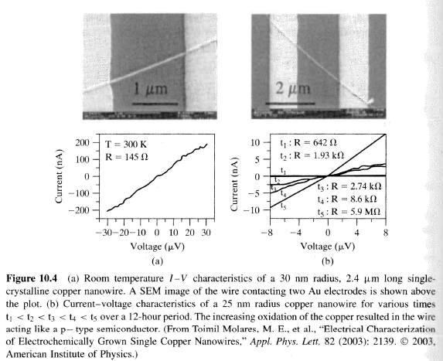
10.1.4 Conductivity of Metallic Nanowires – The Influence of Wire Radius
For rectangular metallic wires 10nm < r < 100nm
Notes:
As L shrinks there are no collisions for most electrons and we have “Ballistic Transport” for L << Lm,Lφ
There is no loss of phase coherence

Slide 8
10.2 Ballistic Transport
In the mesoscopic regime (between atomic and macroscale) the collision transport model doesn’t hold
We need a model of transport that is collisionless, or ballistic
This will be useful in many nanoscale devices
Notes:
Again see Datta

Slide 9
10.2.1 Electron Collisions and Length Scales
Considering the preceding discussion, we'll define several length scales.
L is the system length, in this case the length of the conductor in question.
Lm is the mean free path defined previously. However, now we want to be explicit and define this to be the length that the electron can travel before having an elastic collision.
Lφ is the length over which an electron can travel before having an inelastic collision. This is also called the phase-coherence length, since it is the length over which an electron wavefunction retains its coherence (i.e., retains its phase memory). Over that length phase evolves smoothly

Slide 10
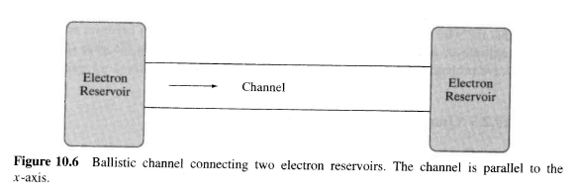
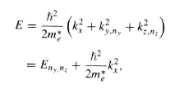




10.2.2 Ballistic Transport Model
Notes:
As the width of the nanowire increases the number of electron channels (parallel) increases. A new channel each time the width becomes equal to multiple of a half-Fermi wavelength (similar to modes in a waveguide)

Slide 11
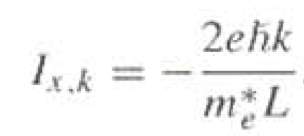
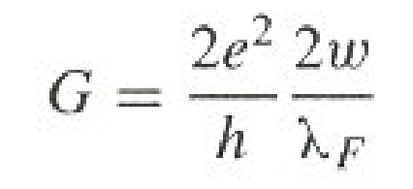
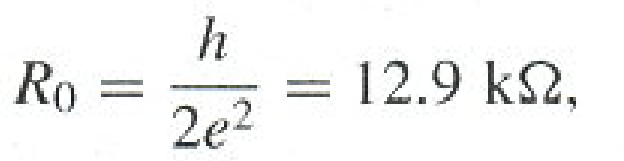
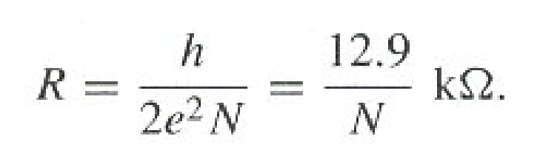
10.2.3 Quantum Resistance and Conductance
Ro is the resistance per channel or resistance quantum for a wire with square cross section w²
R is the wire resistance

Slide 12
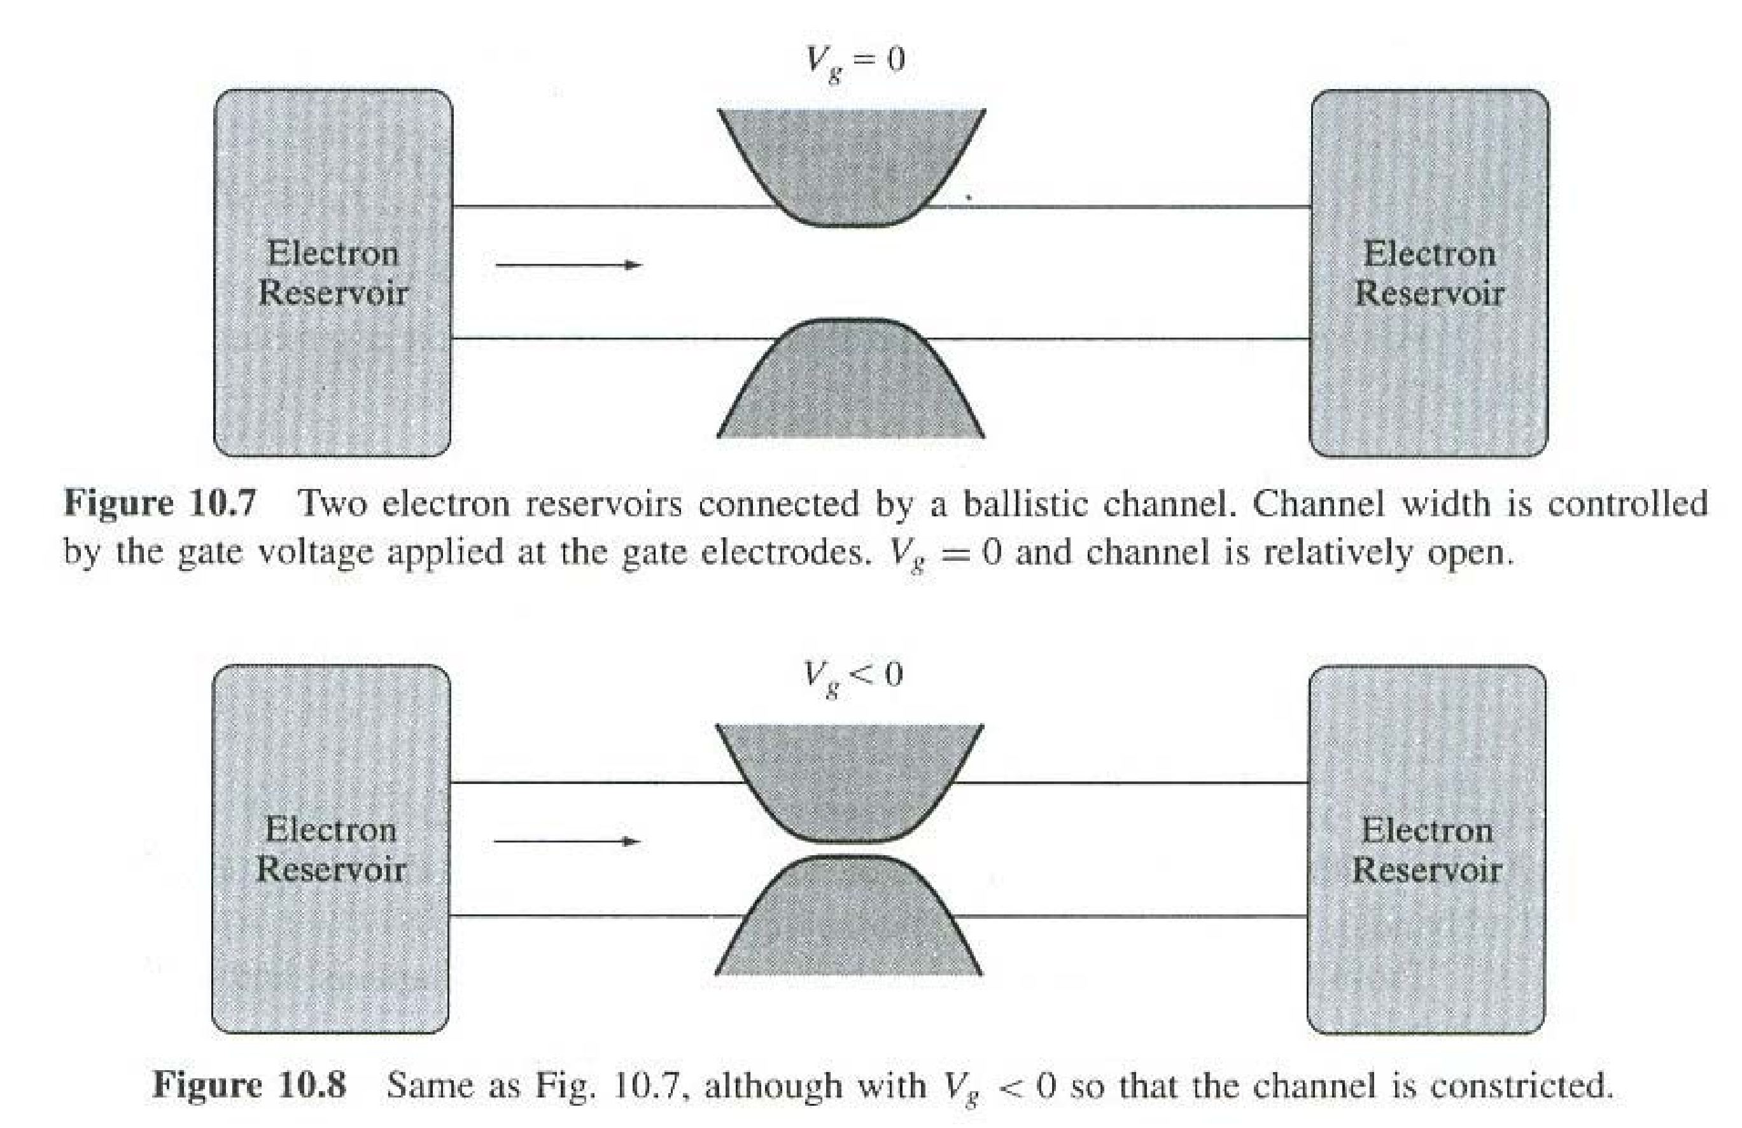
Example Quantum Wire

Slide 13
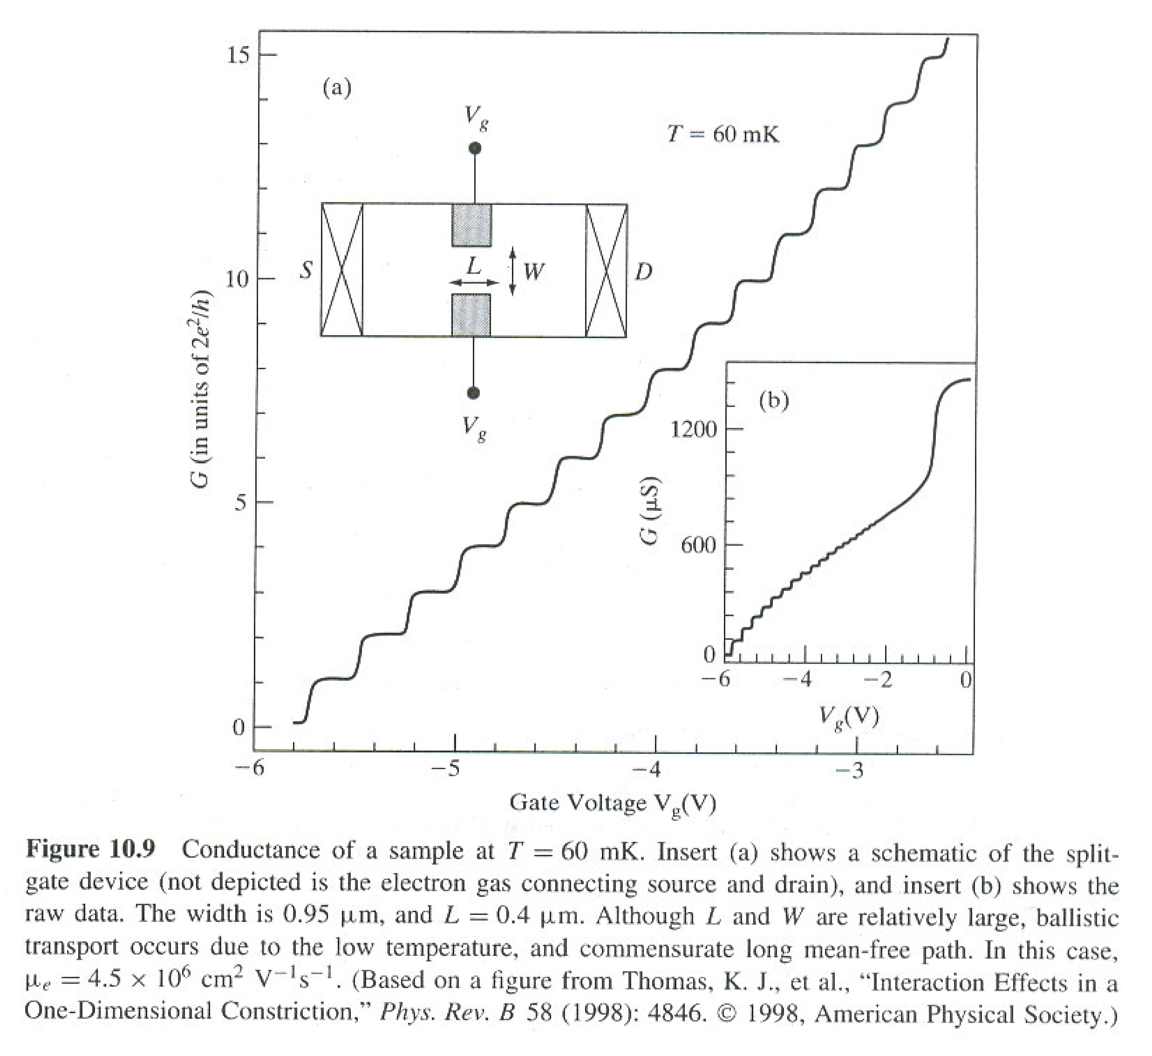
Quantum Jumps in a Nanowire

Slide 14
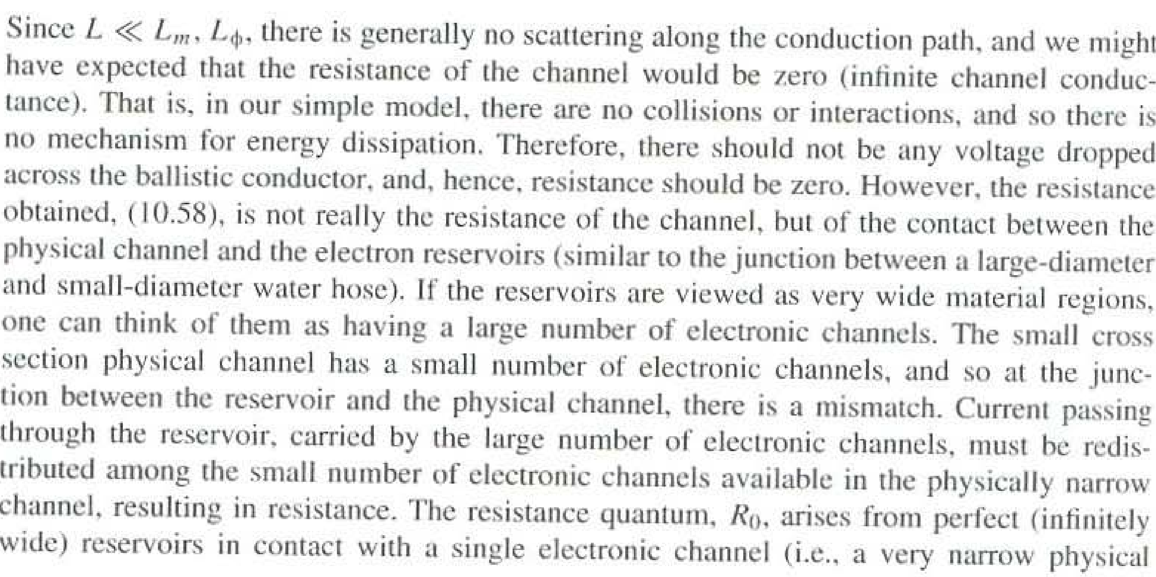
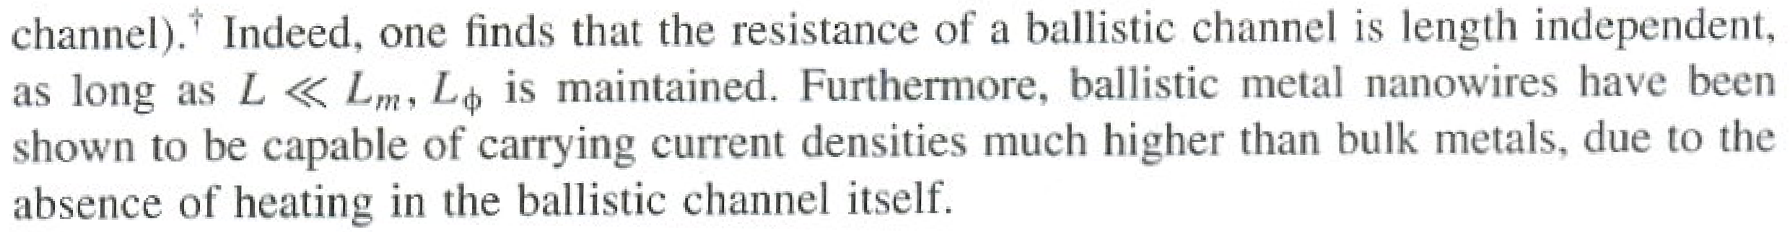
10.2.4 Origin of the Quantum of Resistance

Slide 15
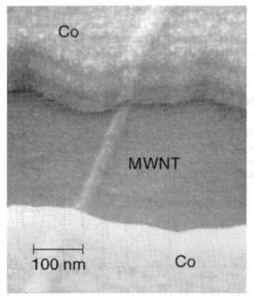
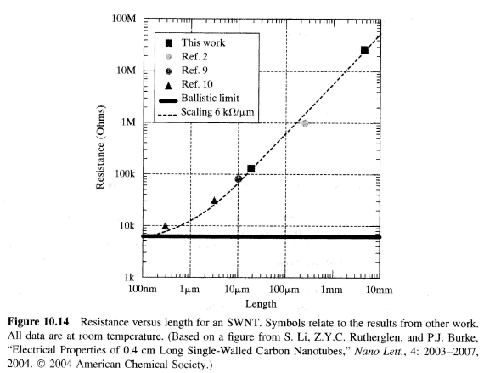
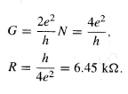



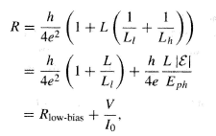


10.3 Carbon Nanotubes and Nanowires
Two π-band channels in CNTs
Mean free path ~ 1.5 microns
For longer wires, R is:
Current saturates ~30 uA

Slide 16
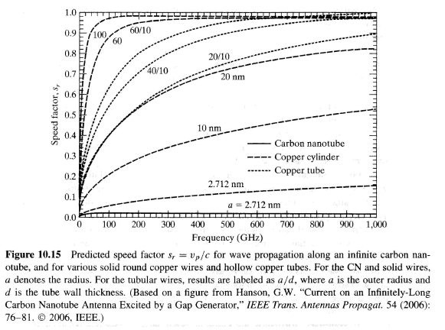
10.3.1 Effect of Nanowire Radius on Wave Velocity and Loss
Notes:
Carbon nanotubes are slow conductors, so are other nanowires, but not as bad.

Slide 17
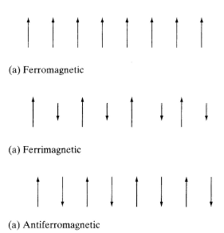
10.4 Transport of Spin and Spintronics
diamagnetic material (DM), the induced magnetization disappears after the magnetic field is removed.
paramagnetic material (PM), atoms have a small net magnetic moment due to incomplete cancellation of the angular and spin momentums. Application of a magnetic field tends to align the magnetic moments in the direction of the applied field, resulting in μr ~1.00001.
ferromagnetic material (FM) the induced magnetization remains after the applied magnetic field is removed. The magnetic moments in an PM-they may already be aligned. Ferromagnetism is the underlying principle of what one typically thinks of as a magnet.
antiferromagnetic, such as chromium, Cr, below about 475 K, MnO, FeO, and others. These have ordered magnetic moments, although adjacent magnetic moments are antiparallel
ferrimagnetic materials (called ferrites, which are really compounds such as Fe304), have adjacent magnetic moments antiparallel but unequal.
Notes:
We are talking about the modern technology in hard drives.

Slide 18
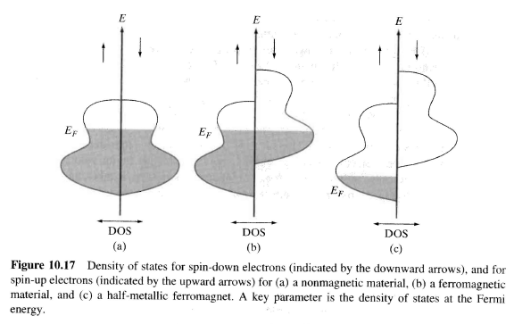
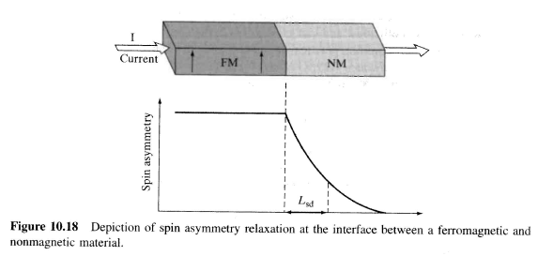

10.4.1 Transport of Spin
Unequal DOS leads to spin polarized current
Spin Diffusion Length

Slide 19
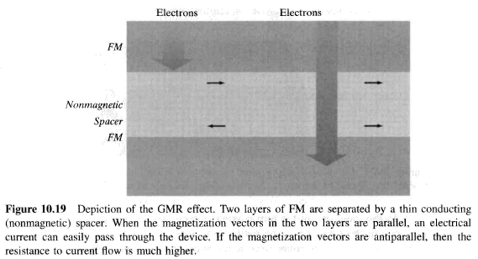
Giant Magnetoresistance
Very useful in building hard drives

Slide 20
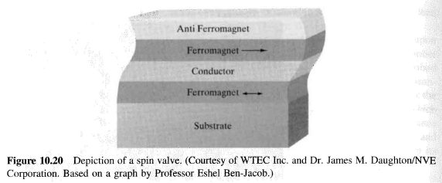
10.4.2 Spintronic Devices and Applications
Variety of devices, from GMR HDD read heads to spin transistors

Slide 21
10.5 Main Points
the classical theory of electrical conduction, including the concepts of conductivity and mobility, and the role of scattering;
the semiclassical (Fermi) model of conductivity, and the idea of resistance;
the idea of ballistic transport, including the various length scales (mean-free path, decoherence length, etc.) that define different transport regimes;
the quantization of conductance and resistance;
ballistic transport on CNs;
size-dependent effects in nanowires;
the basic ideas of spintronics, including the GMR effect and ' the operating principle of spin valves.

Slide 22
10.6 Problems

