Slide 1
Chapter 7d
Digital Carrier Communication

Slide 2
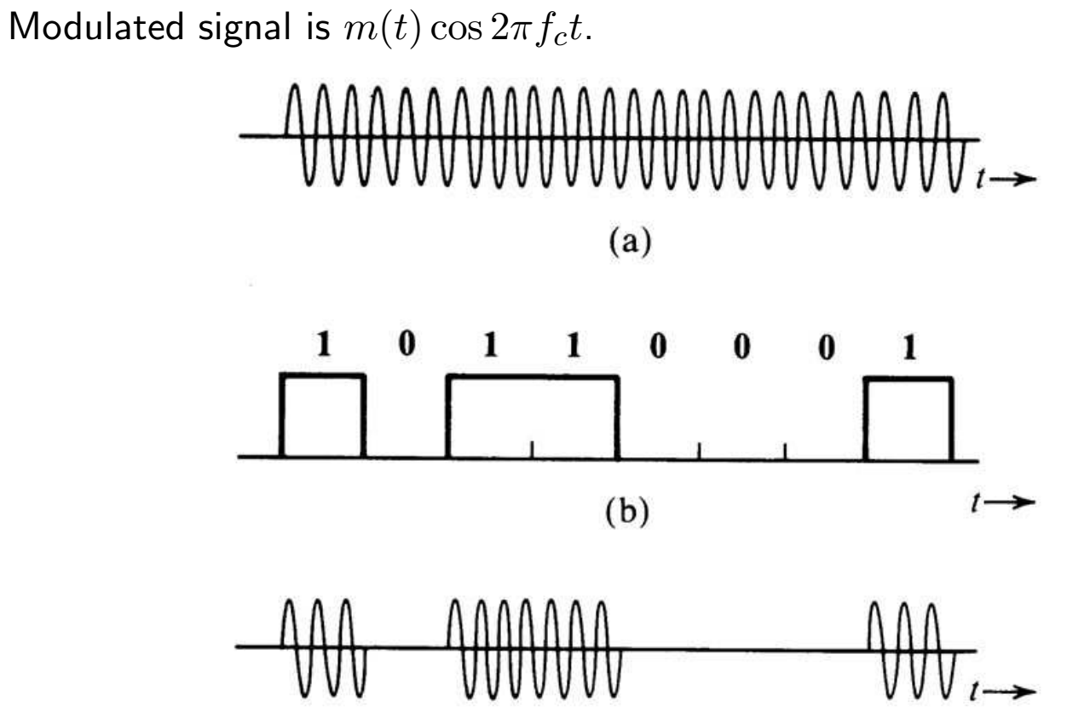
On-Off Keying (OOK) = Amplitude Shift Keying (ASK)
Notes:
Baseband signal may use shaped pulses, so cosine amplitude varies.

Slide 3
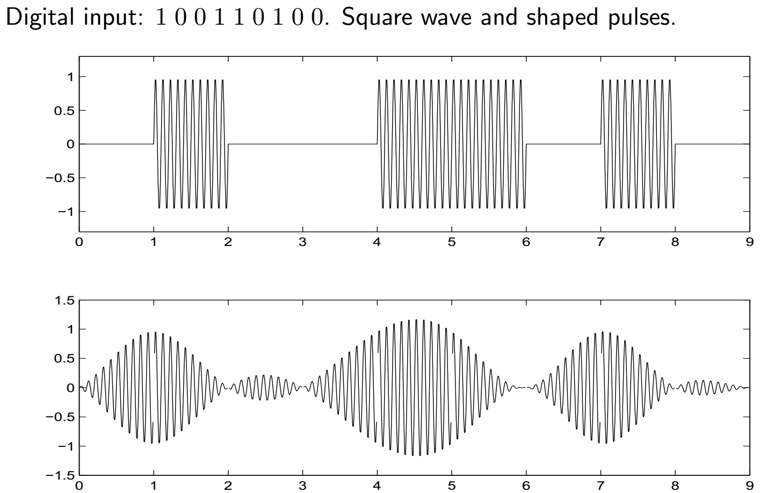
OOK Example

Slide 4
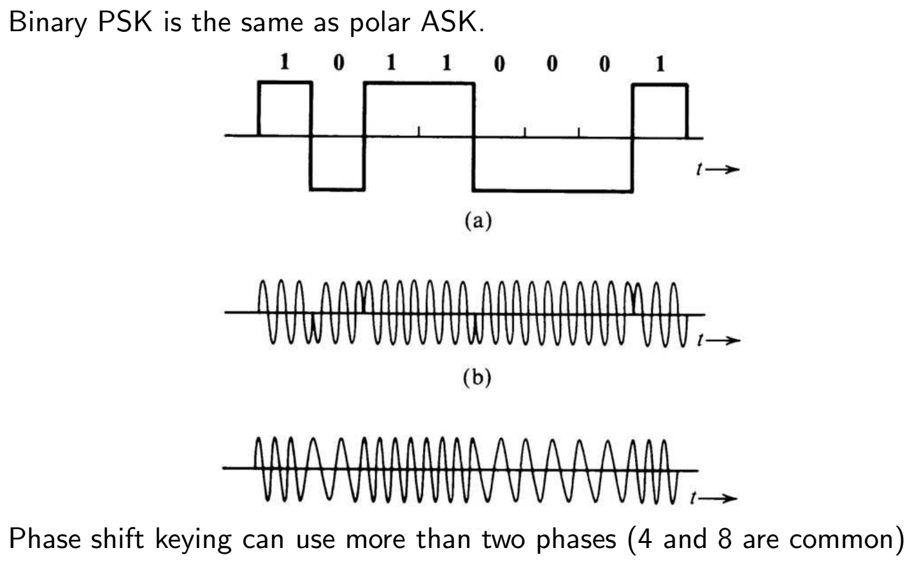
PSK and FSK
Notes:
FSK usually uses only two frequencies.

Slide 5
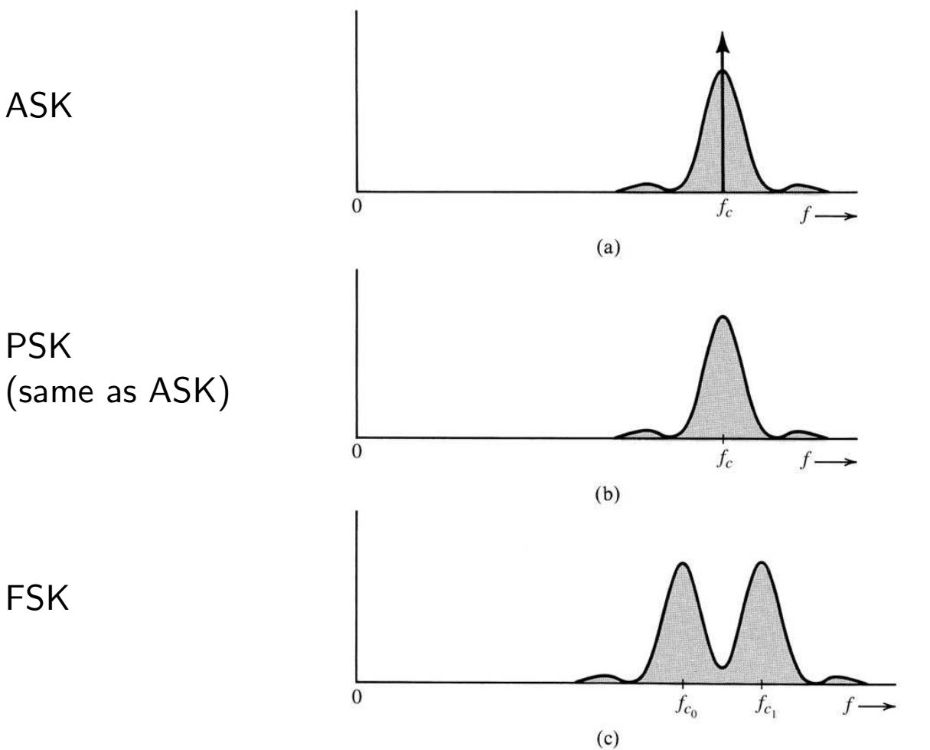
PSD of binary ASK, PSK, FSK

Slide 6
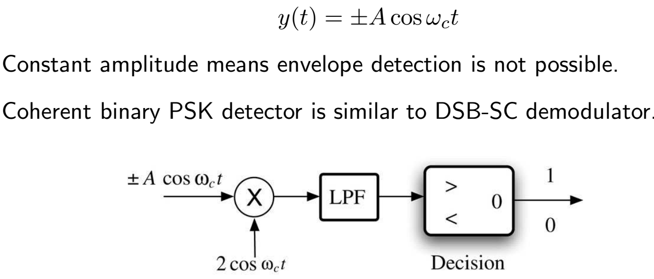
Demodulation of ASK and PSK
ASK demodulation
  envelope detector (signal vs. not signal)
  coherent detector (requires PLL)
Binary PSK is equivalent to binary PAM with

Slide 7
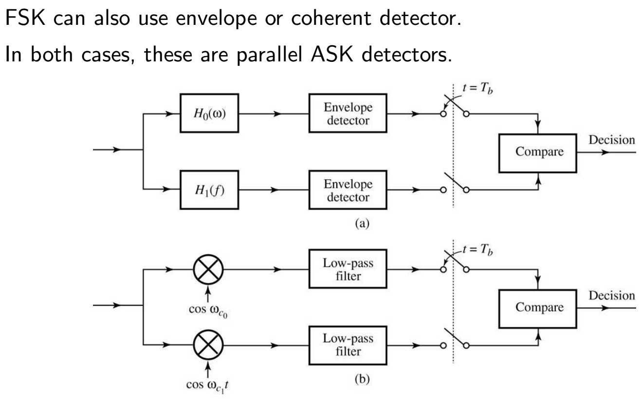
Demodulation of FSK
Notes:
Example: Bell 103 modem (V.21, 300 bps) used 1270 Hz and 1070 Hz for originating station, only 3 or 4 cycles per bit

Slide 8
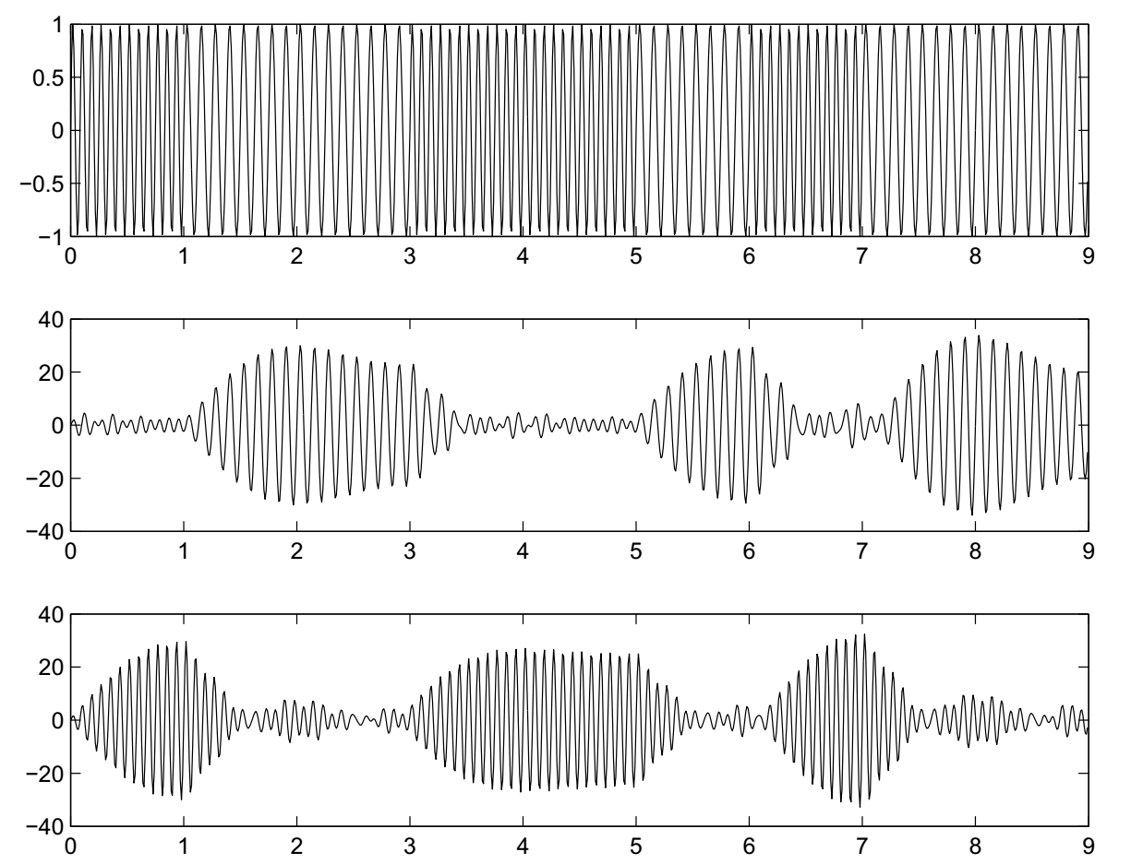
FSK Example: f0 = 8, f1 = 12

Slide 9
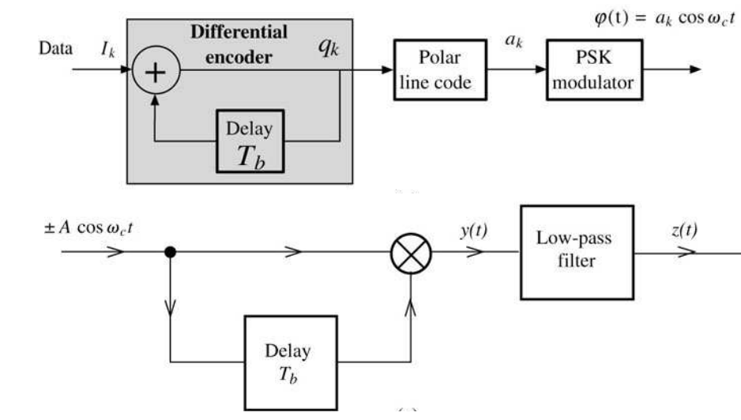
Differential PSK (DPSK)
Encode 1 by change of phase, 0 → π or π → 0
Advantage: local carrier not needed
Disadvantage: less noise immunity than PSK, more bandwidth, errors occur in pairs
More than two different phases can be used.

Slide 10
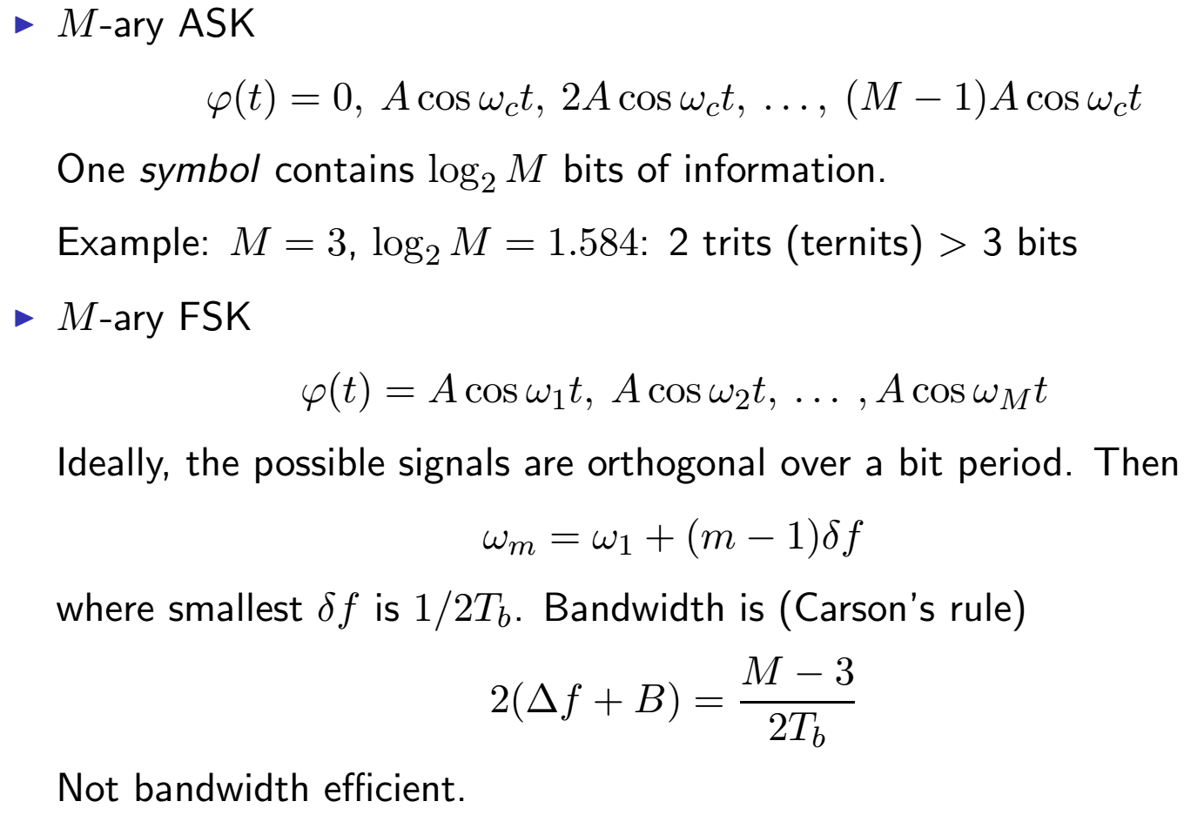
M-ary Digital Carrier Modulation

Slide 11
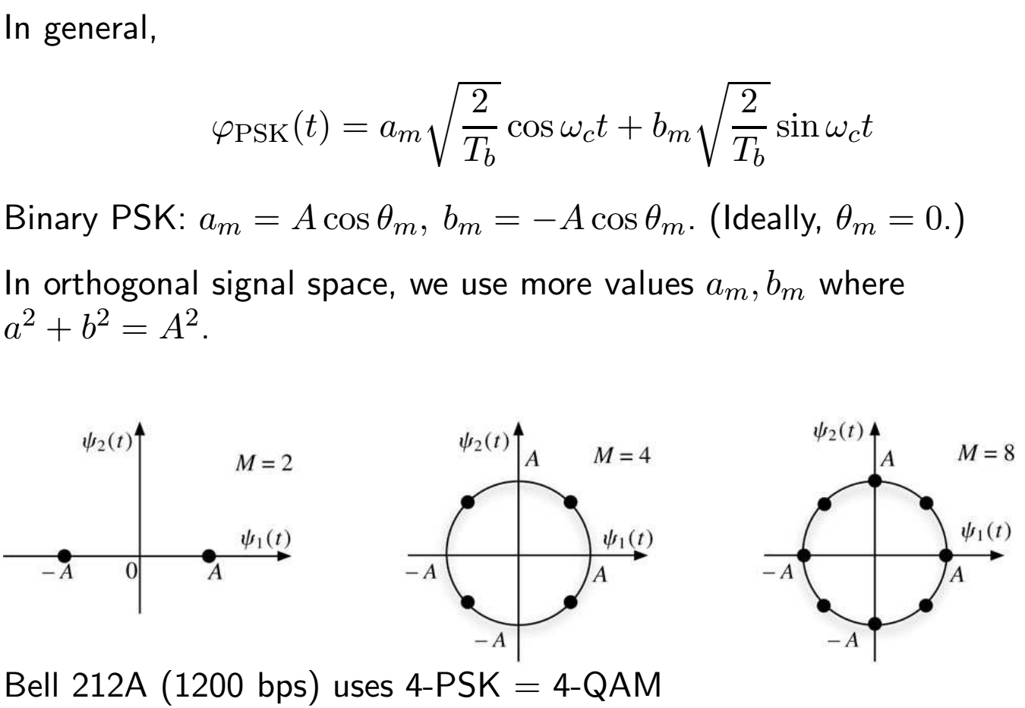
M-ary PSK

Slide 12
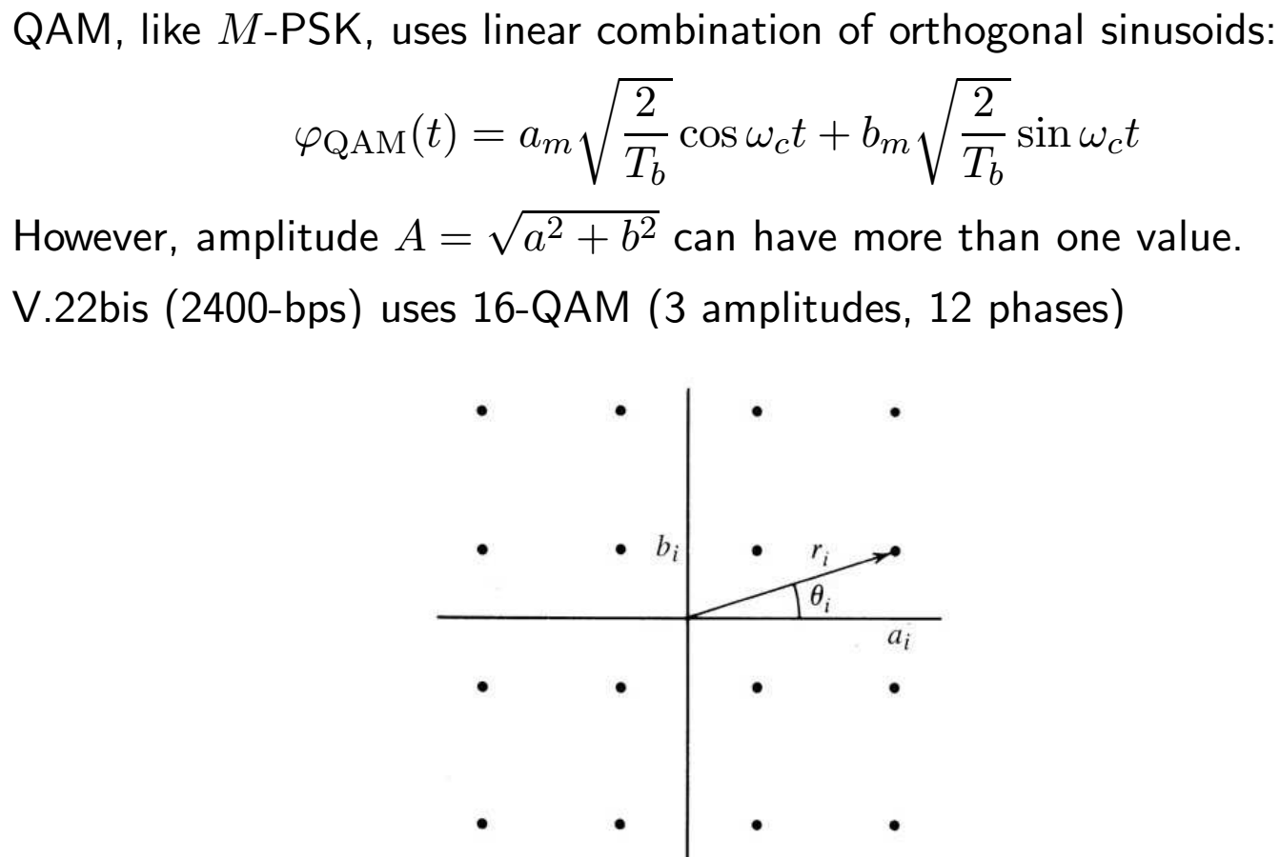
M-ary QAM

Slide 13
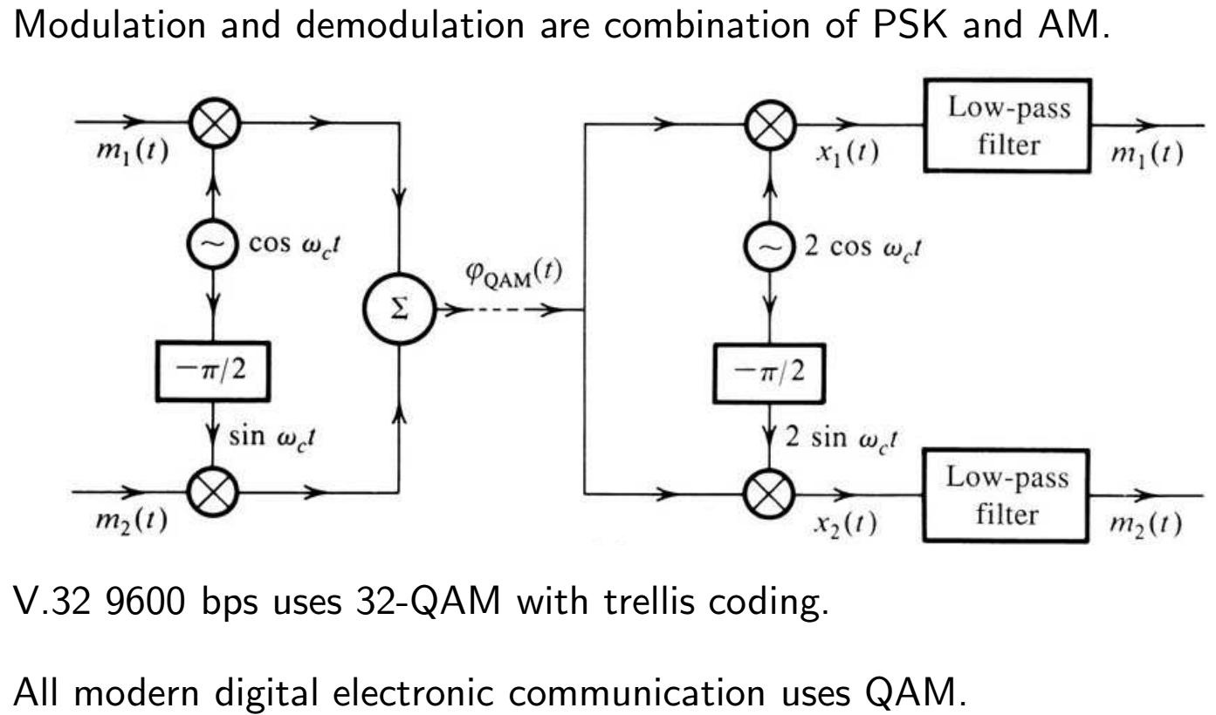
QAM 2

Slide 14
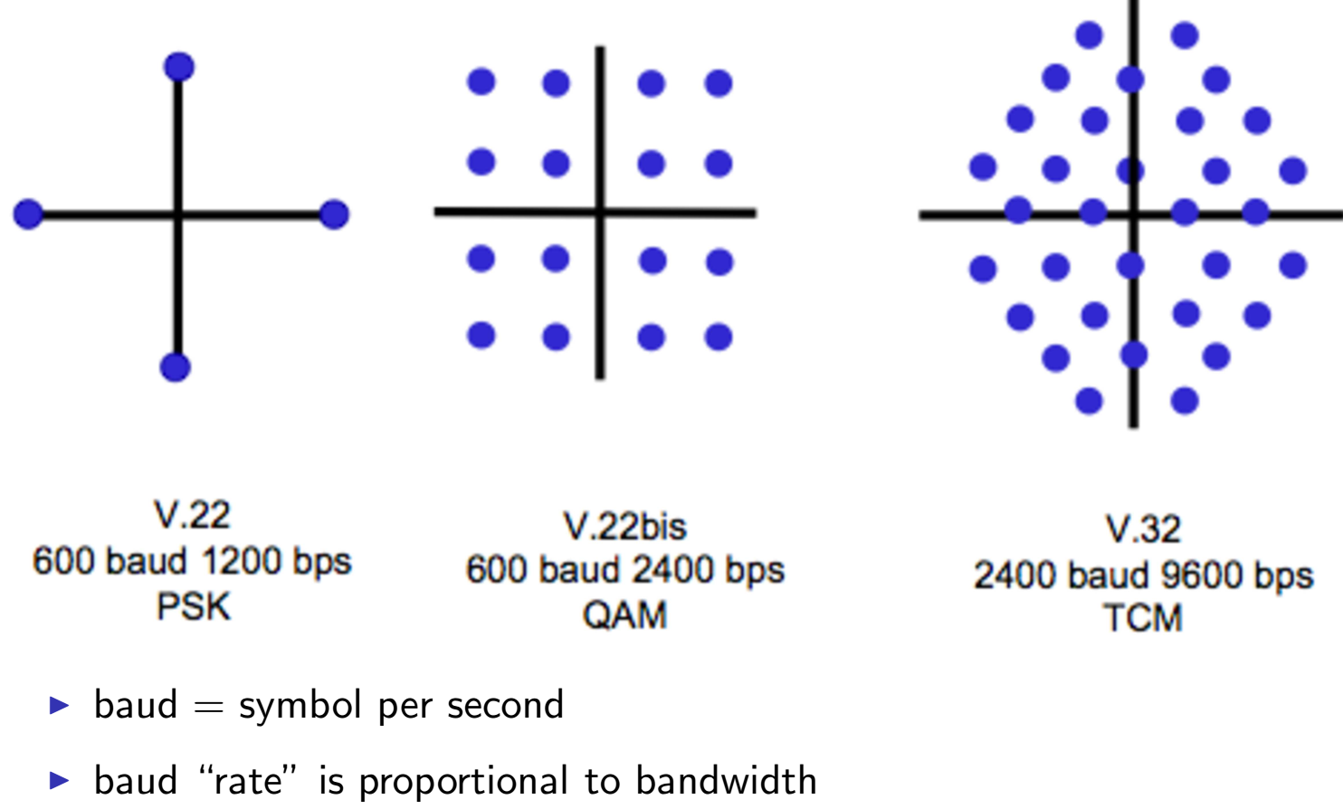
Constellation Examples

